Slide 1
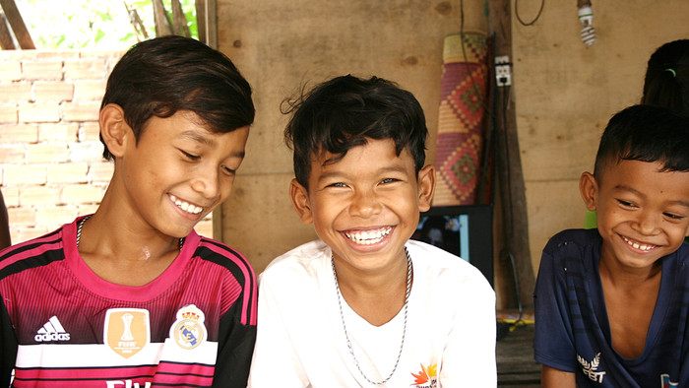
Outcome Mapping and
Outcome Harvesting and
Child Rights framework

Slide 2
Outcome Mapping and Outcome Harvesting
And Child Rights framework
Importance in OM/OH - Actor map
Importance in Child Rights Framework – Actors

Slide 3
Outcome Mapping and Outcome Harvesting
And Child Rights framework
The Importance in Child rights framework – Actors
Right holders, Children
Duty bearers - Legal Duty Bearers - Moral Duty Bearers

Slide 4
Outcome Mapping and Outcome Harvesting
And Child Rights framework
Right holders, Children
In early years, parent acts for the child
The children’s evolving capacities nuance the relationship between the child and their parent in the exercise of rights.
UNCRC, the state’s responsibilities to ensure support to the parent
Children’s rights to protection, to be heard in decision making that affects them, to be informed, to have their best interests considered, to have their rights considered as an interdependent and indivisible whole.
Notes:
In the very early years of a child’s life the parent acts for the child, essentially claiming their rights for them
The children’s evolving capacities nuance the relationship between the child and their parent or legal guardian in the exercise of rights.
UNCRC which establishes the state’s responsibilities to ensure support to the parent such that they can fulfil their responsibilities
Children’s rights to protection and to be heard in decision making that affects them, to be informed, to have their best interests considered in any decision making that might affect them, to have their rights considered as an interdependent and indivisible whole.

Slide 5
Outcome Mapping and Outcome Harvesting
And Child Rights framework
Legal Duty Bearers
The State … the Primary Duty Bearer
Following ratification. The state has four types of obligations:
1. The Obligation to Respect requires States to refrain from interfering directly or indirectly with the enjoyment of the right.
2. The Obligation to Protect requires States to take measures that prevent third parties from interfering with the enjoyment of the right.
3. The Obligation to Facilitate requires States to adopt appropriate legislative, administrative, budgetary, judicial, promotional and other measures towards the full realization of the right.
4. The Obligation to Fulfill requires States to directly provide assistance or services for the realization of these rights.
Notes:
Following ratification of a human rights instrument the State is understood to be the “primary duty bearer” in bringing about the realisation of the rights its committed to. In the normal course of events this implies territory within its borders. (but in the event of its taking control over the territory of another country this is also counted as its responsibility). The state has four types of obligations:

Slide 6
Outcome Mapping and Outcome Harvesting
And Child Rights framework
Within child rights programming, the term “duty bearers” is also used, as Moral Duty Bearers
NGOs, CBOs, religious actors, groups formed by individual's (not a part of the structure of the authorities), media, companies
Human rights obligations can also attach to private individuals, private sector, international organizations, CBOs and other non-State actors, media.
Individuals have general responsibilities towards the community at large and, at a minimum, must respect the human rights of others
The term “duty-bearer” is also used to encompass other situations, such as where there may only be moral, rather than legal obligations. The international community, representing individual member states (as donors or other actors) and international institutions, can have key roles to play; for instance, in response to shortages of resources and capacities in other.
Notes:
within child rights programming the term “duty-bearer” is also used to encompass other situations, such as where there may only be moral, rather than legal obligations. The UNCRC is explicit about the responsibilities of parents and implicit about the responsibilities of, for example, the media and private sector. The international community, representing individual member states (as donors or other actors) and international institutions, can also be considered to have key roles to play; for instance, in response to shortages of resources and capacities in other countries -- the recent Ebola crisis in West Africa, and the Zika epidemic in Brazil being excellent examples.

Slide 7
Outcome Mapping and Outcome Harvesting
And Child Rights framework
OH/OM and right based approach are using the same platform. The different ACTORS
In OH/OM we want to see these ACTORS doing what they are obliged to do.
By looking at the responsibilities they have legally or morally it will help us look for important changes.

Slide 8
Outcome Mapping and Outcome Harvesting
And Child Rights framework
Sharing your experiences
Your additional input
Questions
THANK YOU

