Slide 1
Session 5
Internal control

Slide 3
Learning objectives:
Explain how the four-actions model of internal control protects projects against the risk of losses due to errors, thefts or fraud.
Use procedures and practices from each of the categories of the four-actions internal control model.
Define corruption and list illicit actions that contribute to corrupt practice.
Identify warnings signs of potential fraud in your projects.

Slide 4
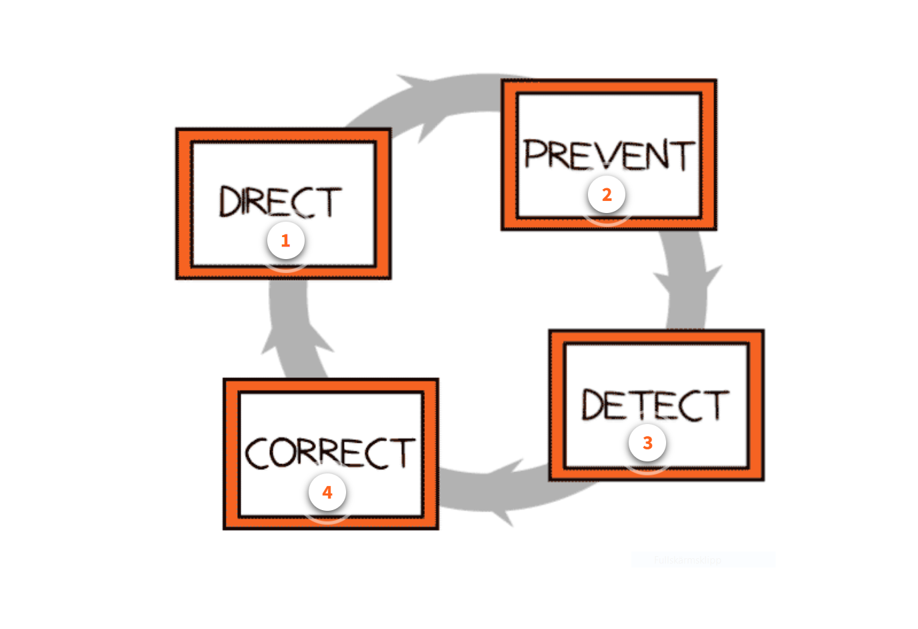
The four-actions model

Slide 5
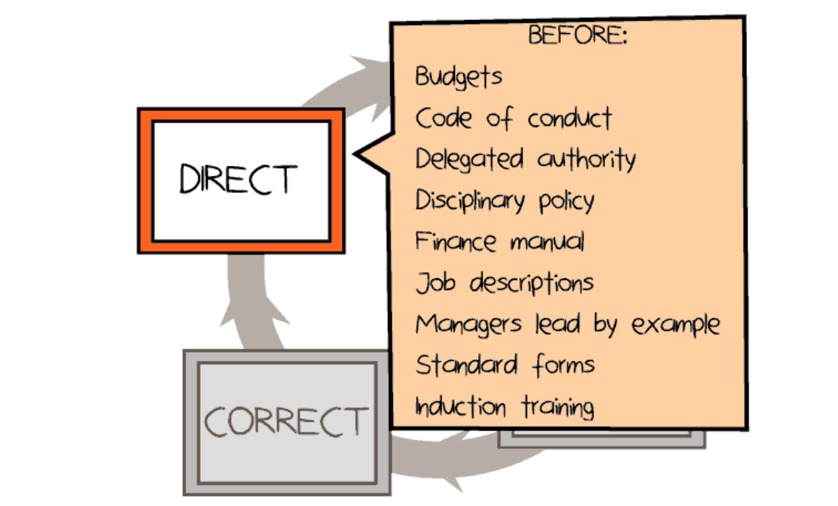

Slide 6
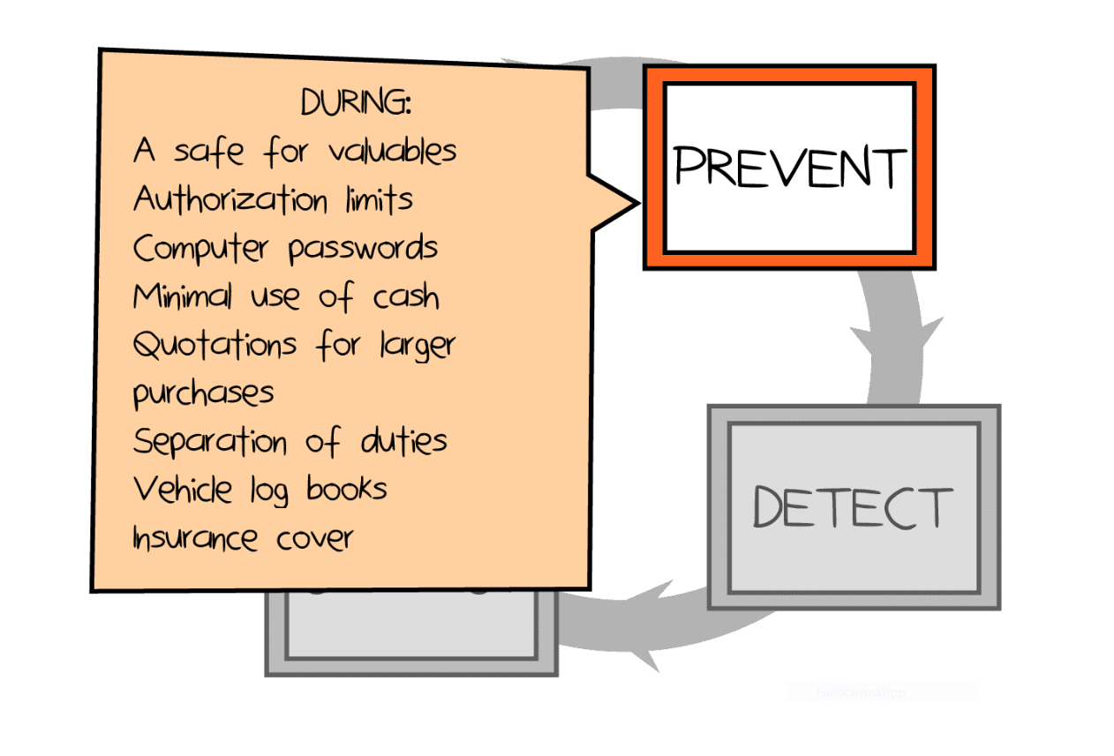

Slide 7
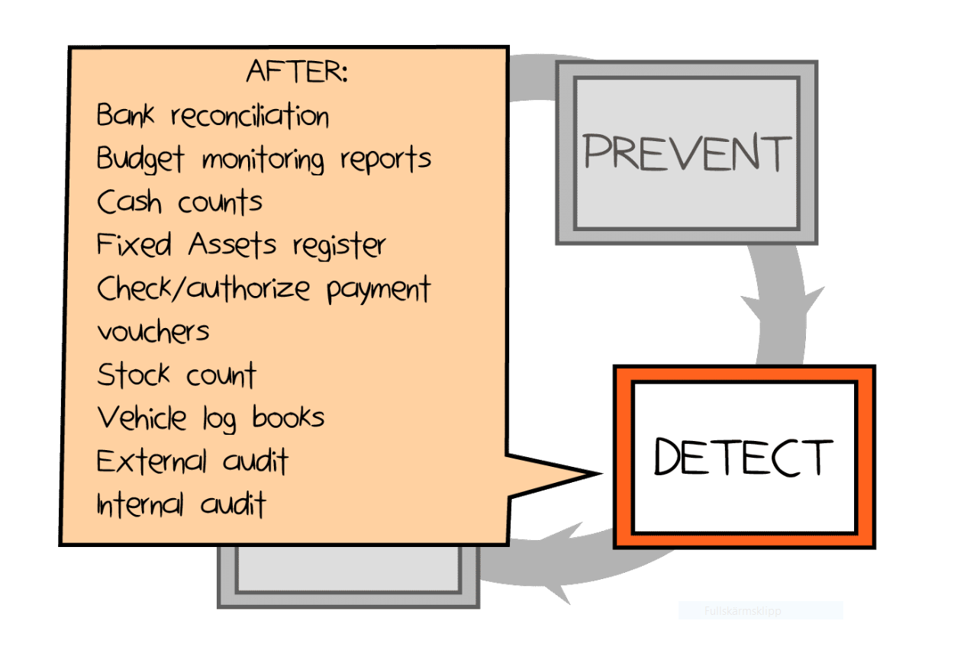

Slide 8
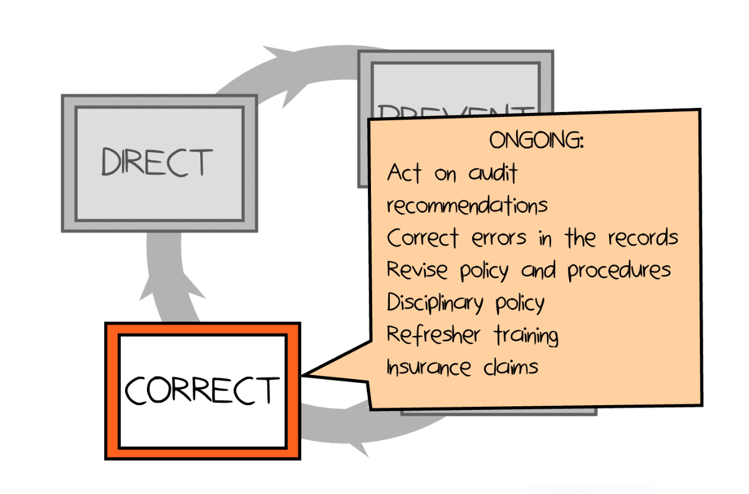

Slide 9
Learning objective:
Use procedures and practices from each of the categories of the four-actions internal control model.

Slide 11
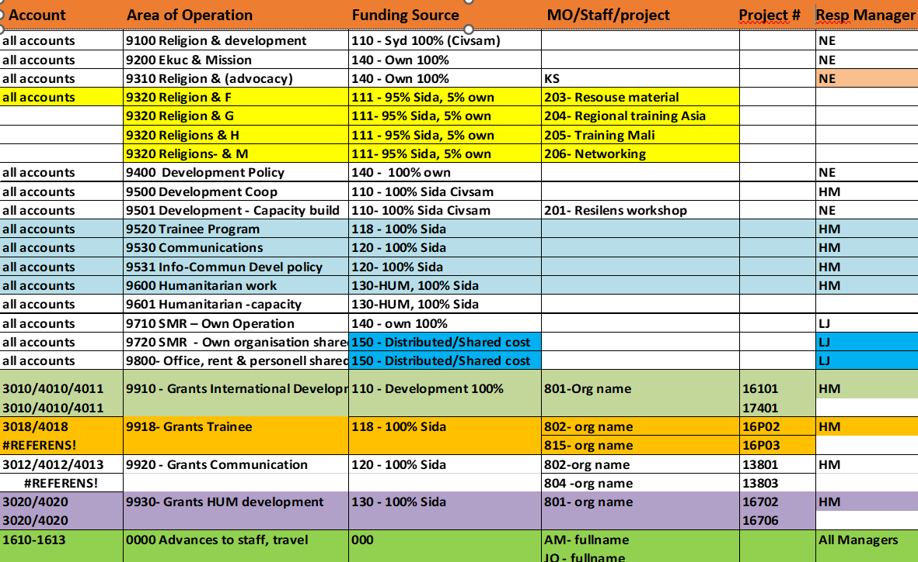
Code
NE
NE
NE
NE

Slide 12
Extract from SMC Financial Handbook
Financial Handbook
Notes:
Above is another extract from our financial handbook for the purpose to guide and instruct SMC:s staff on how to put together a code string. Since all staff at SMC is responsible to record the codestring on source documents. We are also obliged to inform suppliers of the codestring to be added on the supplier invoice when we place the order. The code string is then checked by coordinators and approved by managers before its recorded into the accounting system.
I have put a lot of emphasis on the use of financial code system as it can help deliver user-friendly reports during all four stages, recording, planning, monitoring and control. Most likely your organization already have a chart of accounts that it follows. The challenge is normally during the initial set up when you have to determine how many and which account codes are needed. At a minimum the organization needs to be able to sort and categorize codes relevant for generating income and expenditure reports and balance sheets, fulfilling the financial accounting requirements. You should try to avoid having accounts that maybe will be used sparingly, only once or twice per year but however not too few accounts that the reports are to summarized to allow for analysis processes towards decision making.

Slide 13
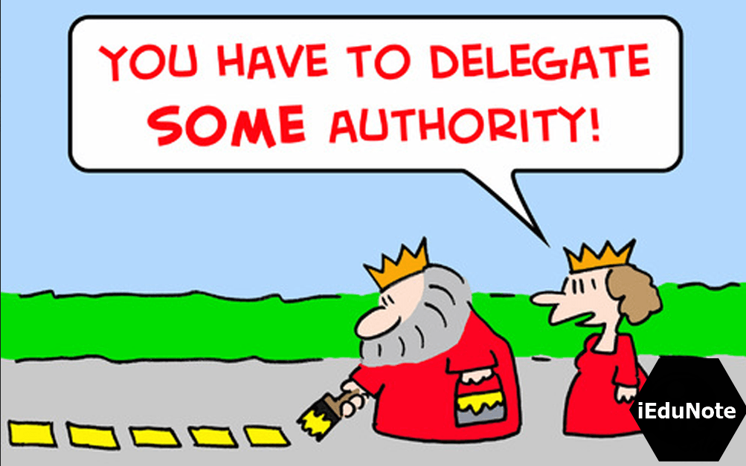
Delegated authority document

Slide 14
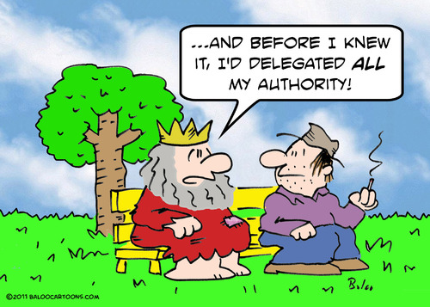
Delegated authority document

Slide 15
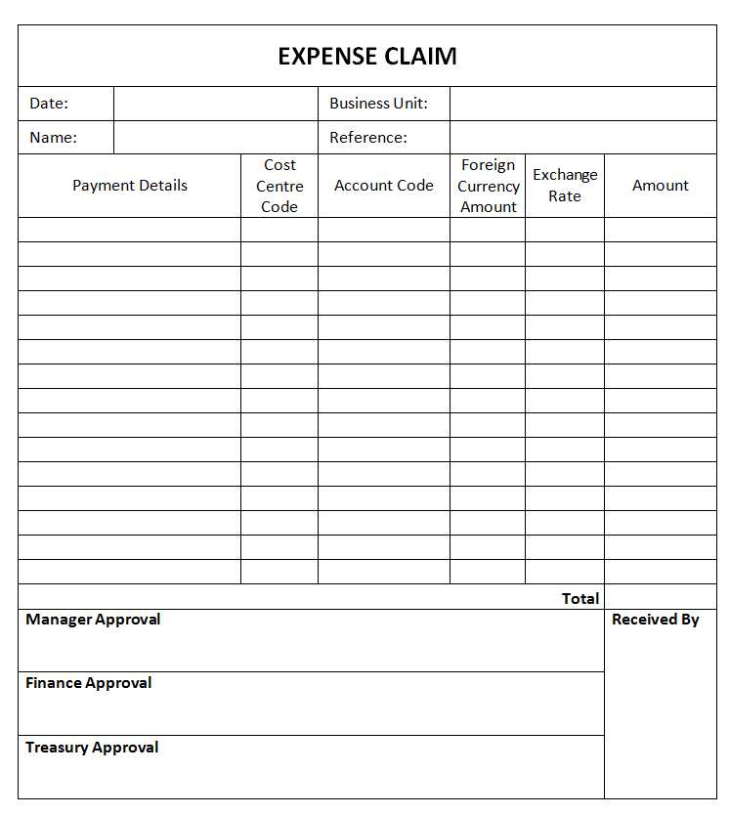
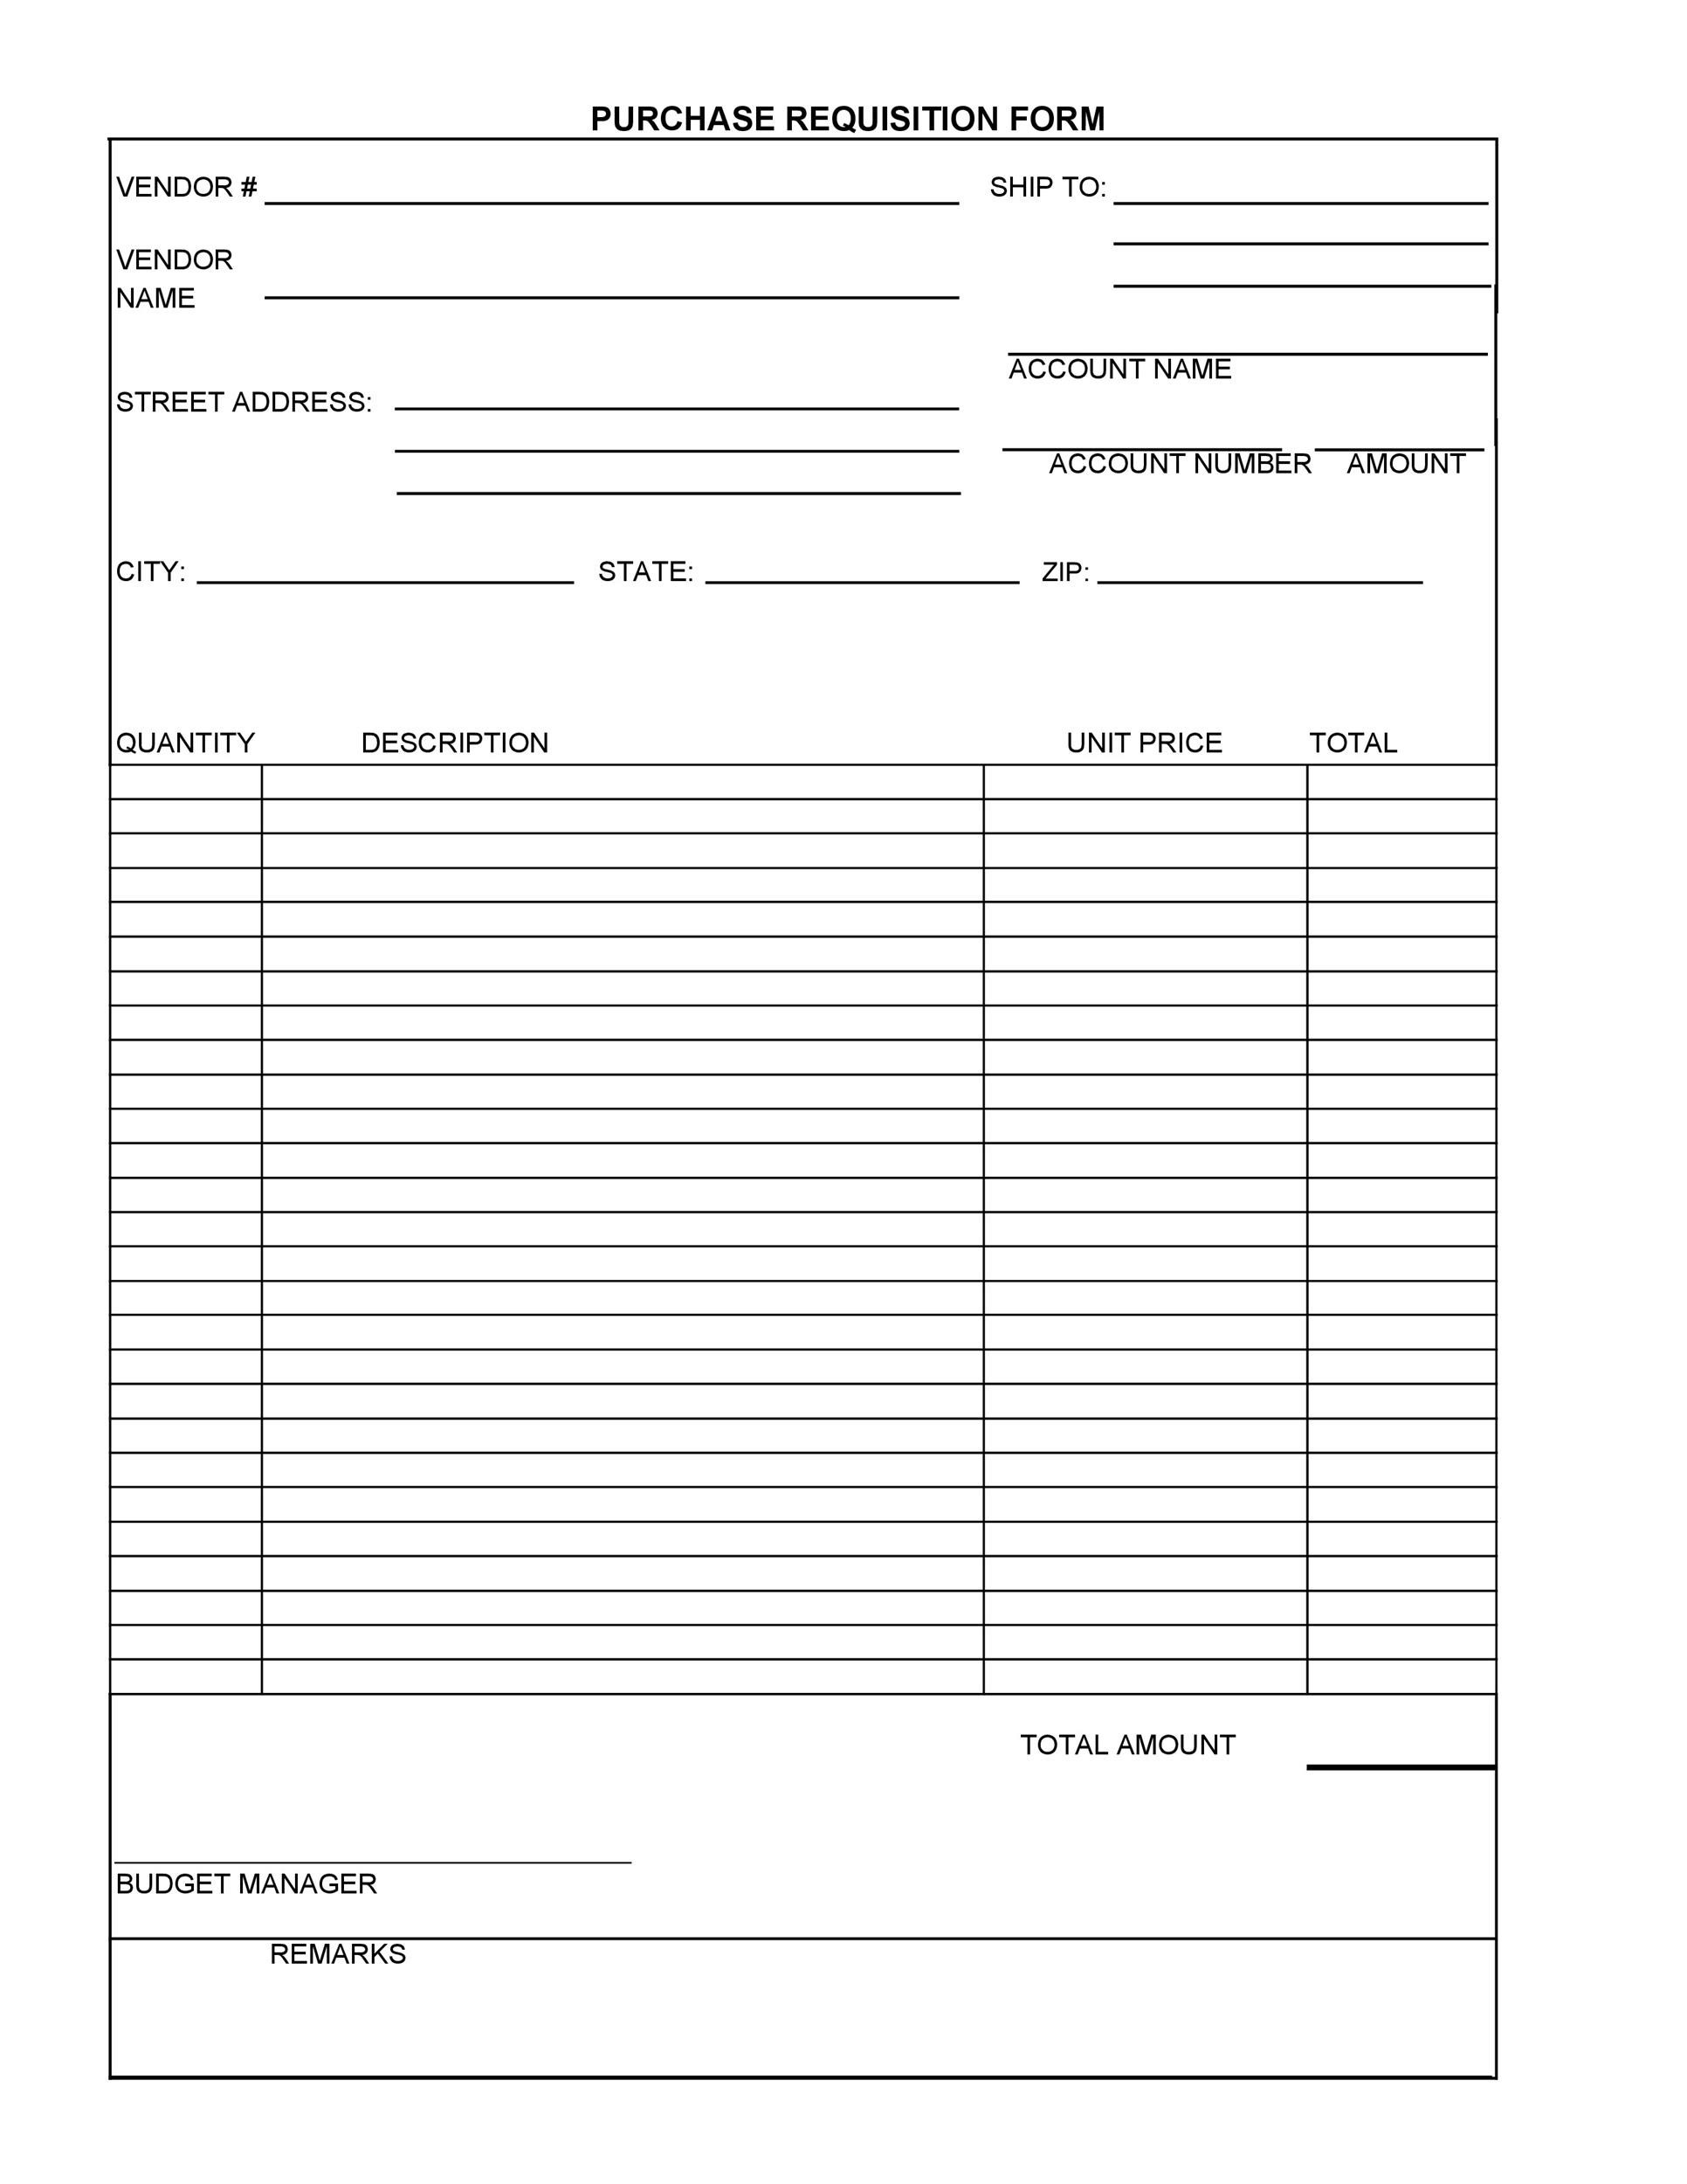
Standard forms
Purchase Requisition Form

Slide 17
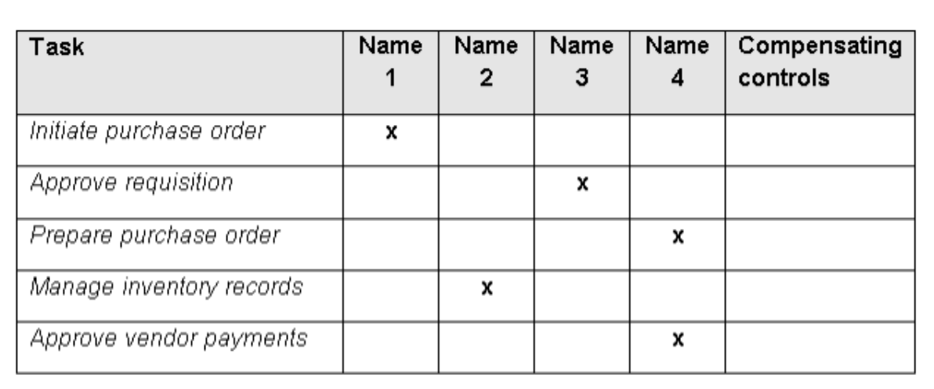
Separation of Duties - Procurement process

Slide 18
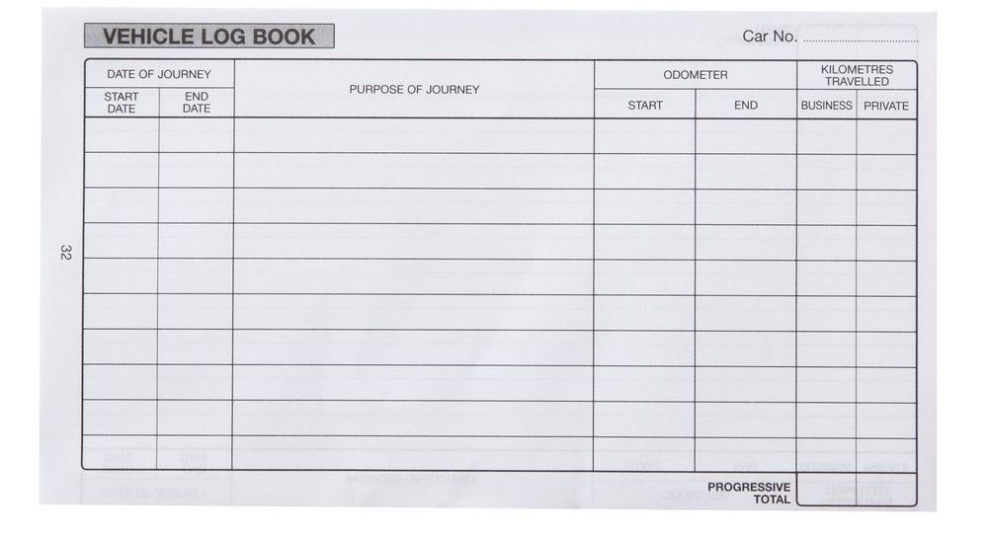
Vehicle Logbook
X

Slide 19
… for handling cash
Keep money coming in separate from money going out
Always give receipts for money received
Always obtain receipts for money paid out
Pay surplus cash into the bank
Set out proper procedures for receiving cash
Restrict access to petty cash and the safe
Keep cash transactions to a minimum

Slide 20
Det här fotot av Okänd författare licensieras enligt CC BY-NC

Slide 22
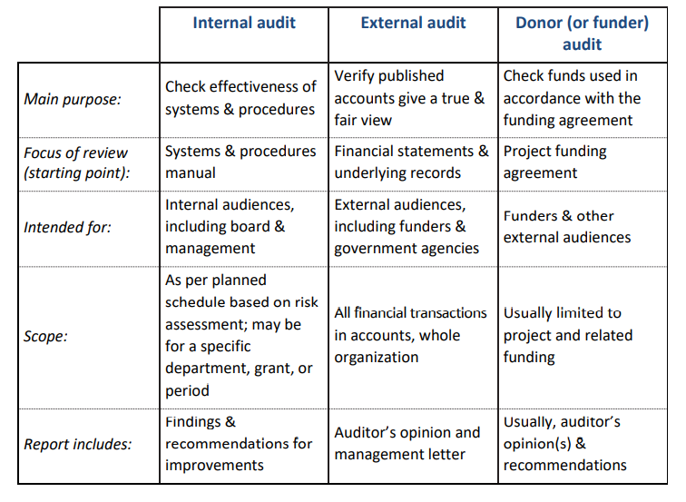
Audits

Slide 24
Learning objective:
Define corruption and list illicit actions that contribute to corrupt practice.

Slide 25
Can you give any examples of corruption?
Write in the chat!

Slide 26
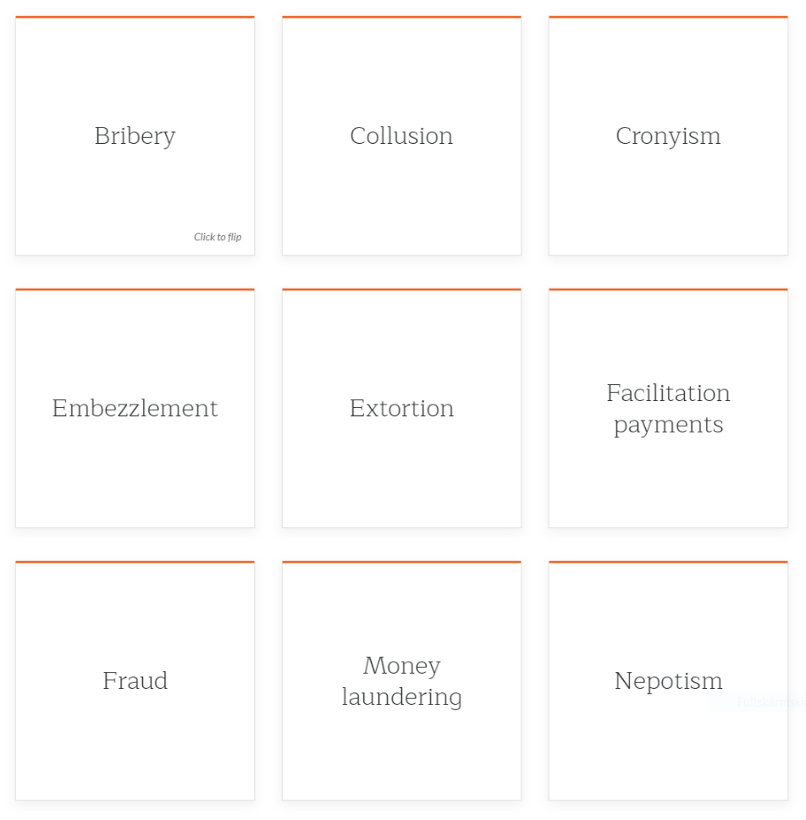

Slide 27
Learning objective:
Identify warnings signs of potential fraud in your projects.

Slide 28
Warning signs of fraud in accounting records:
• Lots of corrections to accounting records
• Vehicle logs or attendance records that look as if they have all been written on the same day in the same hand could be an indication of rewritten or duplicate books.
• Delayed banking of cash received discovered by bank reconciliation could be unauthorized ‘borrowing’ of cash.
• Records are not kept up to date, or are deliberately delayed, so managers cannot detect incidences of false accounting.

Slide 29
Warning signs of fraud in reports:
• Budget monitoring reports reveal inconsistent behavior between line items, e.g. if project-related expenditure is underspent due to delays, but the budget for fuel is overspent. This could indicate abuse of the vehicle.
• Vehicle logbooks are not maintained in an appropriate level of detail. This could indicate abuse of the vehicle.
• Budget monitoring reports are delayed, with potential for covering up unauthorized activities.

Slide 30
Warning signs of fraud in reports:
Irregular work patterns: if someone is first in and last out of the office, this could mean the staff member is working longer hours to compensate for other activities.
Never taking holidays: this could mean someone needs to cover up irregular activities.
Significant change in lifestyle or spending patterns: if expenditure doesn't match a person's income, for example buying designer clothes, expensive social habits, or vehicles.
Creating a smoke screen: making a false accusation about another team member, may be intended to divert attention or help make a quick getaway.

Slide 31
Thank you!

