Slide 1
Session 3
BUDGET PLANNING

Slide 3
Financial planning lies at the heart of financial management for 3 reasons:
Budgets are key to each of the four financial management activities
Financial Planning is a key aspect of successful long-term and short-term programming
3. Budgets are used at all levels of an organisation

Slide 4
Learning objectives:
Describe how the financial planning process works in programs
Describe different budget formats
Describe the three main types of budgets
Explain how to create an activity-based budget using a budget worksheet
Explain why it is important to budget for central support cost
Notes:
Bild 2:

Slide 5
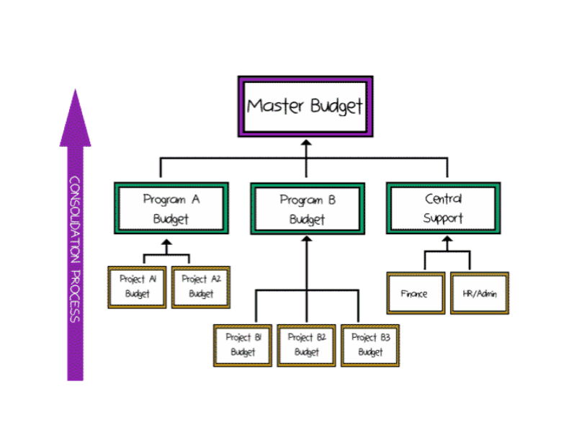
Senior Managers
Responsibility: set budget guidelines and assumptions to support development of budgets

Slide 6
Program/ Project Team
Responsibility: ensure detailed project budgets are developed and consolidate these at a program level and /or produce accurate and complete budgets for their projects

Slide 7
Learning objective:
Describe the different budget formats

Slide 8
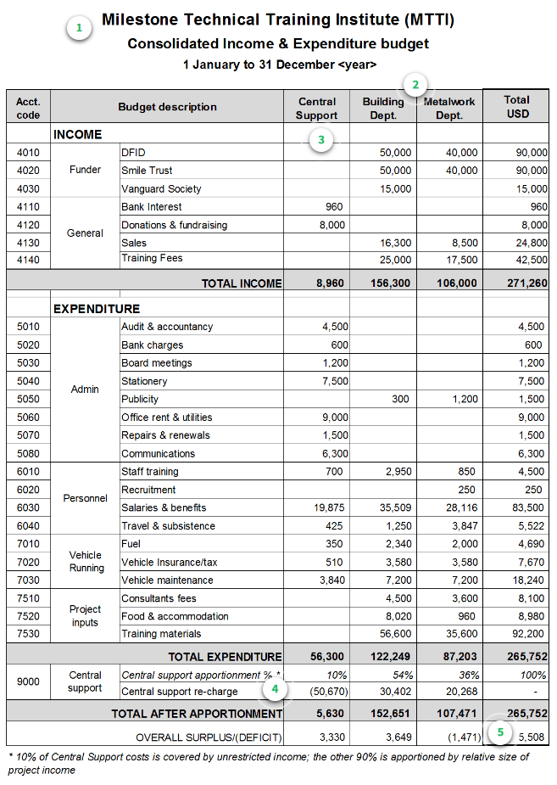
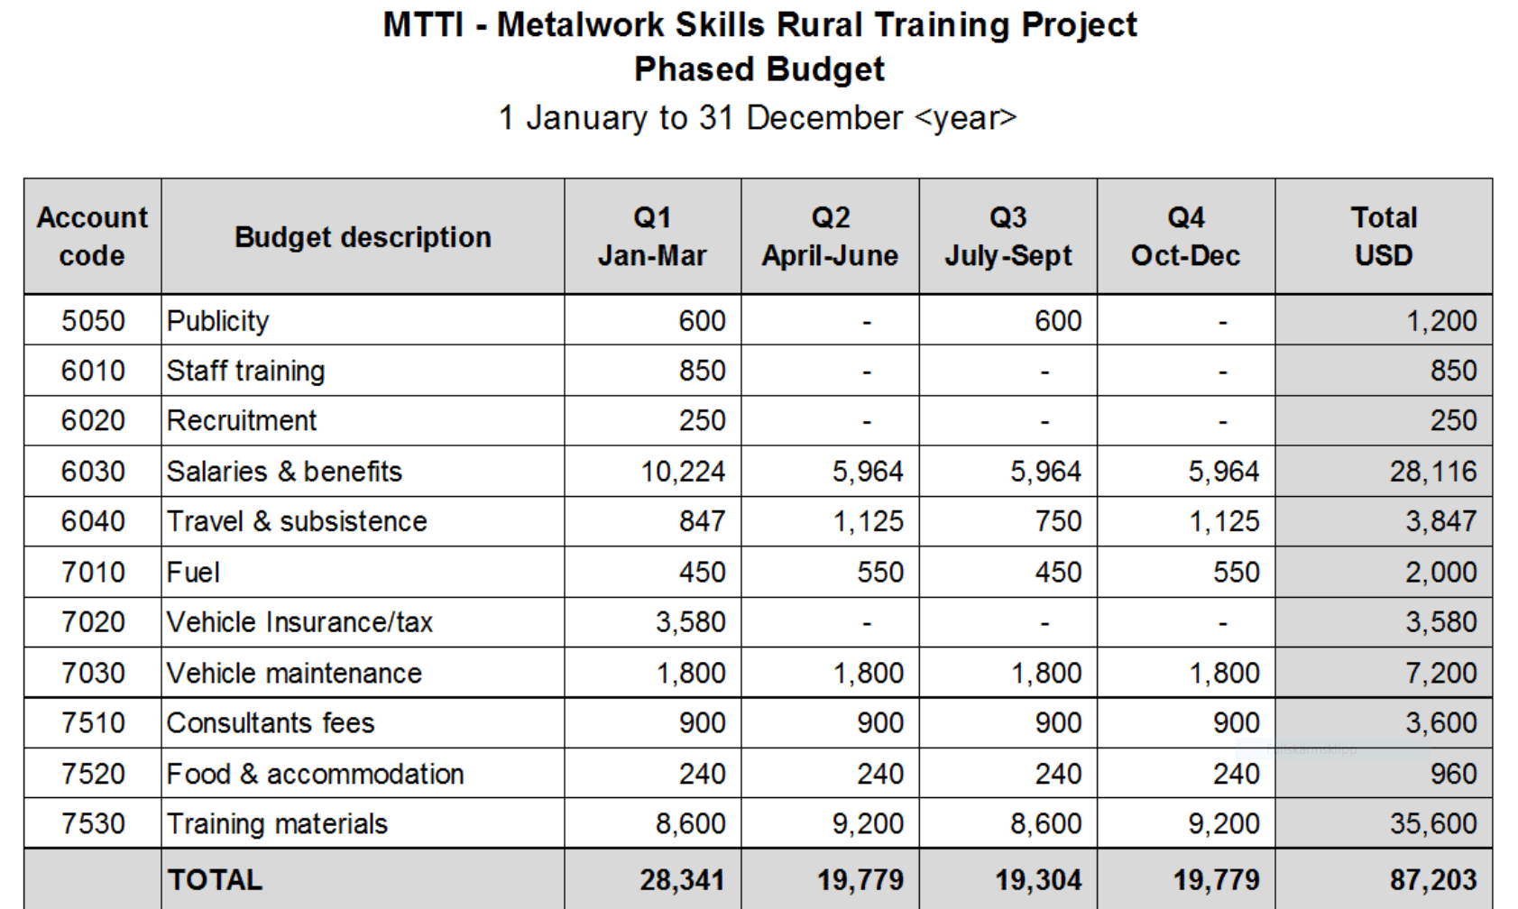
Consolidated budget
Phased budget

Slide 9
Learning objective:
Describe the three main types of budgets

Slide 10
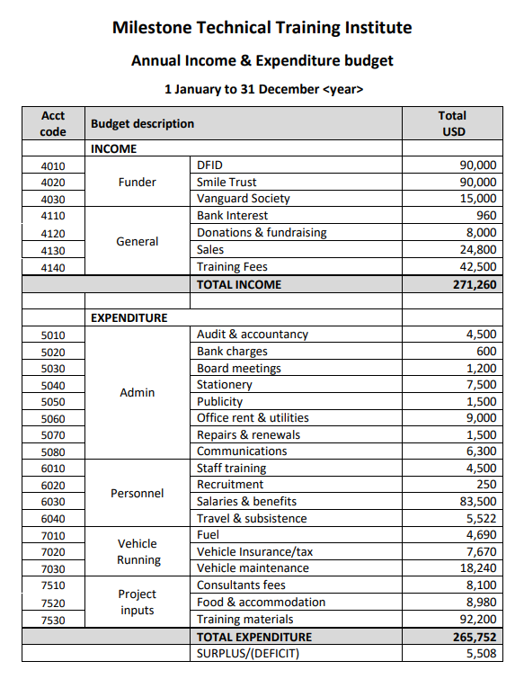
Income and Expenditure budget

Slide 11
Phased budget
Income Statement

Slide 12
Capital Budget
Construction of buildings and infrastructure
Major renovation works
Vehicles
Office furniture and equipment
Computer equipment
Medical equipment
Water and sanitation equipment

Slide 13
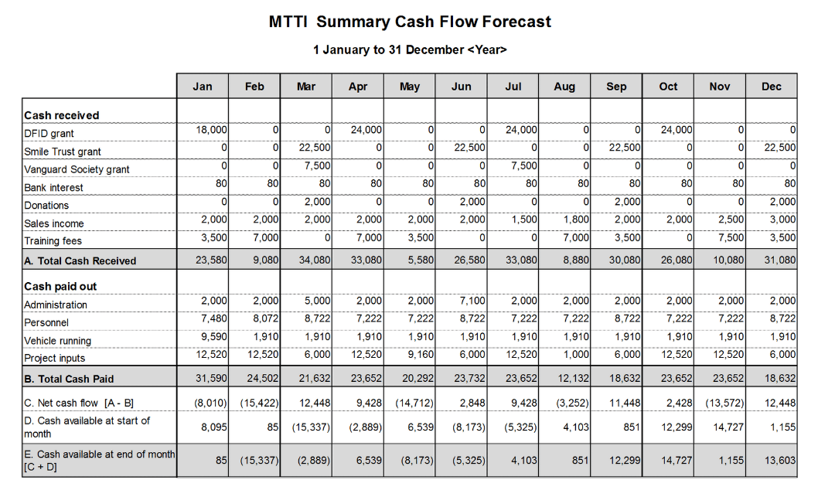
Cash Flow Forecast

Slide 14
Learning objective:
Explain how to create an activity-based budget using a budget worksheet

Slide 15
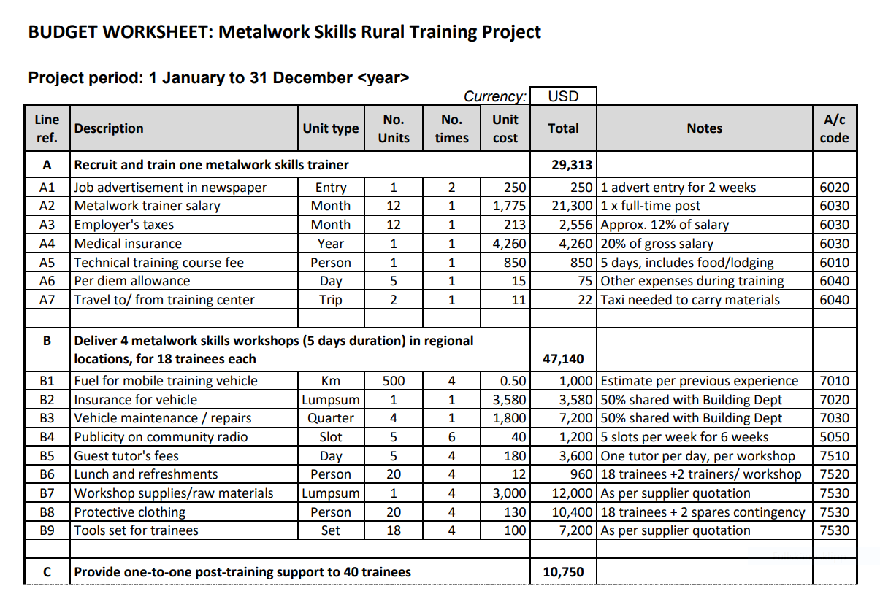
Budget Work Sheet

Slide 16
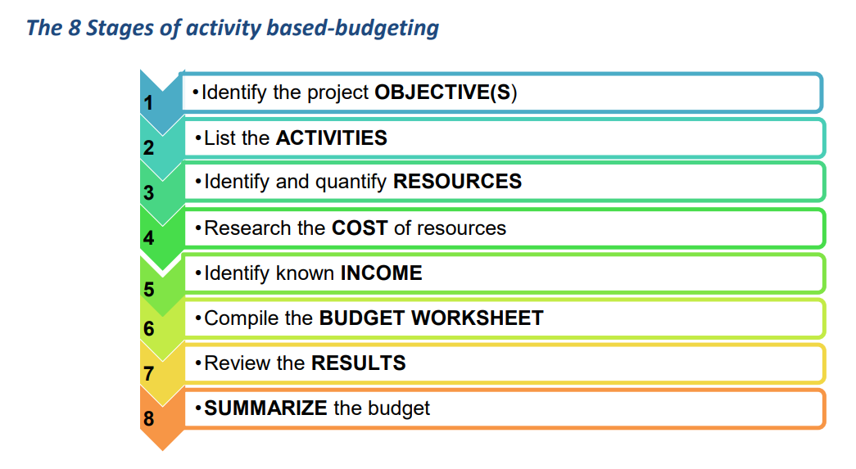

Slide 17
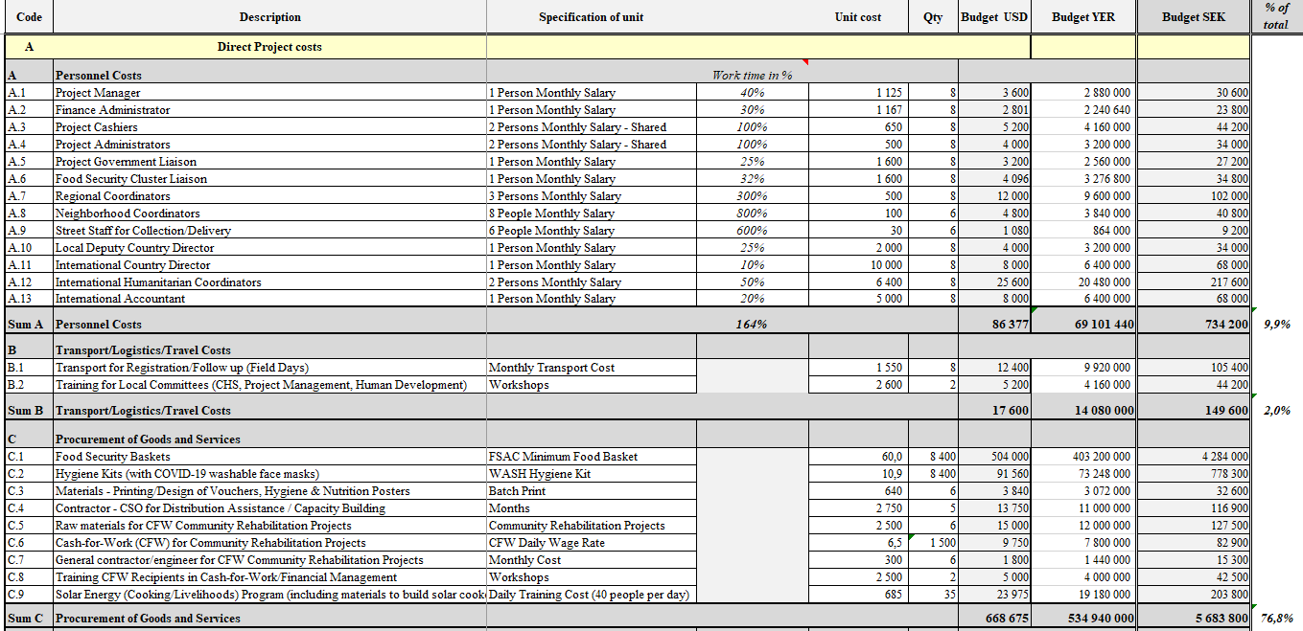
SMC Budget Template

Slide 18
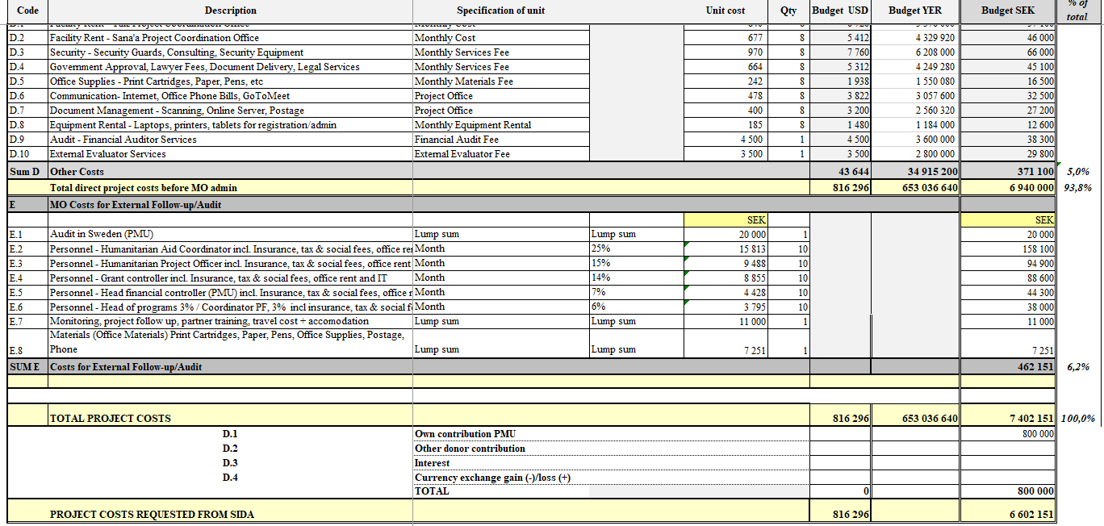
SMC Budget Template

Slide 19
Learning objective:
Explain why it is important to budget for central support cost

Slide 20
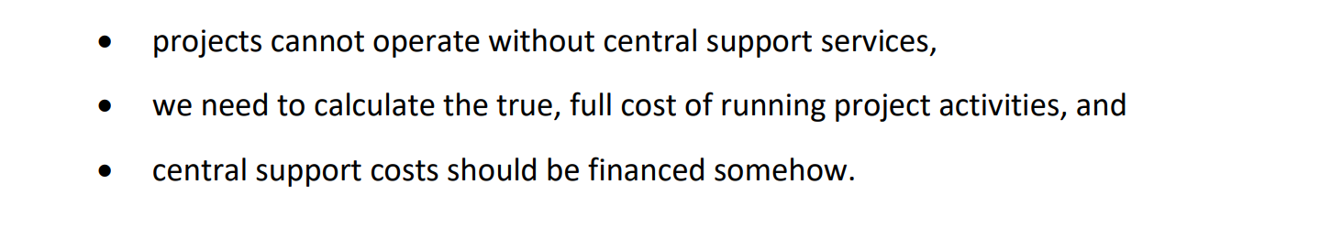
Budgeting for indirect costs

Slide 21
Things to consider while budgeting:
Restricted funds
Unrestricted funds
Direct and indirect costs
Apportionment
Currency

Slide 22
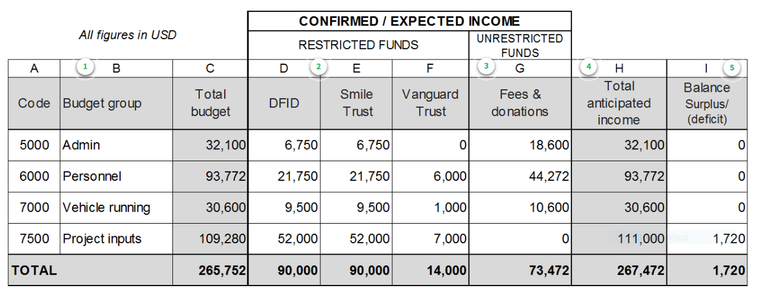
Funding grid

Slide 23
Thank you!

