Slide 1

SMC Financial Management Course

Slide 2
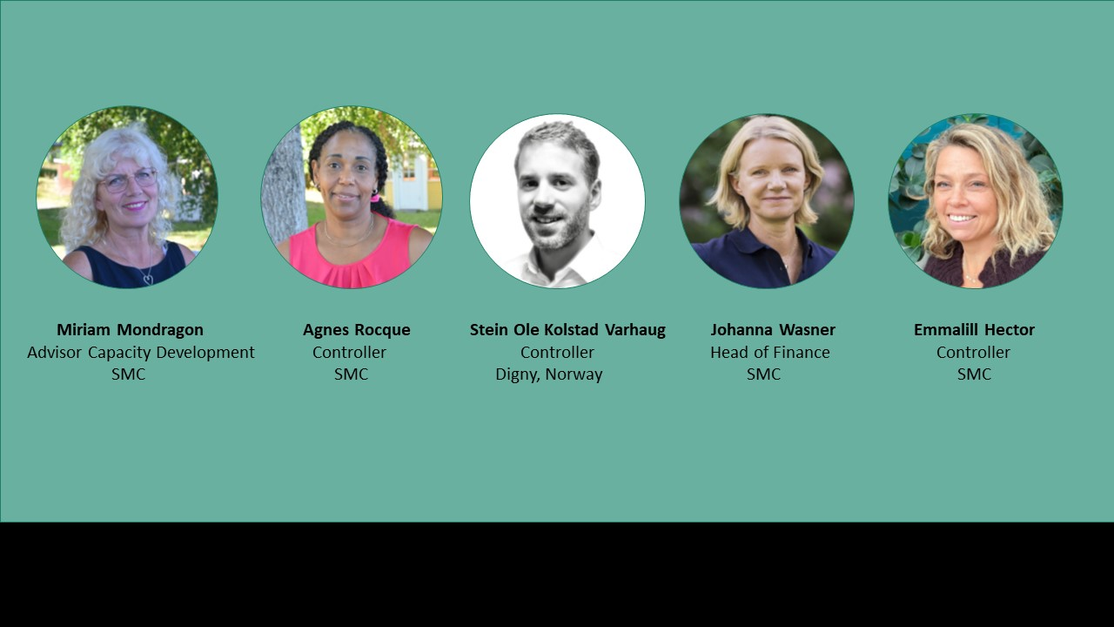
SMC Financial Team

Slide 3

Learning objectives for the session:
What is financial management? (The four building blocks)
Where does financial management fit into the project planning process?
The SMC view on financial management
Who are involved? (”Hand-in-hand”)
Notes:
In the first part of the course you will learn more about the key concepts of financial management;
What is financial management, and what is the aim of financial management. In relation to this we will talk about “the four building blocks of financial management”
Who are involved in the financial management?
Where does financial management fit into the planning process of the organization or project? In relation to this we will look at the plan-do-review cycle
And in this session today, we will also discuss financial management from an SMC view.

Slide 4

What is financial management?
Notes:
So, what is financial management? And who are responsible?
It’s much more tham just keeping accounting records.
It is about planning, organizing, monitoirng and controlling.
WHO is responsible for this?

Slide 5

Good financial management is the responsibility
of everyone in an organization!
Notes:
I don´t know how many of you recognize this, when it comes to financial issues within the project;
But, I am not a finance specialist. Isn’t that why we have accountants, bookkeepers, and financial managers?
A big sigh… “the routines and policies that the financial department makes us follow just make my work complicated and more time consuming.”
Good financial management is the responsibility of everyone in an organization!
There are different competences, but everyone has a responsibility from their point of view..
Finance team – invite the others to your world. Because the outcome and the reporting must be built from both content and financial.
And if you are nott part of the financial team – dare to step in there anyway, to get the whole picture.

Slide 6

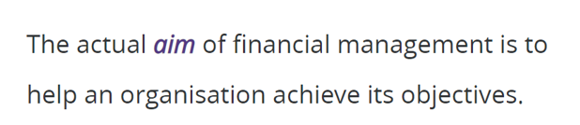
the financial
resources of the organisation.
Notes:
Läs på bilden.
The goal! The objectives!
No financial team has their own agenda. It is always part of the bigger goal, the whole organizational goal.
For the organization or project to achieve its goals, planning is required. To identify upcoming activities and ensure that sufficient resources are available to carry them out. To do this, planning tools such as strategic plans and budgets are needed.
Once plans have been made and resources organized, we must also monitor activities to identify risks and problems early and, if necessary, take corrective action to ensure that plans are kept. To help us with the follow-up, we need, for example, periodic status reports, financial reports and budget follow-up reports. Therefore, it is important that the financial information is correct and up-to-date, otherwise decisions made based on this information can lead the project in the wrong direction and thus miss the target.
Important what we put into the system, cause otherwise we can’t get it right in the end.
Finally, to ensure that resources are used effectively and efficiently, we need to control activities by setting up rules, procedures and practices such as delegated authority, procurement processes and budget.
So it is not only the accountants, bookkeepers and financial managers who are involved. Good financial management is everyone’s responsibility.
Example from deviation. SMC have seen…
The relation between planning, organising, monitoring and controlling can be understood as an open loop. As information you get from monitoring activities for example can give an indication about if you need to revise you plan, what additional controls might be needed a.s.o.
Johanna, which are the different roles within the financial management of an organization?

Slide 7
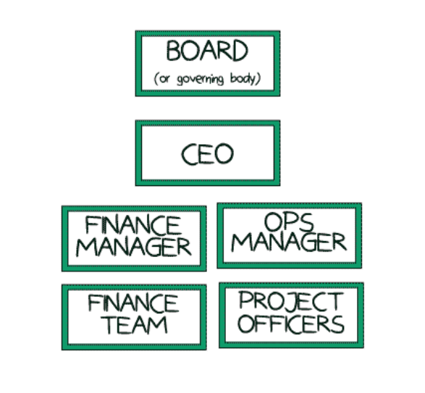
Accountability
Delegated authority
Notes:
These are different roles in a regular organization. Who or which of these would you say is involved in the financial management of the organization?
The financial manager and the financial team are quite self-explanatory, they are definitely involved in financial management. And we also mentioned earlier that the project team, including operations managers and project managers, are involved in financial management. But what about the CEO and the board, how do they get involved?
An organization's board is ultimately responsible for the funds being used for what they are intended for. They are also ultimately responsible for the strategic planning of the work and for providing resources for the work to be carried out, Because they are not normally part of the day-to-day work, they must delegate decision-making and operational authority to others, usually to a CEO. The CEO then delegates to the senior managers, who delegate to project and operational teams.
The authority to make decisions and run operations is thus delegated down in the organisation. However, teams are accountable for their operations and decisions they make, and must report upwards. Reporting on the progress of operations gives the management of an organization strong data to manage strategically. This is an ongoing process, we will use the plan-do-review cycle to illustrate.
Financial Stewardship.

Slide 8
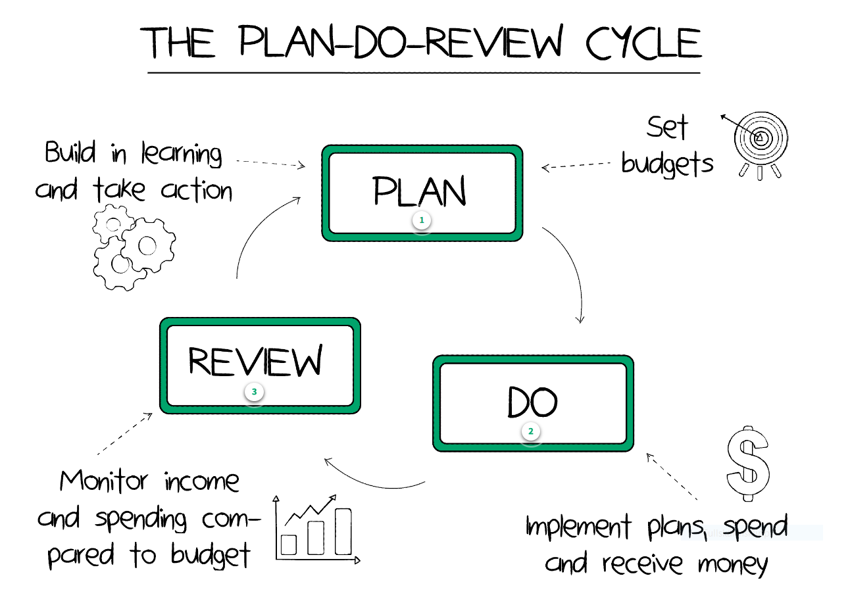
Notes:
This cycle illustrates the ongoing process of planning activities, implementation and review by comparing the original plans with what actually happened. The reviews guide the decisions and priorities the board and management make for the activities going forward, in order for the organization to reach its goals. Therefore, strong financial management exercised at all levels of the organization is a prerequisite for the organization to realize its strategic goals AND its operational goals!
The same can be said about a project. Activities are planned, then implemented and reviewed (internally and externally by for example an auditor). The review compares the original plans with what actually happened. The lessons learned form the review will be incorporated into forward planning and so on.
From an SMC view, when it comes to this process, we would like to highlight that the feedback from Member organisations or SMC on your reporting should for example feed back into the strengthening your financial systems
and control. Also, use the observations and recommendations in the auditors reporting, system audits to help prioritize what areas needs to be strenghten.
So now we have set the different roles, the board and the CEO work strategically and delegate most of the operational work to the project and finance teams. We have also looked at how they all are involved in the plan-do-review cycle. They have the overall responsibility for the Financial Stewardship
Now we will look more closely at the division of roles between these two teams, and after that more specifically at the role of the finance team, who have the overall responsibility for the Financial Stewardship.
But first:
Knowing your own role, how you contribute to acheiving the organisations objective is a good starting point. But it is also important to
have an understanding of your collegues role, as well. Accountants, bookeepers use and organise the information they are
provided with. And other functions uses the financial information provided by the financial team, like budgets, reports, cash-flows etc.
There is a co-dependence between financial and non-financial staff that needs to be respected to get good results, be effective
and effecient
Johanna lämnar över till Emmalill

Slide 9

Finance team
Setting up strong finance systems
Recording financial data in a timely way
Administering payment and reconciliation processes
Producing financial reports
Advising project teams on the best apporaches to complex financial issues (compliance issues, cost sharing, depreciation etc)
Notes:
The finance team are experts in financial matters and will support the project staff in the areas listed above.
From a communication point of view, the finance team should be readily helpful to help non-financial staff
with interpretation of financial information, maybe even producing financial reports for internal use more readable for
non-financial staff when possible.
From a communication point of view, the non-financial staff needs to have a sense of the underlying principles governing
financial management and how it relates to for example producing financial reports for external use. The choice of
accounting standards are for example not optional and the consistent use of policies and procedures are important

Slide 10

Project team
The project team is involved in the implementation of a project.
They have detailed knowledge about the activities and stakeholders involved in achieving project objectives.
Notes:
This information is critical when managing project finances and other resources. It helps when developing and managing project budgets, and reporting to managers and funders. Having detailed knowledge of the project operations helps the project team to identify where there are risks and opportunities for improvement in the use of project financial resources.
So the finance team cannot be solely responsible for the financial management of the project. For example; to manage the budget, you need input from the project team regarding which activities are planned for the upcoming period. To manage the budget you also need to follow up the outcome, you need knowledge of whether the implementation of the project was according to plan, or whether there were any deviations.
Övergång: Johanna, can you give us an example of how both the finance team and the project team must be part of the reports?

Slide 11
Financial report Reporting period Jan-Oct 2022
Notes:
To illustrate this, we can look at a financial report for an example project. These are numbers taken from our financial system. The CEO asks for our comments, regarding whether the project expenses is aligned with the budget or not. What do you say?
Yes
No
We don’t have enough information
We set up a meeting with the project manager where we ask him to tell us about the progress of the project activities, compared to the plan. He then tells us that; “The project has been a great success! The villagers have really benefited from the water tanks that have been delivered. But we had a slight delay in the start-up when the delivery of water tanks was delayed. So instead of delivering five water tanks, we have only managed to deliver four, and this also means that we have only completed four out of five field trainings. But now we will soon have several water tanks delivered, so we will work to catch up during the next period!”
What comment can we now give to the CEO, regarding whether the project is on budget or not?
Yes
No
We don’t have enough information
Emmalill: What would have been the risk if we had only looked at the numbers, without input from the project manager?
Johanna:
We could have given the wrong information to the CEO and said that the project is on budget even though they spent too much, which in turn could have the consequence that we might lack financial resources later in the project.
Emmalill: What is important to do now?
Johanna:
Together with the project manager, we need to review the reason for the overspending. And we need to plan and review the budget for future periods. Can we change something in the project to stay within budget? Or do we need additional funding?
Emmalill: What needs to be communicated with the donor?
Johanna:
How can we make sure the receiver of the financial report understands the budget deviation we have noted in the review? It is good practice to include deviation notes in financial reports. This helps the reader more easily interpret financial information. In this case, it would have made the budget deviation very clear to the reader if the deviation in units had also been stated in the financial report. The reader of the financial report then does not need extra information to interpret the project's status.
We also need to consider how and when is good to communicate regarding the Cash-Flow Budget – securing project funds are available for the budgeted
expenses during Q4, given that the project leader wants to catch up with the activities.
We can't leave this example without taking another look at the Plan-Do-Review cycle, as this is a classic example of the importance of continuously going through these steps.

Slide 12


Financial report Reporting period Jan-Oct 2022
Only 4 of 5 water tanks builts
Only 4 of 5 trainings completed
Notes:
To illustrate this, we can look at a financial report for an example project. These are numbers taken from our financial system. The CEO asks for our comments, regarding whether the project expenses is aligned with the budget or not. What do you say?
Yes
No
We don’t have enough information
We set up a meeting with the project manager where we ask him to tell us about the progress of the project activities, compared to the plan. He then tells us that; “The project has been a great success! The villagers have really benefited from the water tanks that have been delivered. But we had a slight delay in the start-up when the delivery of water tanks was delayed. So instead of delivering five water tanks, we have only managed to deliver four, and this also means that we have only completed four out of five field trainings. But now we will soon have several water tanks delivered, so we will work to catch up during the next period!”
What comment can we now give to the CEO, regarding whether the project is on budget or not?
Yes
No
We don’t have enough information
Emmalill: What would have been the risk if we had only looked at the numbers, without input from the project manager?
Johanna:
We could have given the wrong information to the CEO and said that the project is on budget even though they spent too much, which in turn could have the consequence that we might lack financial resources later in the project.
Emmalill: What is important to do now?
Johanna:
Together with the project manager, we need to review the reason for the overspending. And we need to plan and review the budget for future periods. Can we change something in the project to stay within budget? Or do we need additional funding?
Emmalill: What needs to be communicated with the donor?
Johanna:
How can we make sure the receiver of the financial report understands the budget deviation we have noted in the review? It is good practice to include deviation notes in financial reports. This helps the reader more easily interpret financial information. In this case, it would have made the budget deviation very clear to the reader if the deviation in units had also been stated in the financial report. The reader of the financial report then does not need extra information to interpret the project's status.
We also need to consider how and when is good to communicate regarding the Cash-Flow Budget – securing project funds are available for the budgeted
expenses during Q4, given that the project leader wants to catch up with the activities.
We can't leave this example without taking another look at the Plan-Do-Review cycle, as this is a classic example of the importance of continuously going through these steps.

Slide 13
Notes:
Plan: We had a plan to deliver five water tanks and to conduct five field trainings linked to this. We also had a budget for this.
Do: The project activities are carried out, but due to delivery delays from the supplier, we only manage to deliver four water tanks to the villages and thus also conduct only four field trainings.
Review: In the financial review, everything appears to be going according to plan, but after discussion with the project manager, we understand that there is actually a budget variance, as all activities have not been completed.
Plan: We need to include this information in future plans. Why were all funds used even though all activities did not take place? Can we make changes to the project, or will we need additional funds for the coming period? Will we have cash flow problems in the next period? If the project management needs to make changes to the project plans, this must be communicated upwards in the organization and with all certainty also with the donor.
With strong financial management, this is detected in time and measures can be taken!
Överlämna till Emmalill

Slide 14

The four building blocks of financial management
Notes:
As we have now seen, the main purpose of financial management is to ensure that financial resources are used effectively to meet an organization's objectives. This is achieved by ensuring a strong system of financial control. The responsibility for creating this system lies above all with the finance team
When it comes to creating a robust financial system, we can talk about the four building blocks, accounting, financial planning, financial monitoring and internal control, and how they are aligned and interconnected.
1. The first building block is accounting records. Every organization must keep an accurate and complete record of all financial transactions that take place during the financial year so that they can show how the funds have been used.
Here we can take as an example keeping the accounts separate for different projects, to enable us to compile financial reports for different donors.
Another example is having a system for how shared costs are to be distributed between the projects, such as overhead costs or personnel costs.
Accounting records include both the physical paperwork (such as receipts and invoices) and the account books where
transactions are recorded and summarized. Regarding this, we want to frame your thoughts with slogans like;
”Doing it right from the beginning (as far as possible) saves a lot of time".
”Entering the correct information into the accounting system saves a lot of time and avoids unnecessary corrections, which often lead to the need to make more corrections.”
2. The second block is financial planning. The most common tool when it comes to financial planning is budgets. Budgets are the cornerstone of any financial system and play an important role in the monitoring of funds. Budgets help us plan for the use of funds in advance, but they also help with follow-up and any adjustments to plans, that we talked about when we looked at the plan-do-review cycle earlier. Other examples of planning tools include cash flow forecasts and a financing strategy
3. The third block is Financial monitoring. Providing an organisation has kept accurate and timely accounting records and has set budgets, it is possible to produce financial reports for use by different stakeholders. For example, budget monitoring reports help managers to monitor the progress of their projects (as we saw in the example earlier), and annual financial statements provide accountability to external stakeholders.
4. The last block is about Internal control. Innternal control is a system of common sense controls, checks, and balances designed to manage internal risk and safeguard an organisation's money, equipment, and other financial resources. The purpose of internal controls is to minimize losses, such as through theft, fraud or incompetence; and to detect errors and omissions in the accounting records. An effective internal control system also protects staff, an organisation's most important asset!
In the upcoming modules we will go deeper into this four building blocks. But before we leave them for now, let's look at an important task for the finance team when it comes to financial management, keeping an up-to-date finance manual.

Slide 15
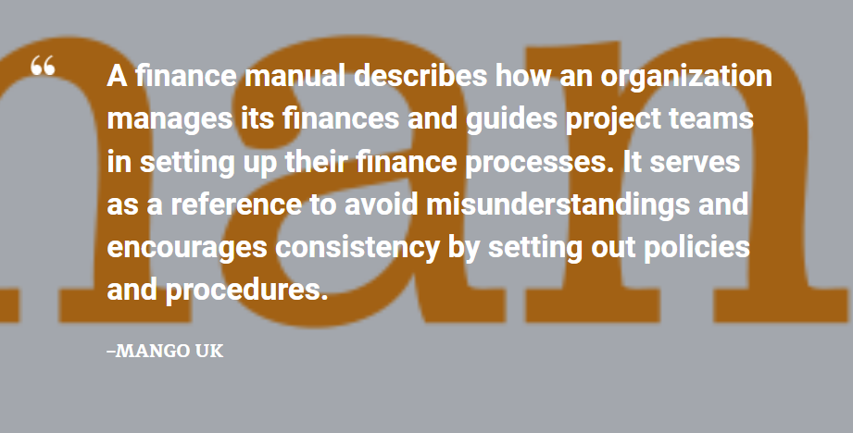
Notes:
For those of you who attended our controller network webinar a couple of weeks ago on agreement compliance, you may remember that we talked about the importance of making sure your procedures and systems are set up to meet the requirements of the agreement. To do this, it's good to have a financial handbook, and also to make sure it's up to date. As we can read in this image, ”A finance manual describes how an organisation manages its finances and guides project teams in setting up their finance processes. It serves as a reference to avoid misunderstandings and encourages consistency by setting out policies and procedures.

Slide 16

Financial Handbook or Manual
Accounting rules and routines | Foreign exchange
Bank and cash handling procedures | Fraud and other irregularities
Code of conduct | Grant management guidelines
Coding structures | Insurance
Delegated authority | Procurement procedures
Financial planning and budget management processes | Staff benefits, allowances, and expenses
Financial reporting routines | Stock control
Fixed assets | Vehicle management
Notes:
• Accounting rules and routines
• Bank and cash handling procedures
• Code of conduct
• Coding structures
• Delegated authority
• Financial planning and budget management processes
• Financial reporting routines
• Fixed assets
• Foreign exchange
• Fraud and other irregularities
• Grant management guidelines
• Insurance
• Procurement procedures
• Staff benefits, allowances, and expenses
• Stock control
• Vehicle management are examples of what can be included in the manual.
Överlämna till Johanna
Please tell us something short, brief about the accountability

Slide 17
Accountability
Delegated authority
Notes:
Before we end this session, we will say something about accountability. We looked at this image earlier when we talked about different roles within the organization. We then also discussed the two arrows that show that authority goes down in the organization, from the board and CEO to the finance team and the project team, and acountability goes up, from the finance and project teams to the CEO and board.
But who else is the organization accountable to?

Slide 18
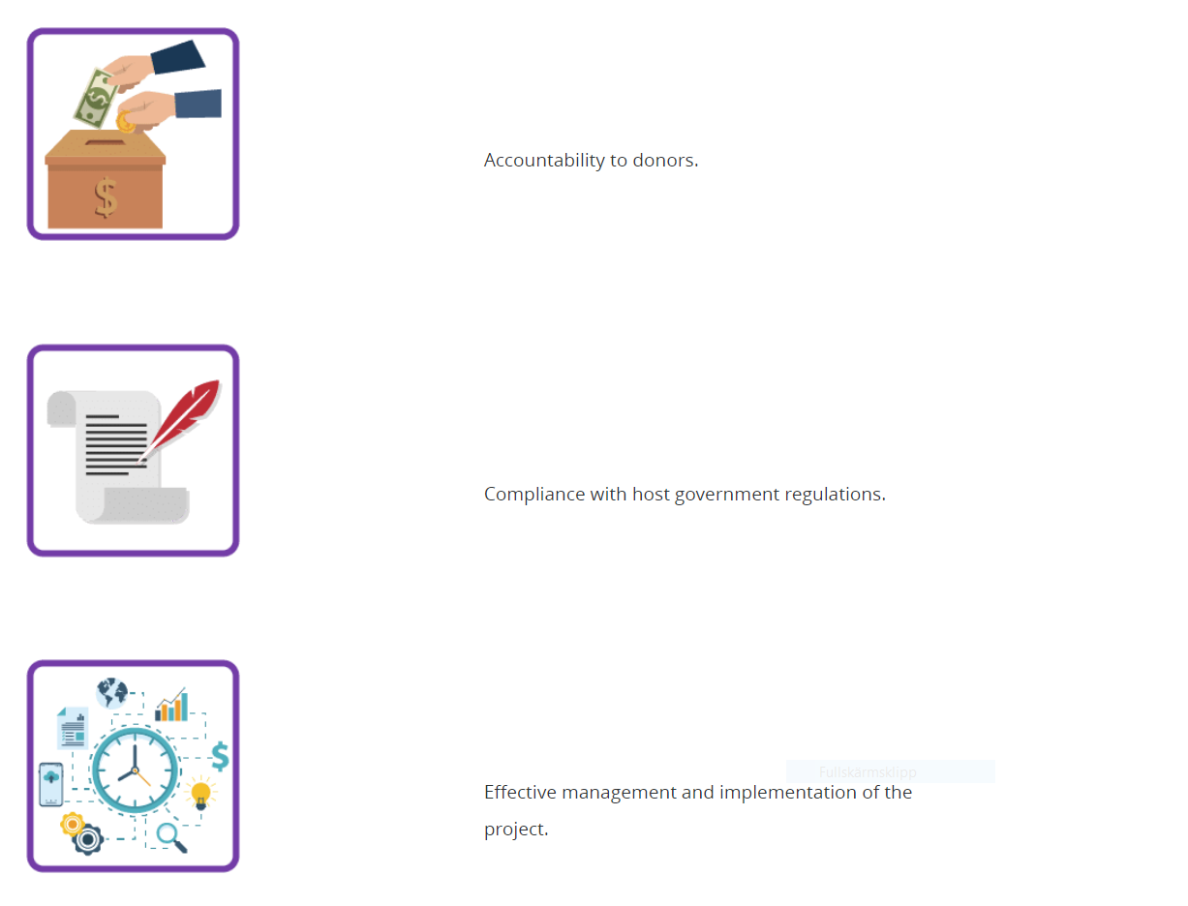
Accountability to donors
Compliance with host government regulations
Effective management and implementation of the projects
Notes:
The organization is responsible towards the donor, to keep the agreement with the donor.
The organization is also responsible for compliance with the authorities' regulations, for example regarding taxes and personnel
The organization will also be held accountable for effectiveness in managing and implementing the projects.

Slide 19
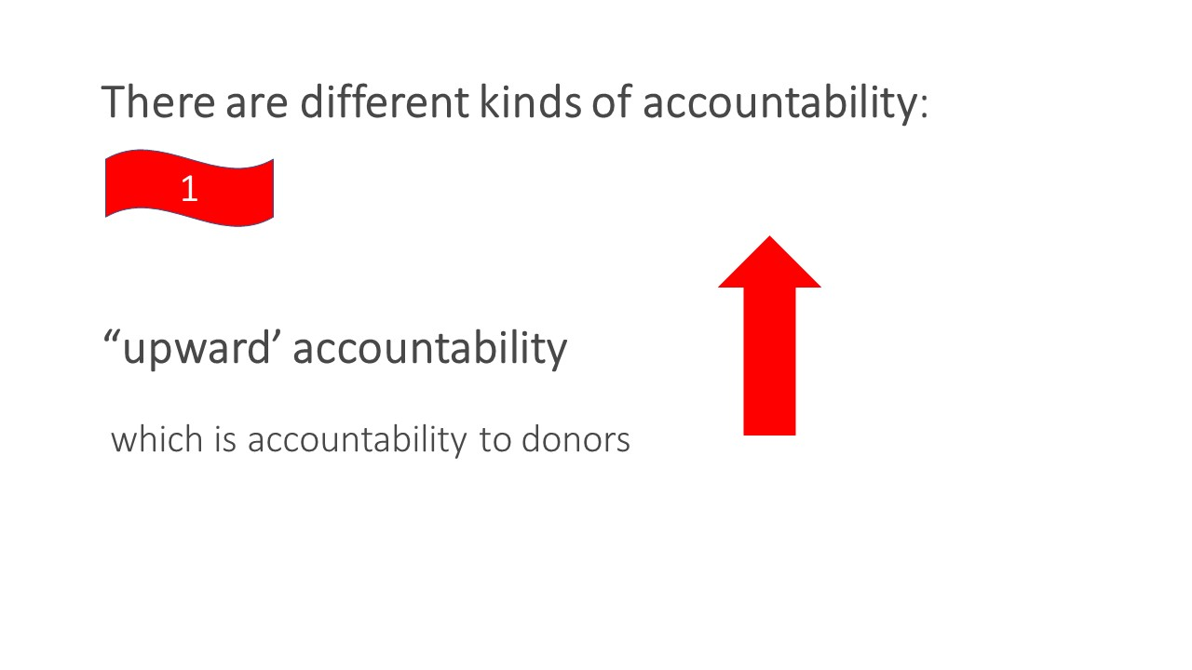
Notes:
We can look at accountability from three perspectives.
It is upward accountability, which is accountability to donors.

Slide 20
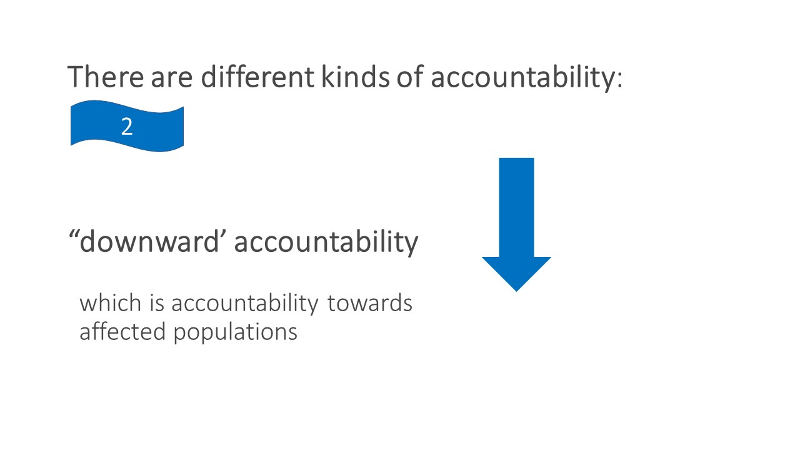
Notes:
We also have downward accountability, which is responsibility towards affected populations, that is, the beneficiaries of the project. Will they receive the support they are entitled to according to the project plan.

Slide 21
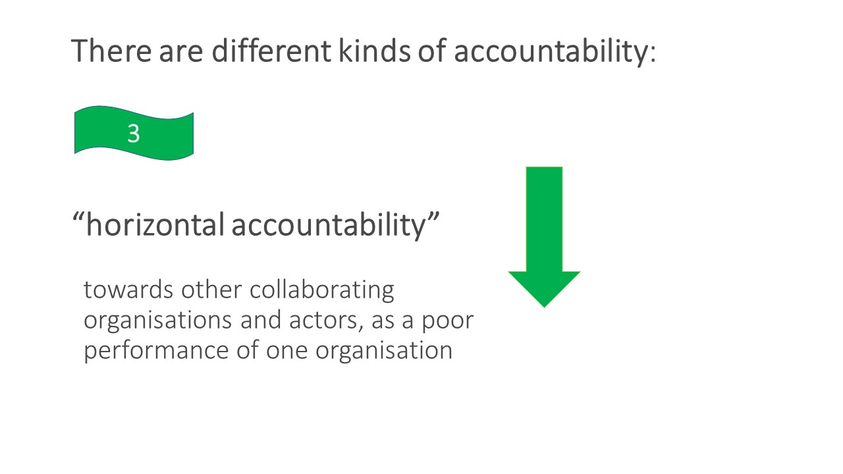
Will affect the others?
Notes:
Finally, we have horizontal accountability, which is accountability to other collaborating organizations and actors, as poor performance in one organization can affect the others. If we apply this to the SMC network. If things go badly, we may be faced with a situation where an organization within the network's misuse of funds, due to fraud or poor routines, may lead to a lack of trust from Sida, which in turn may lead to lower grants in the future.
But we can not end this way… We end by looking at the purpose of financial management instead, which is how to avoid such a situation as just described!

Slide 22

Notes:
Emmalill tar det sista med hänvisning till starten.
Wrappi

Slide 23
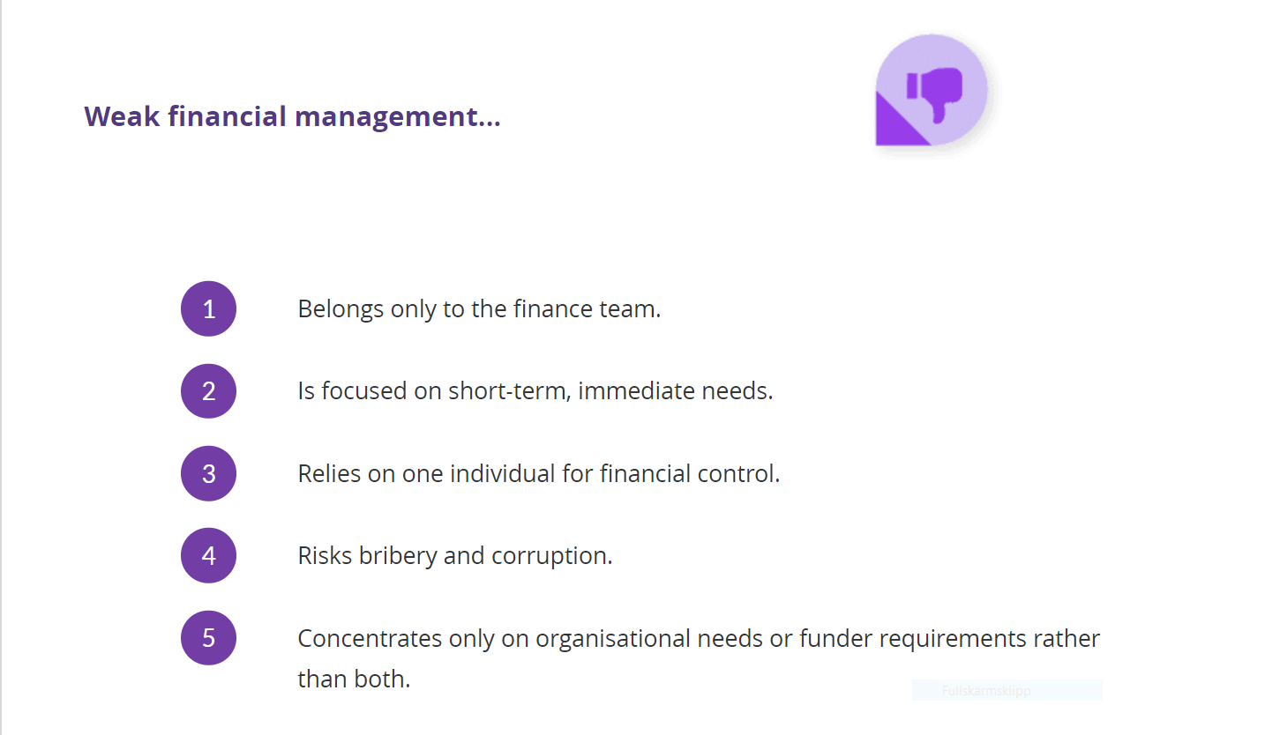
Weak Financial Management
Notes:
Can you identify (in your mind) 1 to 3 weaknesses in your own organisations financial management system, (Do not have to share)
Response ability –
How would you describe your organisations “response ability” according to the following definition- When a project team better understand and manage their financial resources, they make better decisions, respond more effectively to stakeholders needs, and are more agile in adapting to ever-changing environments, risks and issues.

Slide 24
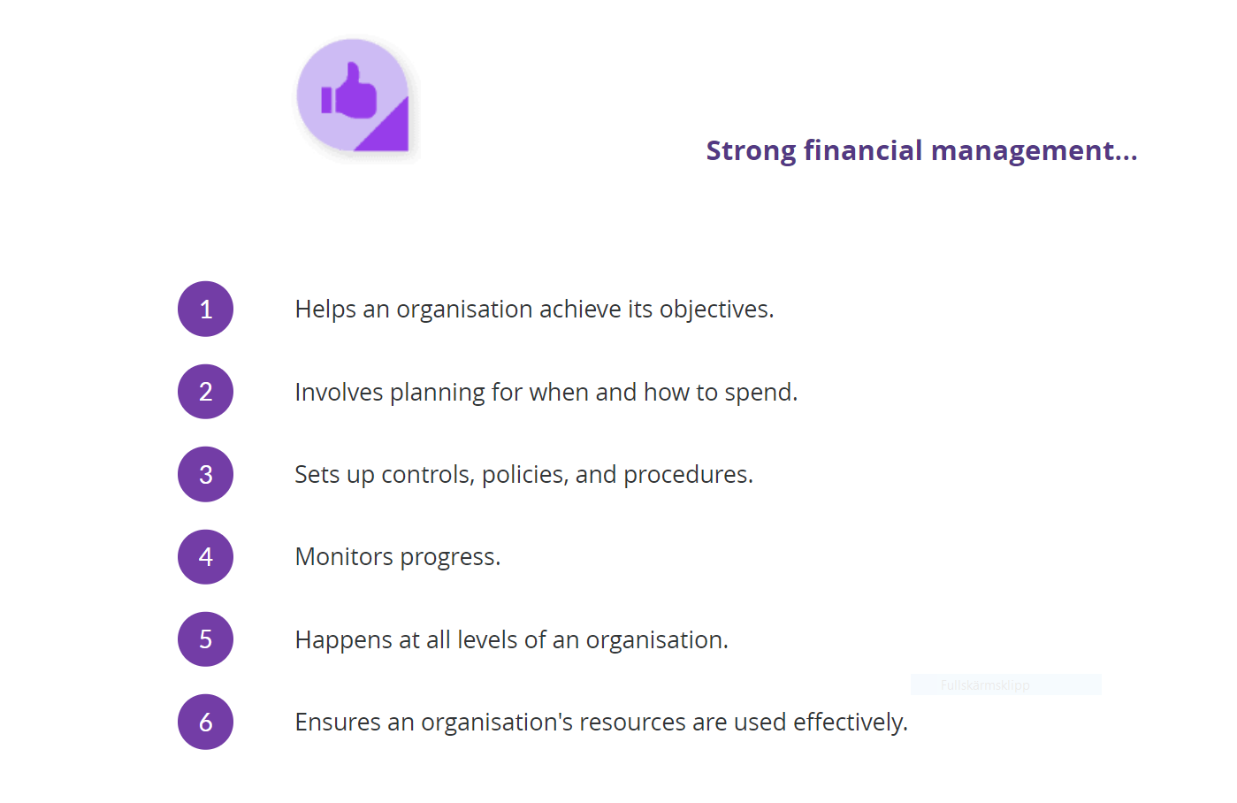
Strong Financial Management
Notes:
CAT VISA could be used as a checklist for assessing the strength and weaknesses of the financial management within your organisation
Your financial system should be able to secure:
Consistency
- that we are not apply different rules and proceedures in how we handle and report financial information every year.
Accountabilty
we are able to explain how funds, equipment etc have been used as well as decisions and actions regarding financial
resources, to all stakeholders
Transparency
- we are able to prepare accurate, complete and timely financial reports
Viability
- we can manage our spending in relation to our funding strategically so we can keep our operations ongoing in the long run
Integrity
- we, the entire organisation, are operatiing with honesty and decently
as specific to financial reports means that they are dependent on accuracy and completeness of financial records.
Stewardship/Financial Stewardship
- we take good care of and use financial resources for the purpose they were intended
Accounting standards
- we can keep accurate financial records and documentation and we observe internationally accepted accounting standard
and principals
For your self (Do a quick assesment of the financial at your organisation)
- Assess if your control system – is there a reasonable balance, efficiency, from your control and bureaucracy/administration and the risk of
for example delayed reporting to donors/stakeholders

Slide 25
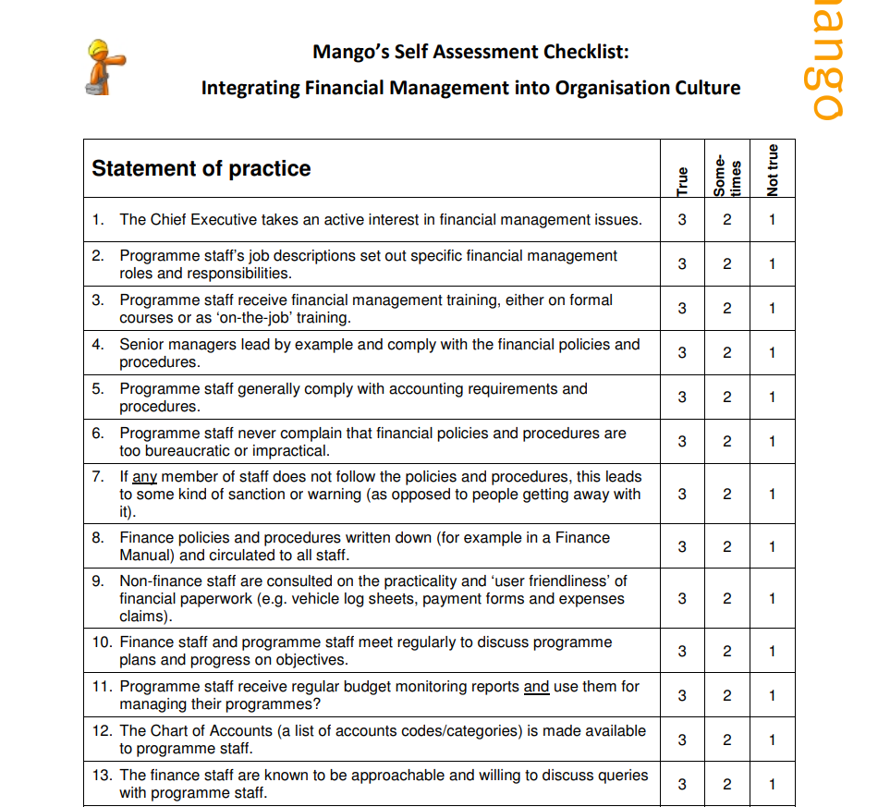
Assignment sent by e-mail:
Self Assessment Checklist:
Integrating Financial Management into Organisations Culture

