Slide 1
PLUS A SPECIAL GUEST!

Slide 2
Communications in humanitarian settings

Slide 3
First… some introductions!
Who are we.. And who are you? (write in the chat)

Slide 4
Question to you!
Do you currently use communication/ media? In what way? What platforms do you use? What impact has this had?

Slide 5
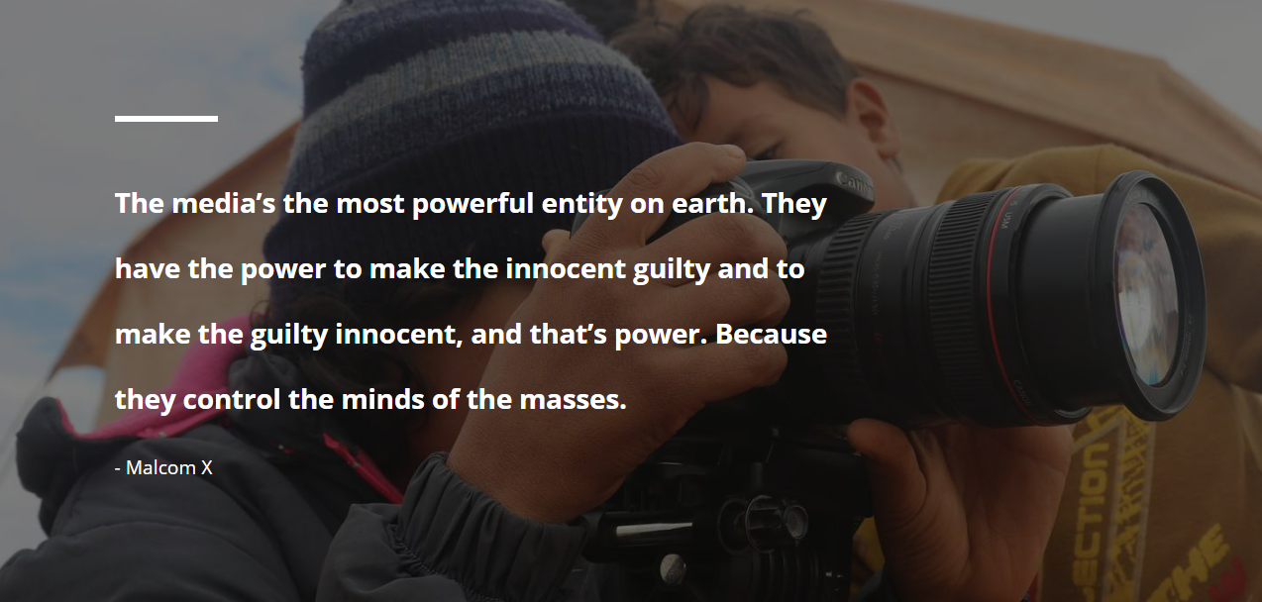

Slide 6
What are the benefits of Humanitarian Communications?

Slide 8
Notes:
Pause here for discussion!

Slide 10
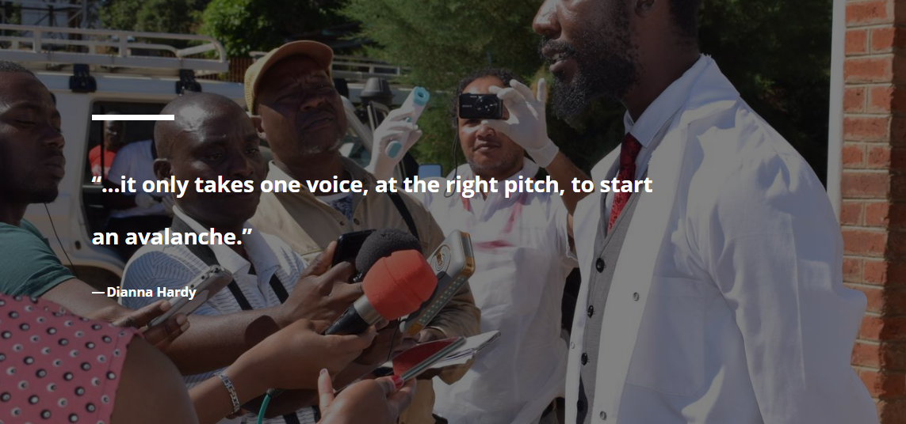

Slide 11
Opportunities for raising organisational profile
YOU HAVE SOMETHING TO SAY and are close to the ground
During an emergency few people are on the ground, it is your USP to be delivering information, news as well as chance to tell the truth on your:
Purpose
Activities
Impact
This can be an opportunity to create:
Awareness
Trust
Third-party validation and endorsement of your work

Slide 12
Discussion
What other opportunities are there? What do you want to get out of this session?

Slide 13
DO NO HARM & Advocating for change
There is a tricky balance between doing no harm, raising awareness and advocating for change
Make sure you keep the NUMBER ONE rule in mind, protecting the most vulnerable
Child safeguarding
Human dignity
Welfare of the interviewees

Slide 14
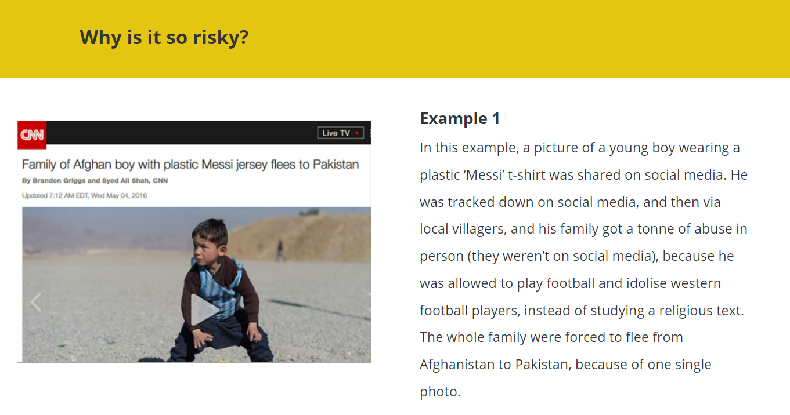

Slide 15
Discussion
What examples of harm in the media have you seen?

Slide 16
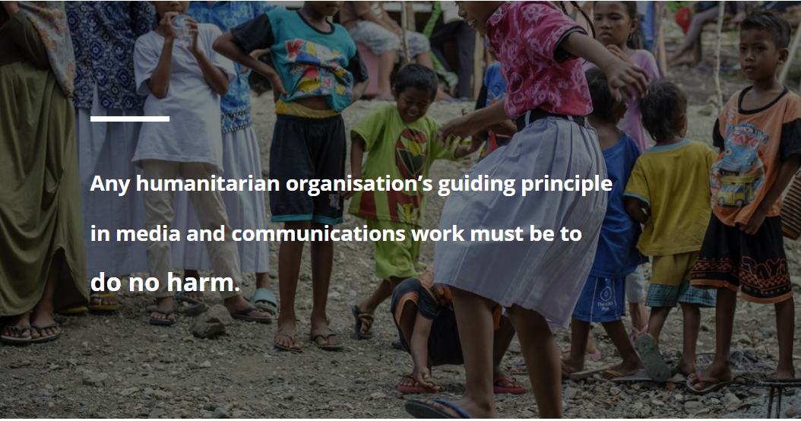

Slide 17
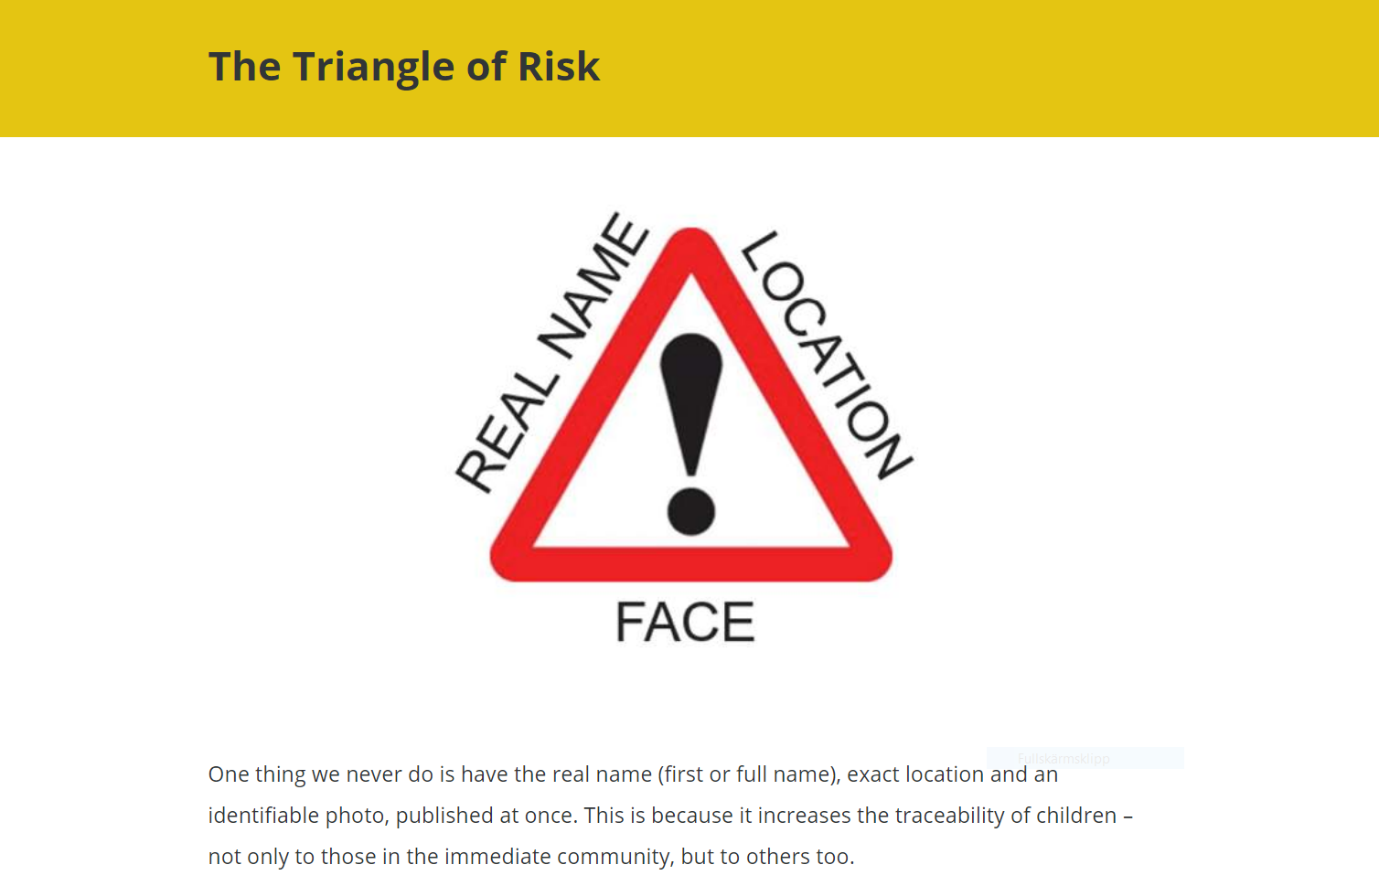

Slide 18
Do you have any other examples?
Time to share experiences…

Slide 19
Bringing in the expert…
YOU TOO WILL GET A CHANCE TO ASK QUESTIONS…
What other things should we look out for when reporting from humanitarian settings?
Top tips (from your experience)
What are examples of sucessful communication pieces?
What about not successul / harmful?
What should our audience be looking out for when reporting from these settings?

Slide 20
BREAK

Slide 21
Branding and creating your voice
Brand your organisation and create media

Slide 22
You don’t have to be a professional…
You can be a professional observer, teller of what you see and create desired action (awareness, word-spreading)

Slide 23
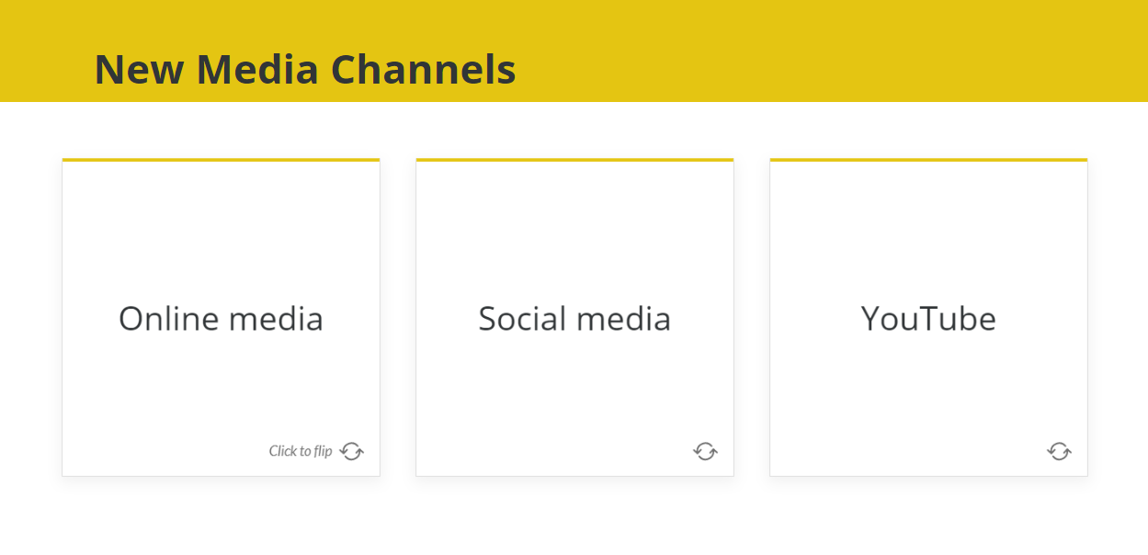
Notes:
Dangers, risks and opportunities of new channels
Branding
Some examples of youtube:
- podcast
live streaming
Training and free training (why is this useful? )

Slide 25
What platforms do you use today?
Share in the chat…

Slide 26
Brand
Purpose
Vision mission
What do you do?
And what impact does it have?
On who?
Why are you unique or an important actor?
What are your org values?

Slide 27
Who is your audience?
Who?
Age
Sector
Give them a persona (name, profession, background etc)
What do they feel? Think?
What action do you WANT FROM THEM (when they see your organisation name)
HOW do you reach them?
What do they respond to?

Slide 28
How to find your story?
Think about what is worthwhile communicating?
Who are you targetting?
What do you want them to know?
Ensure it is in line with your purpose:
TRUE (corroborated and checks out)
It’s not just about the issue, but also about the USP of your organisation
Empowering or dignified
Creates awareness
Connects with the audience
Factual
Builds on your brand
WHAT IS YOUR UNIQUE VOICE?
Think about who you are, what sort of voice do you have?
How can you build this into your messaging?
How can you still be you…(personal branding perhaps on facebook etc)
It’s not only about content WHEN the disaster happens, it’s also about your organisation and personal voice AFTER the disaster, it’s an ongoing story of change…

Slide 29
Creating Content…
DO NO HARM
Keep it to the point
Keep it simple (easily understandable in a short space of time… people are busy and easily distracted!)
Make sure your purpose (desired action of the audience) is clear
Make it interesting and informative for your audience
You can measure the success of your communication

Slide 30
Let’s get practical
Template to be shared in chat
Get into groups of 4 and work on the template of one of your organisations (choose a real scenario…)

Slide 31
Top (free/ almost free) tips
Canva
iMovie / Movie making apps on iStore & Google Play
MailChimp
http://miro.com
Podcast
Live stream events - Streamyard
Video making - Camtasia

