Slide 1
Staff Care and Well Being in Humanitarian Response

Slide 2
5 things I wish I knew before leading people

Slide 3
1. Practice honest self-reflection 2. It is all about human dynamics 3. Define your leadership style 4. It is a marathon, not a sprint 5. You cannot constantly be a leader

Slide 4
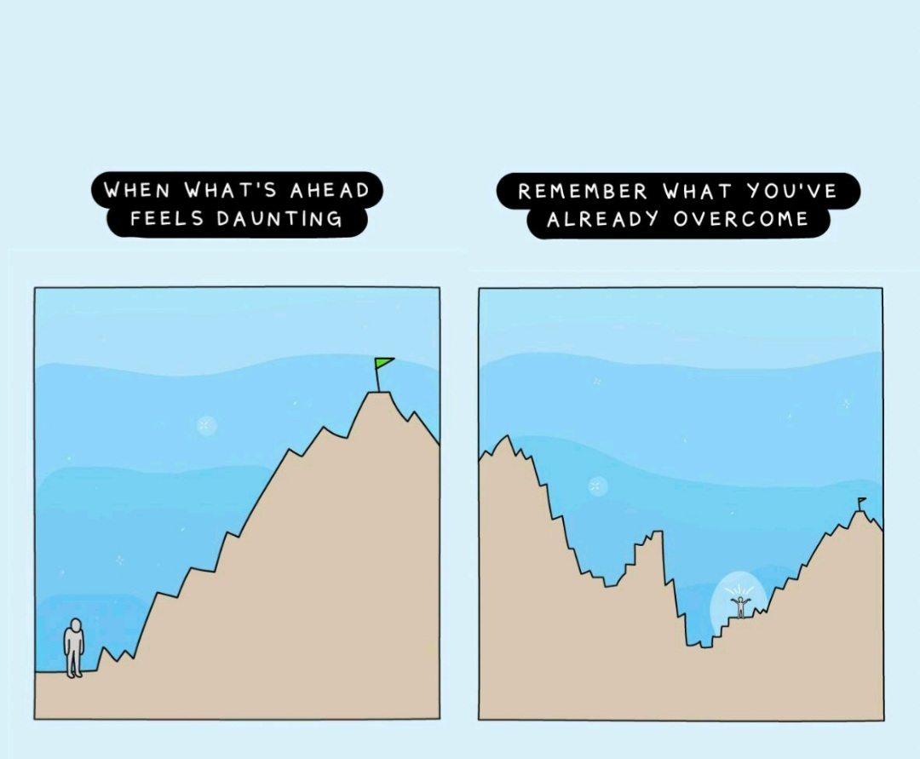

Slide 6
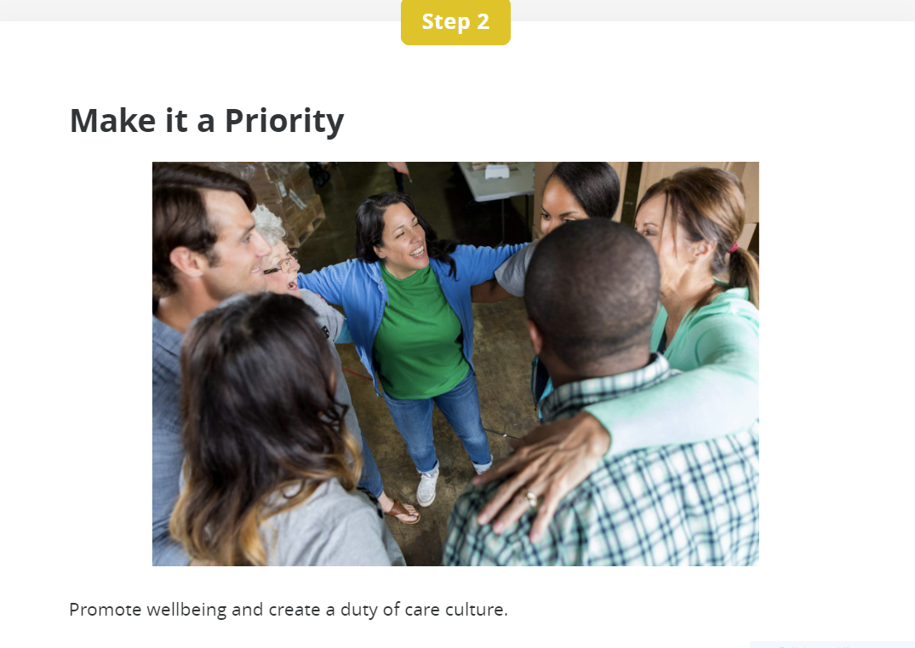

Slide 7
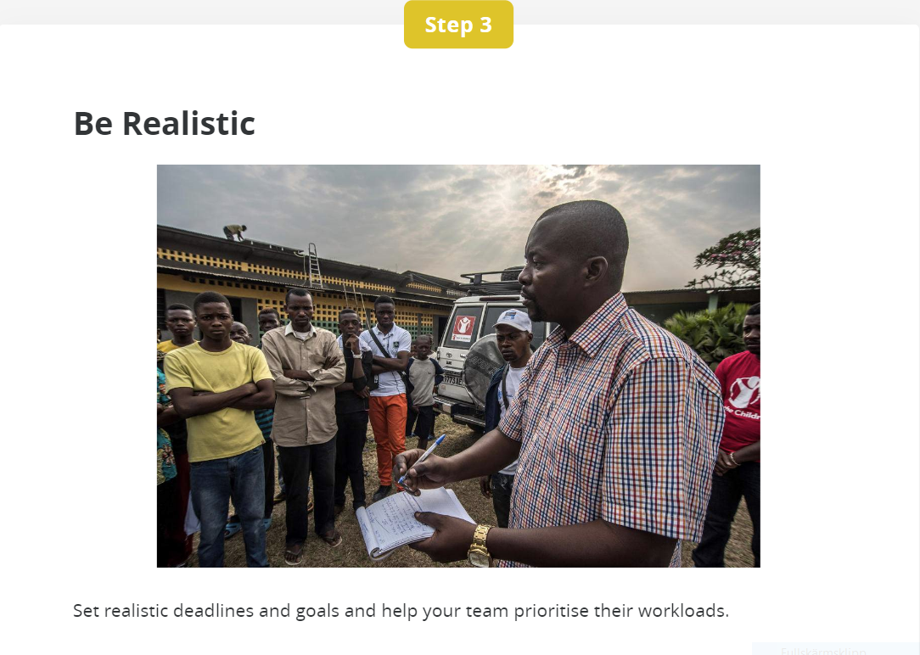

Slide 8
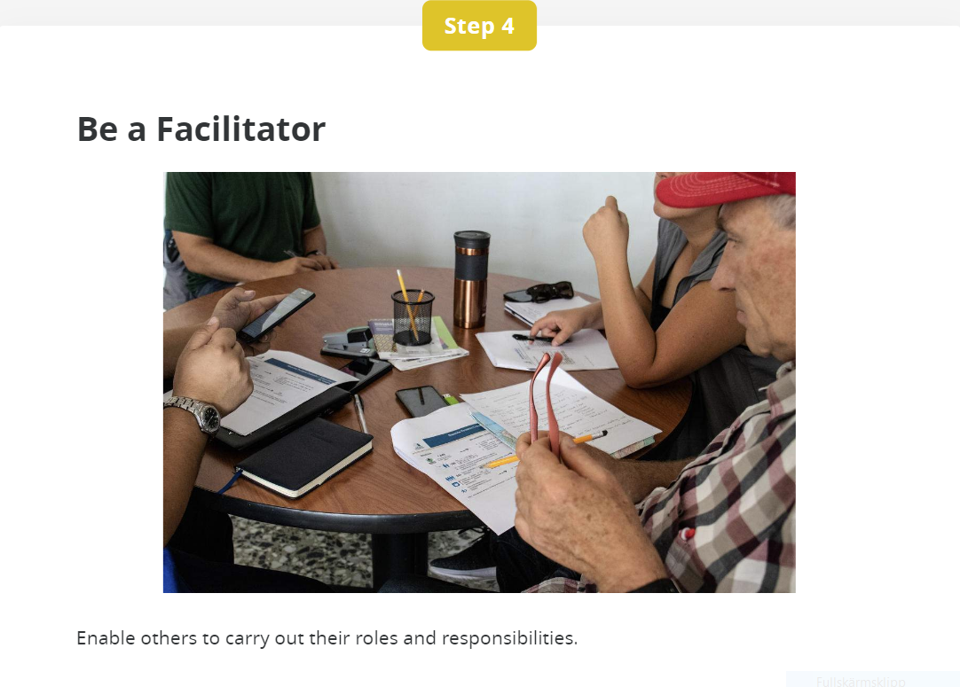

Slide 9
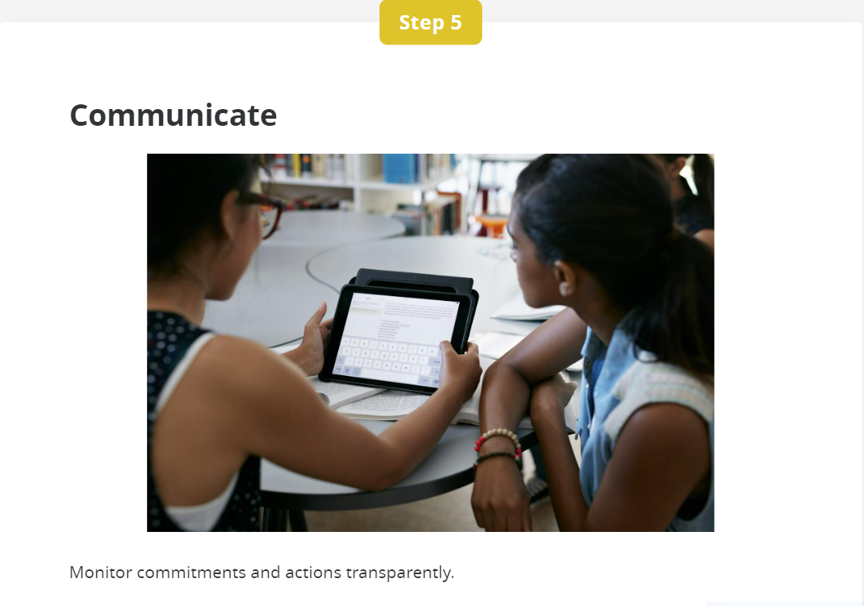

Slide 10
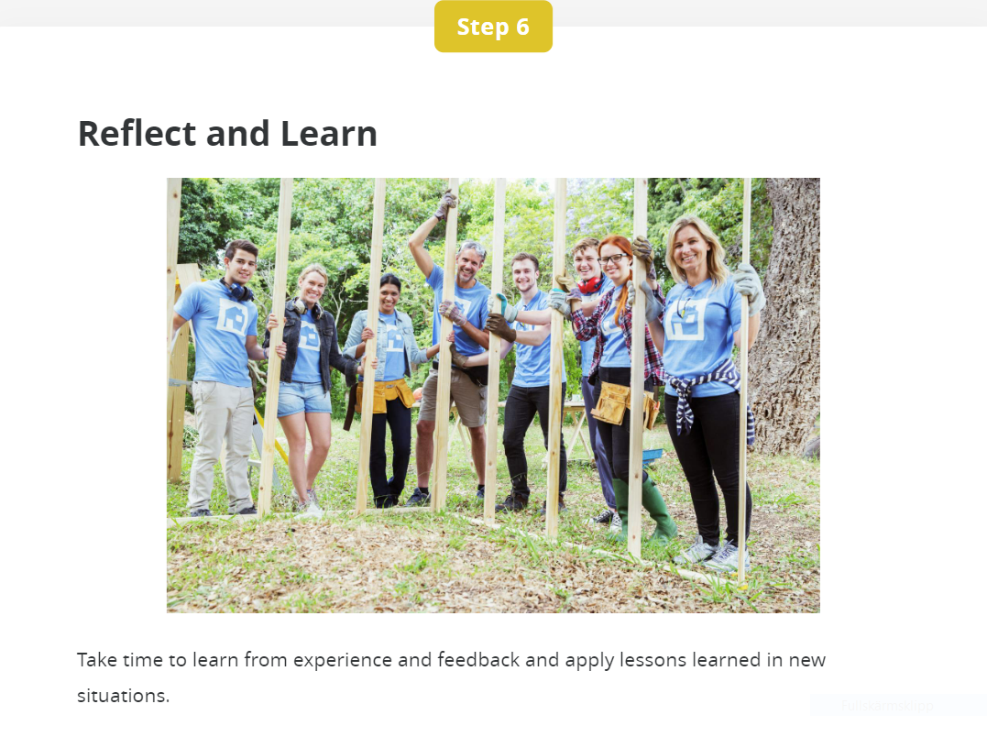

Slide 11
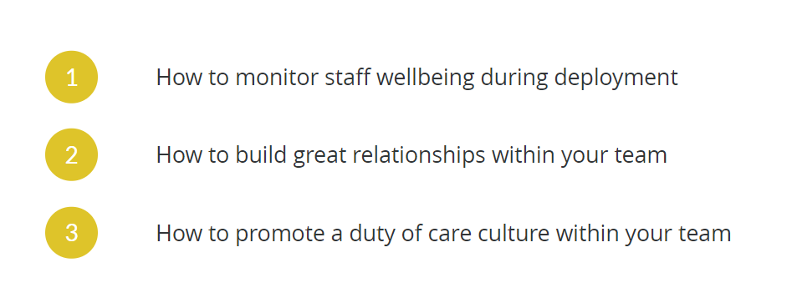
Building Healthy Teams

