Slide 1
SUPPORTING PRACTICAL FAITH-BASED ACTION
TO PROTECT & RESTORE BIODIVERSITY
Chantal Elkin, WWF UK, Tom Barasa, Kenya, James Wumbura, WWF Tanzania
August 29, 2023

Slide 2
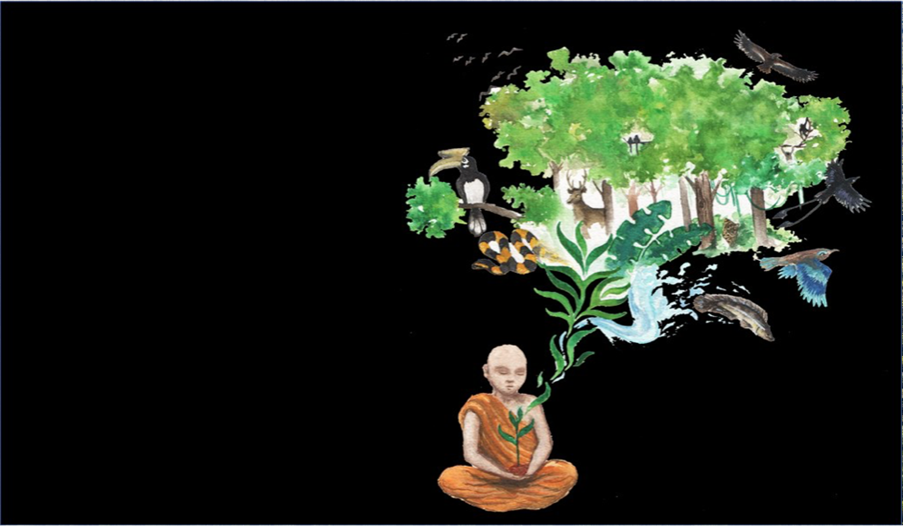
Engaging with Hindu, Christian, Buddhist, Muslim and Indigenous Traditions
ALL FAITH TRADITIONS SPEAK TO CARE FOR NATURE

Slide 3
Faith Calls to Action on Biodiversity:
Laudato Si Call to Action:
“Concretely, to safeguard biodiversity, we can take action by planting trees and form partnerships with organisations that care for land and seas. We must act together so that there is no more biodiversity loss and prioritize restoring degraded ecosystems, including on church land. We can grow Laudato Si’ gardens, living chapels, support regenerative agriculture and agroecology practices that protect and nourish human and planetary health.”
There are similar calls to action by every faith tradition:
Islam: "In Islamic teachings, humans shall act as Guardians (Kalifah) of our shared planet.”
Hinduism: "The Earth is our mother and we are all her children.”
Buddhism: We are the generation with the awareness of a great danger. We are the ones with the responsibility and the ability to take steps of concrete action, before it is too late."

Slide 4
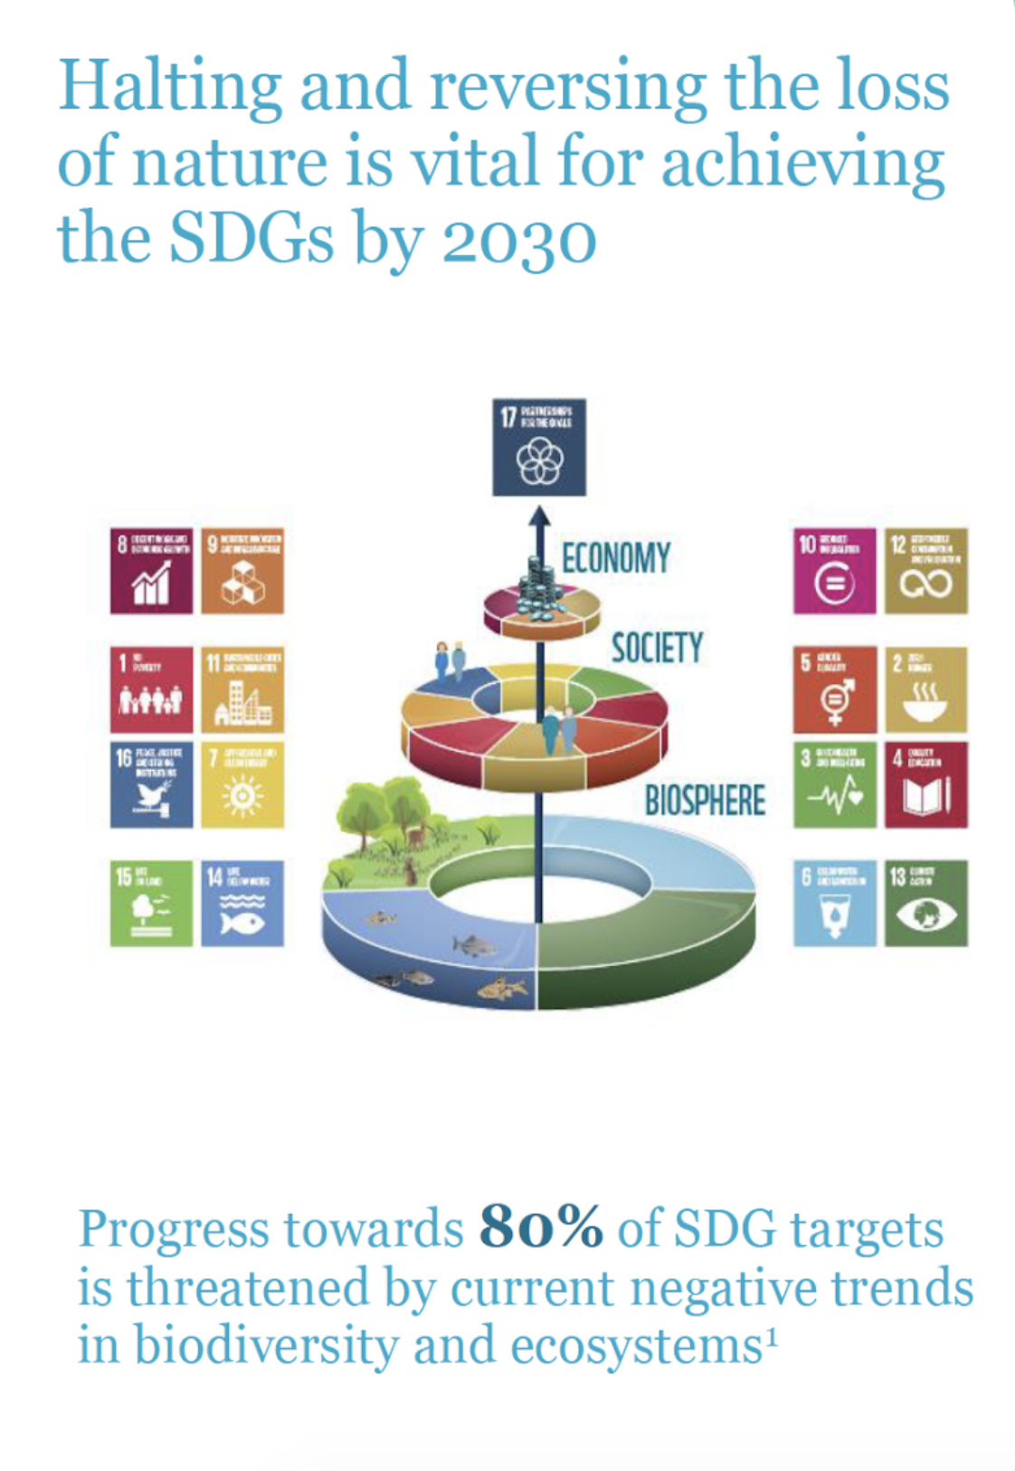

Slide 5
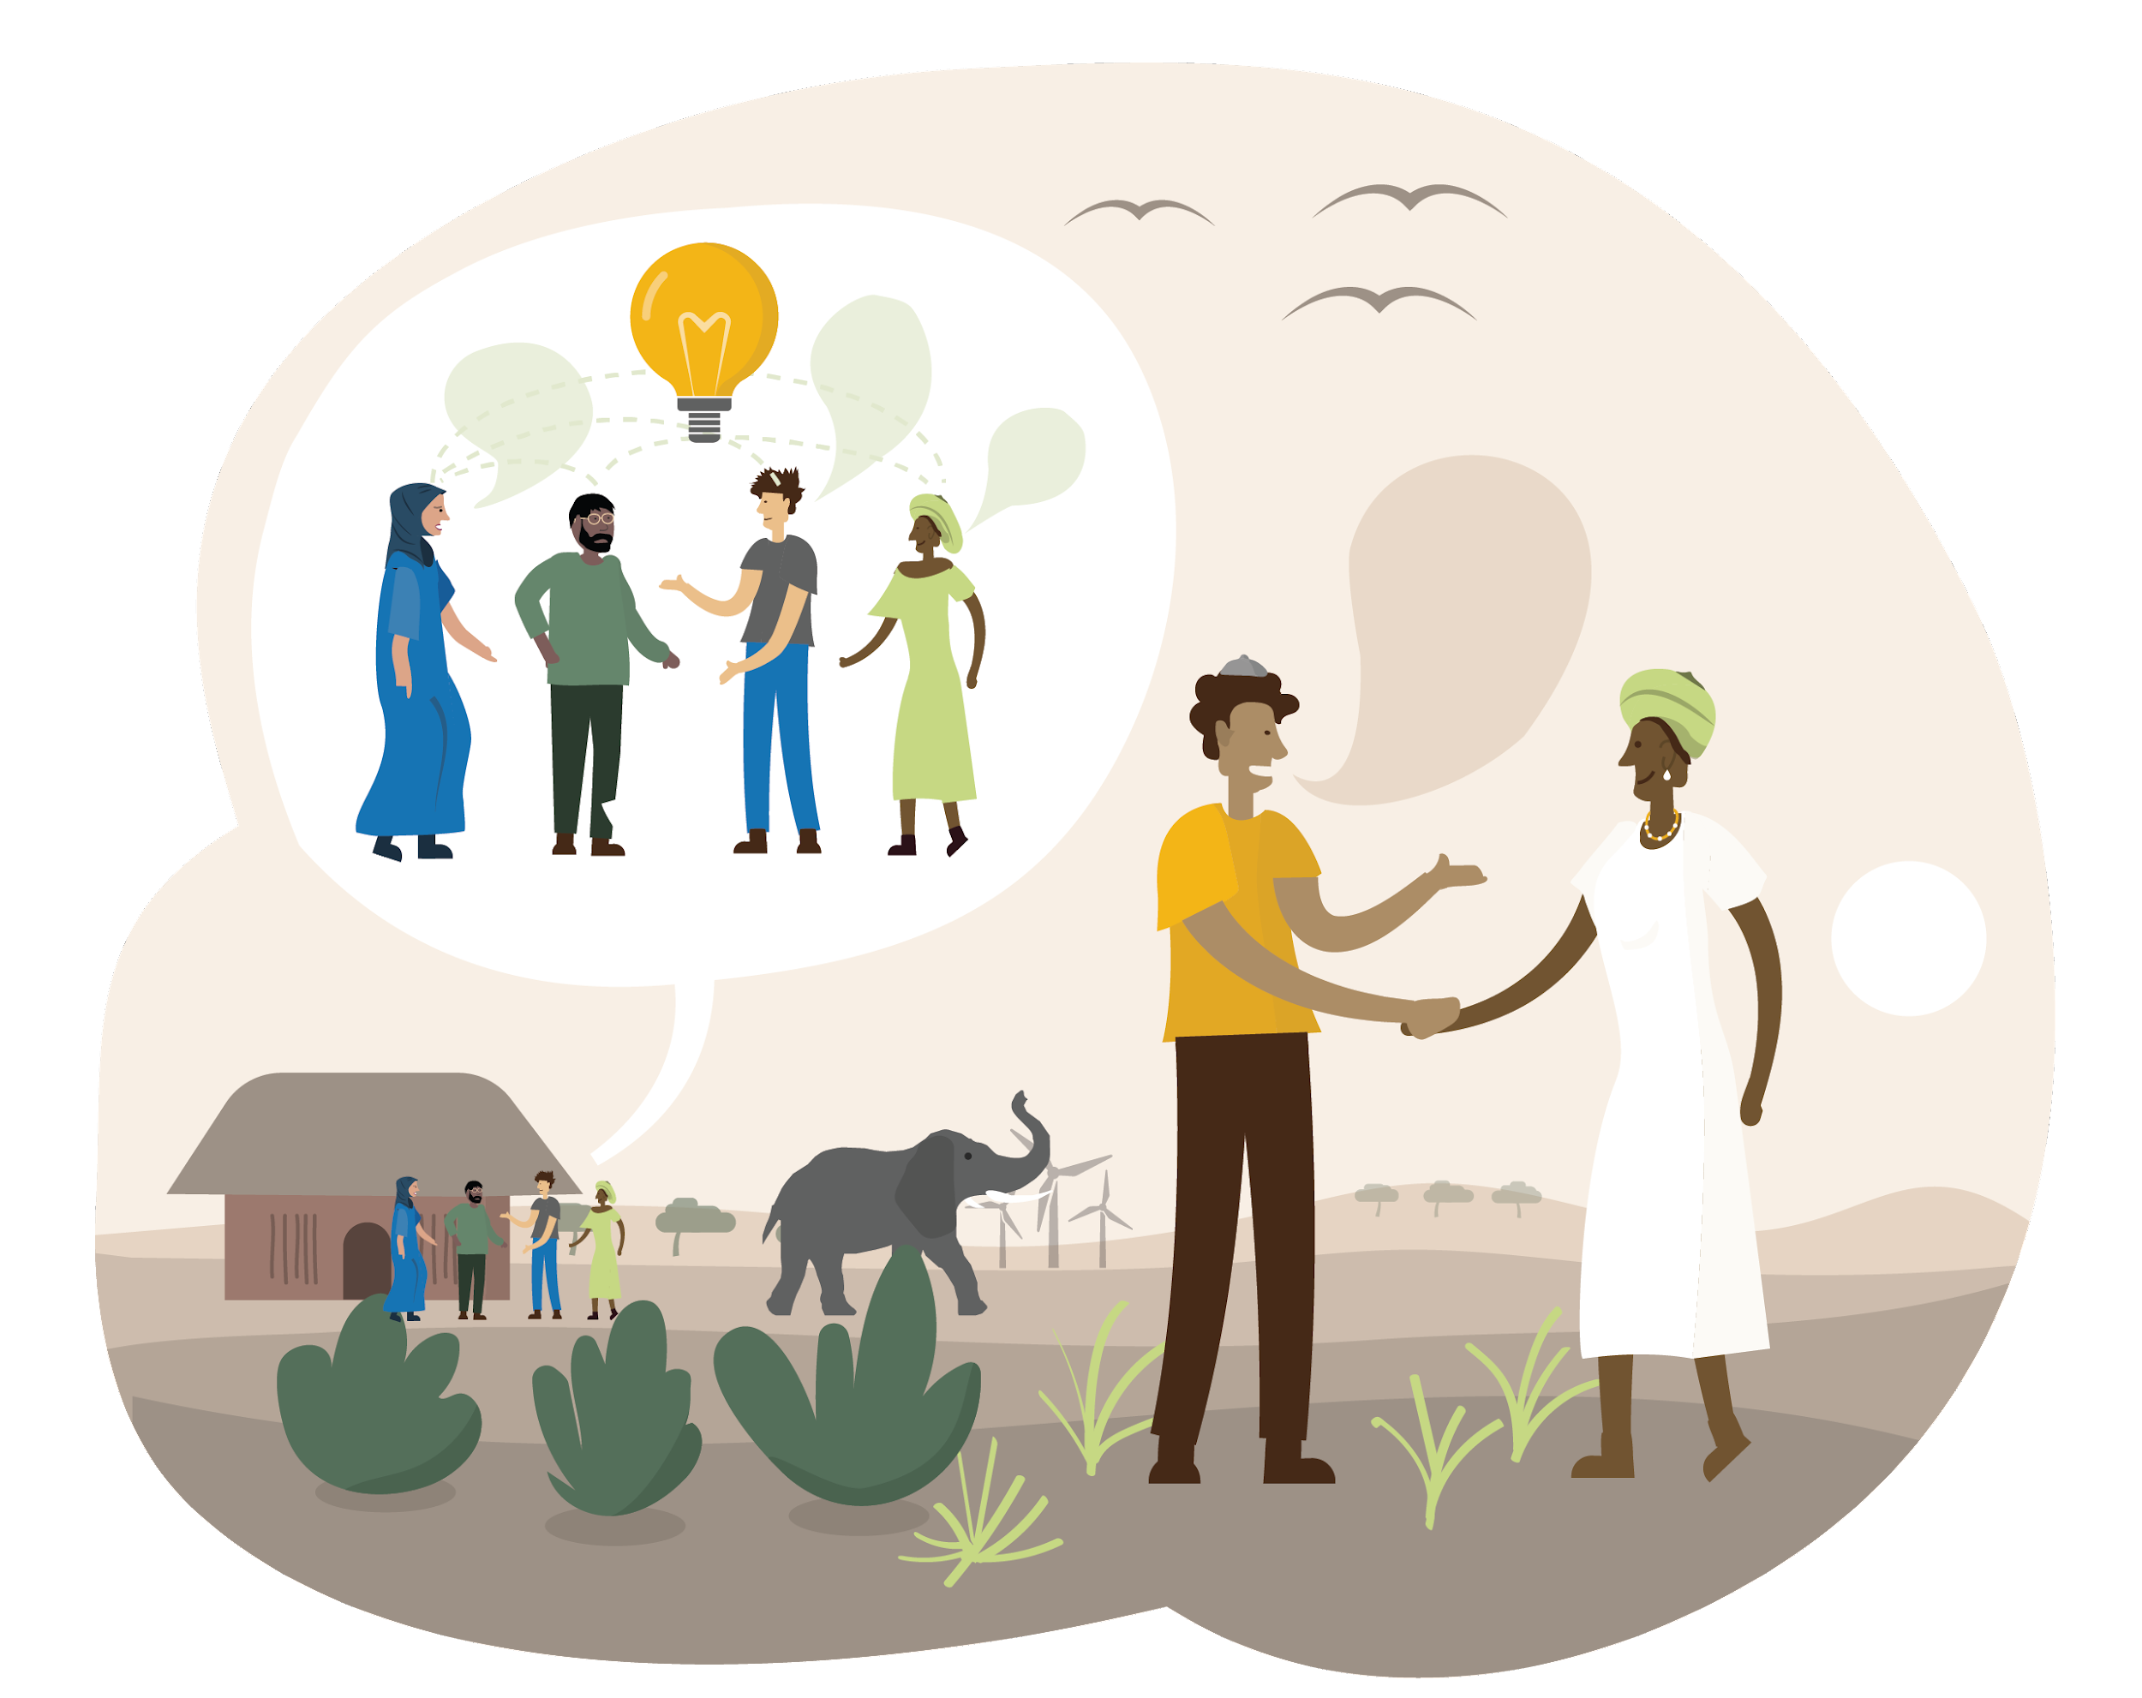
Food for Thought
What can Faith-based Organisations and Communities do to Protect and Restore Biodiversity?

Slide 6
1 -EDUCATE, STRENGTHEN AWARENESS, COMMUNICATE FAITH TEACHINGS ON NATURE
THAT CAN INSPIRE & UNDERPIN BIODIVERSITY ACTION IN YOUR COMMUNITIES
EXAMPLE: MYANMAR
Christian seminary launched new book of Christian eco-theology writings by Burmese Christian leaders
Now being used to train new pastors, and for their liturgies
To empower Christian leaders to preach about key conservation issues in their communities
Notes:
Practical Action: Protect

Slide 7
2 -PROTECT YOUR LANDS: GBF Target of protecting 30% of land and seas
Notes:
Practical Action: Protect

Slide 8
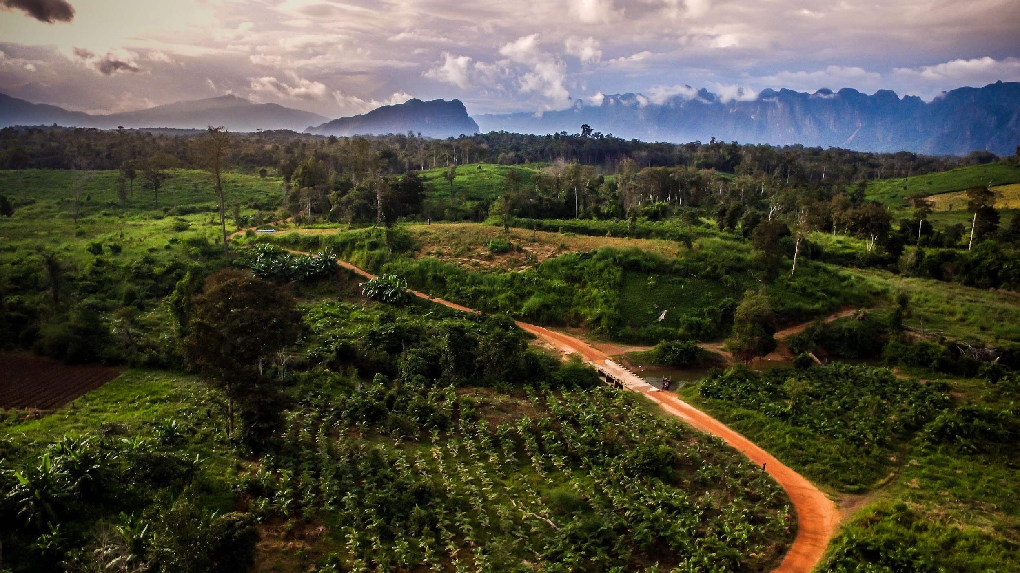
3 -RESTORE YOUR LANDS: GBF Target of restoring 30% of degraded ecosystems
Notes:
Practical Action: Protect

Slide 9
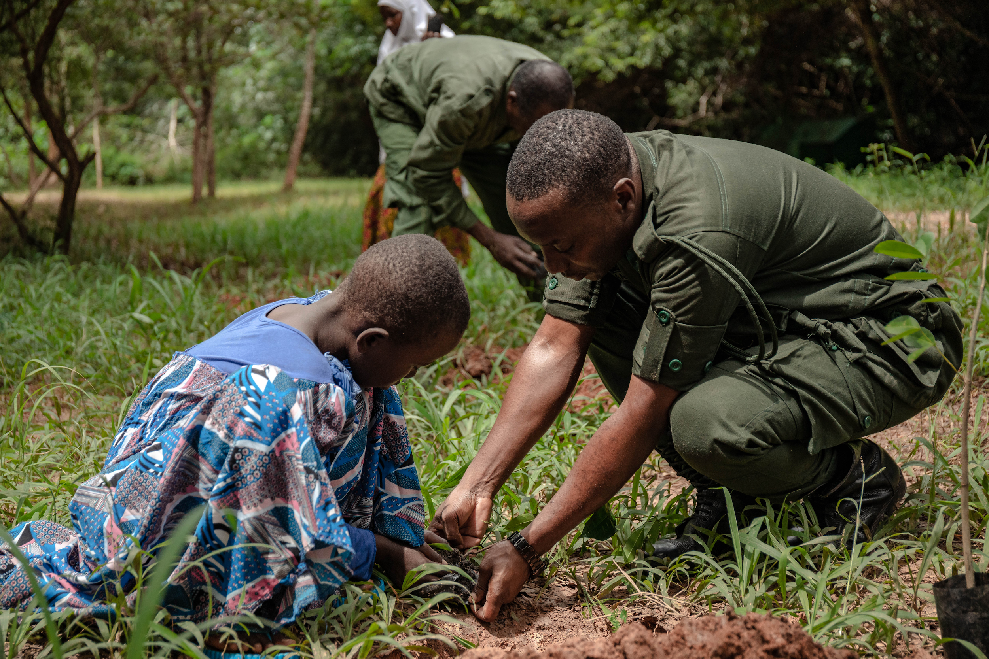
3 -RESTORE YOUR LANDS: THROUGH TREE GROWING
Tree growing is a great way to help prevent biodiversity loss, as trees and forests are habitats to many organisms. This could happen on faith-based institutional land, private farmlands owned by members, and on public land.
Globally, FBOs have planted 335+ million trees in the last 2 decades, with plans to plant 350+ million additional trees by 2030
There is thus a great opportunity to build technical capacity of FBOs to grow trees (rather than plant) according to best scientific practice so that they can survive and thrive, and contribute to conservation of biodiversity.
Notes:
Practical Action: Protect

Slide 10
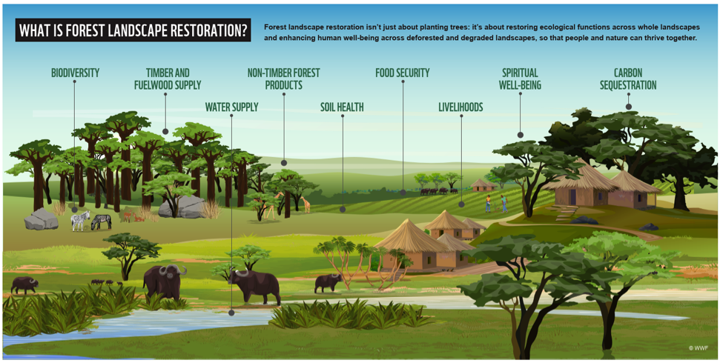
RESTORE YOUR LANDS:
GROWING vs PLANTING TREES

Slide 11
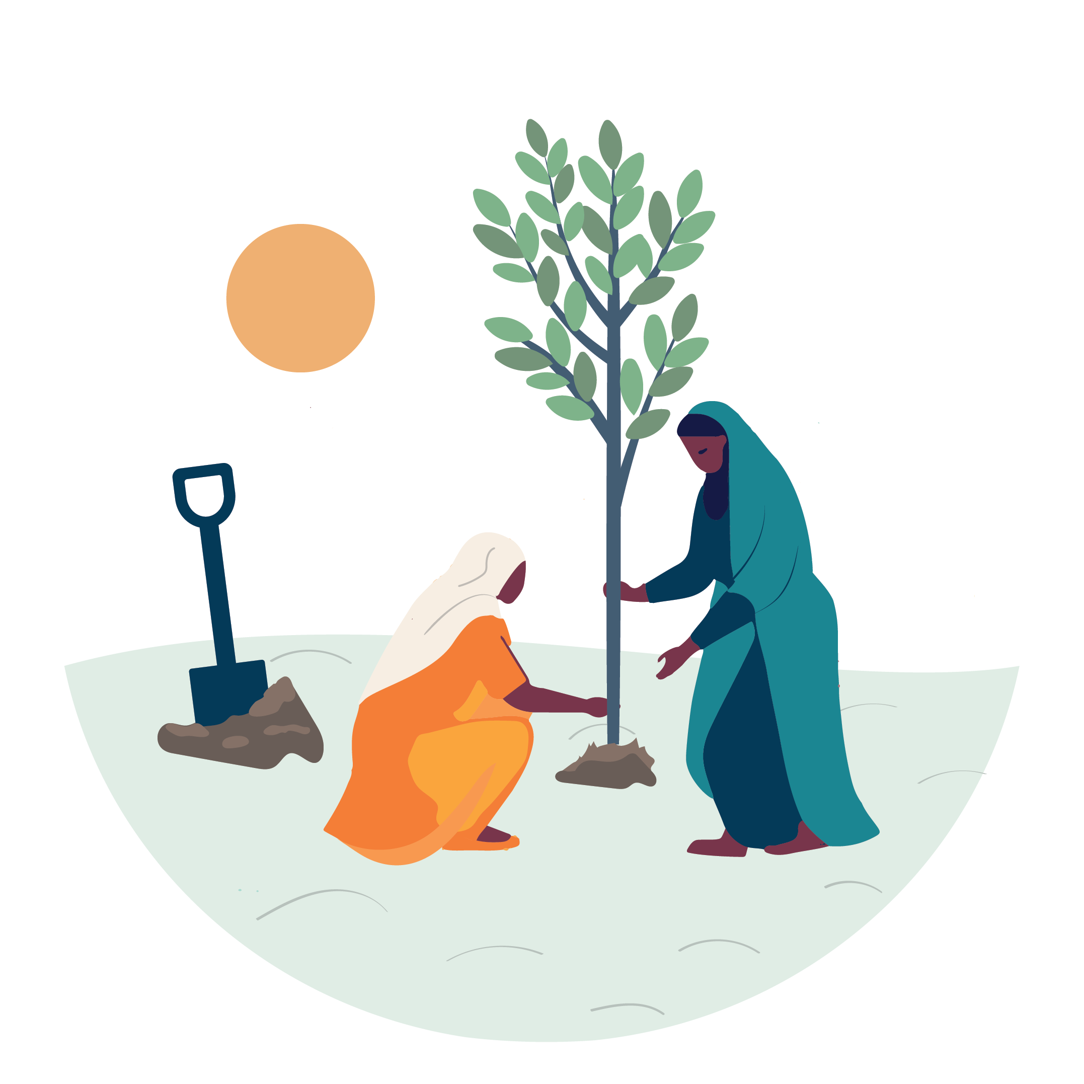
ENSURING TREE GROWING BENEFITS PEOPLE, NATURE AND CLIMATE
Planting the right tree at the right time in the right place is important
Technical capacity to grow trees according to scientific best practice is a gap in faith tree growing, globally
M&E was found to be the weakest link in faith tree growing

Slide 12
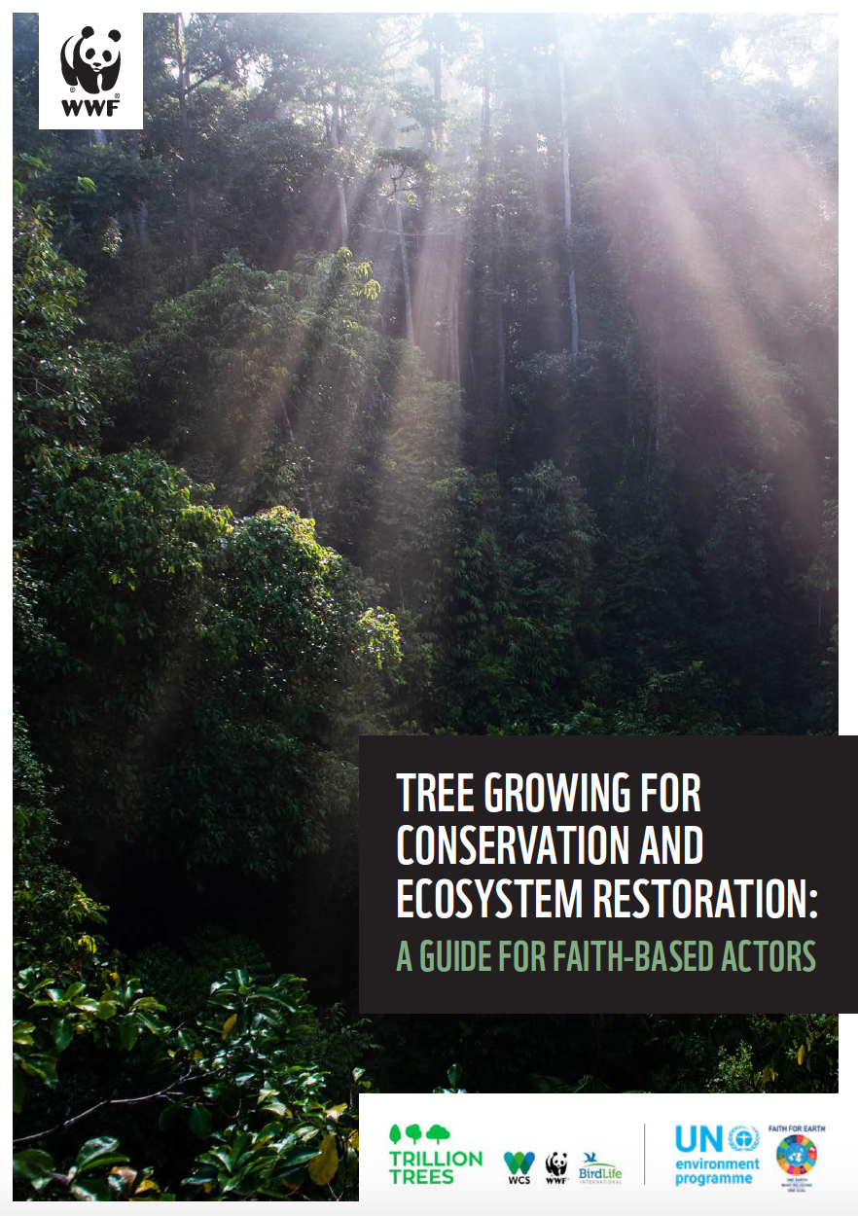
GUIDELINES ON BEST PRACTICE IN TREE GROWING
WWF in partnership with UNEP's Faith For Earth Initiative and Trillion Trees, developed a faith-friendly resource on tree growing for ecosystem restoration
The Guide was launched at COP15 in 2022 and is being used across the world to build capacity of FBOs to grow trees according to scientific best practice
To be translated into 8 languages, including French, Spanish, Portuguese and Kiswahili
It can be downloaded at https://trilliontrees.org/wp-content/uploads/2022/12/wwf_trillion_trees____tree_growing_for_conservation_and_ecosystem_restoration_guide_d.pdf
© WWF-Indonesia/Samsul Komar

Slide 13
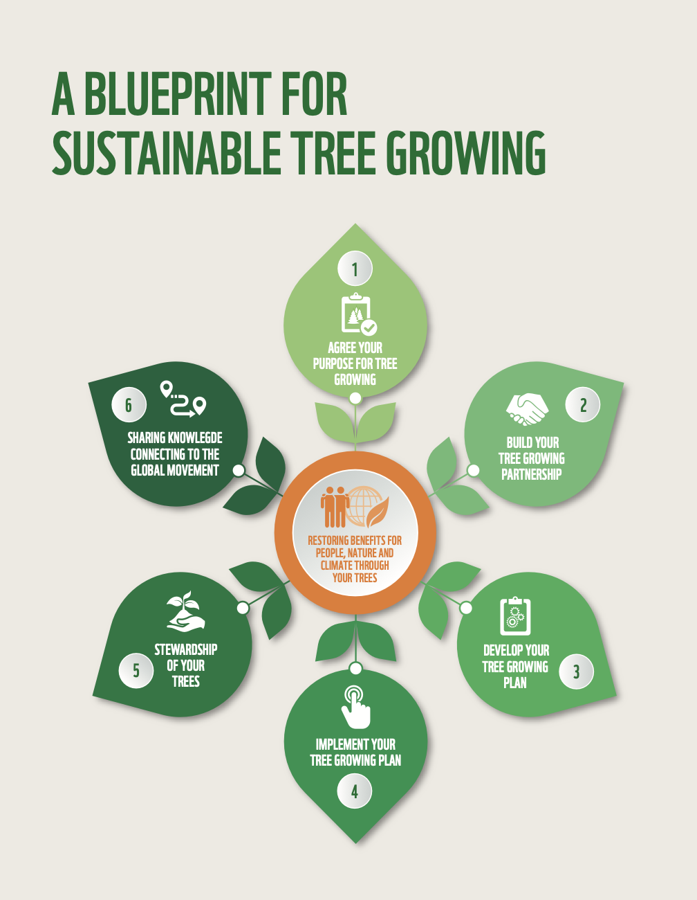

Slide 14
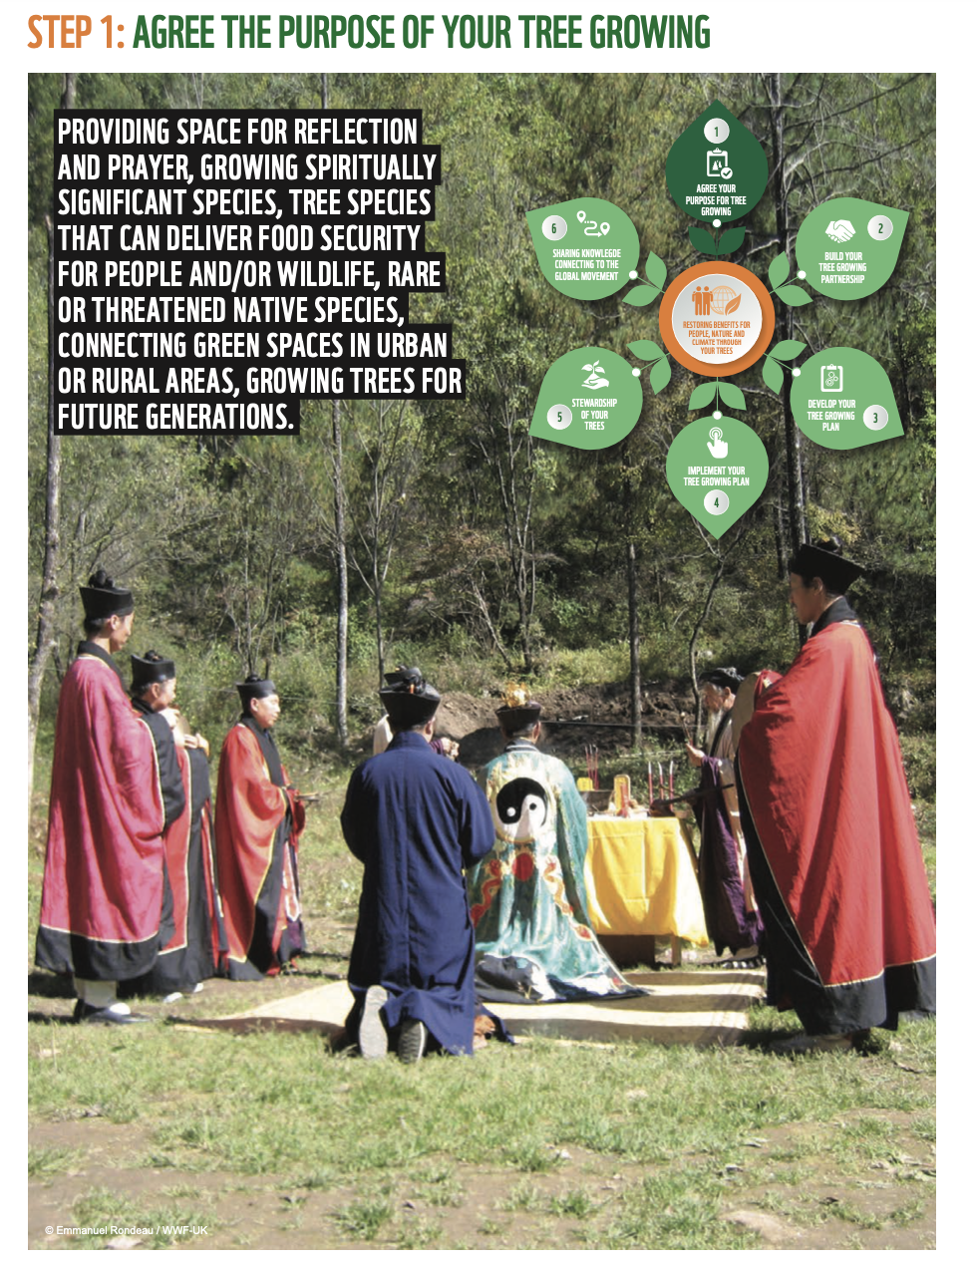
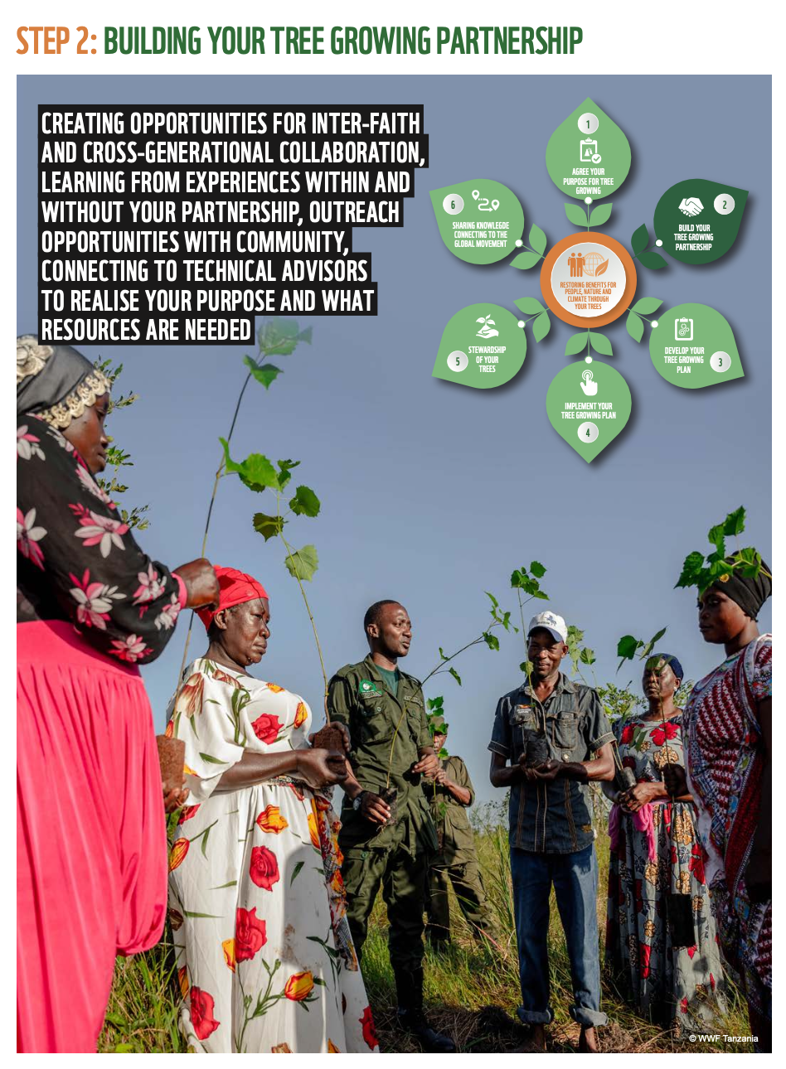

Slide 15
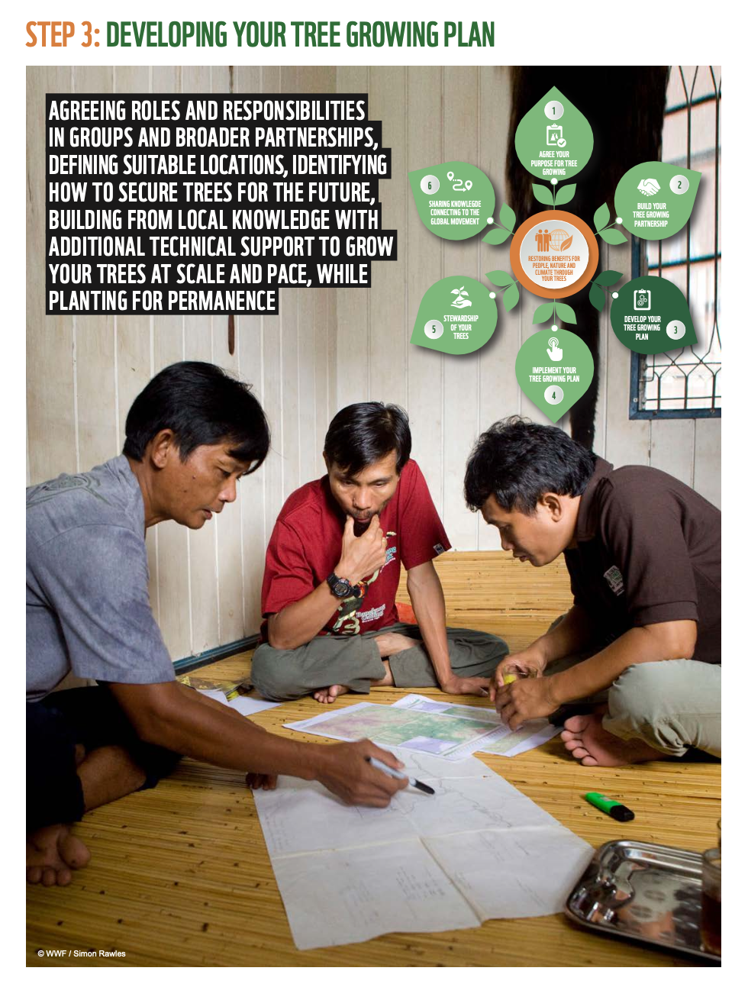
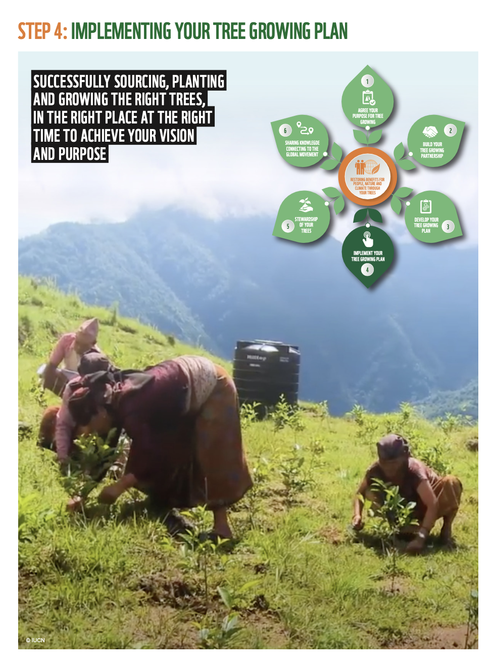

Slide 16
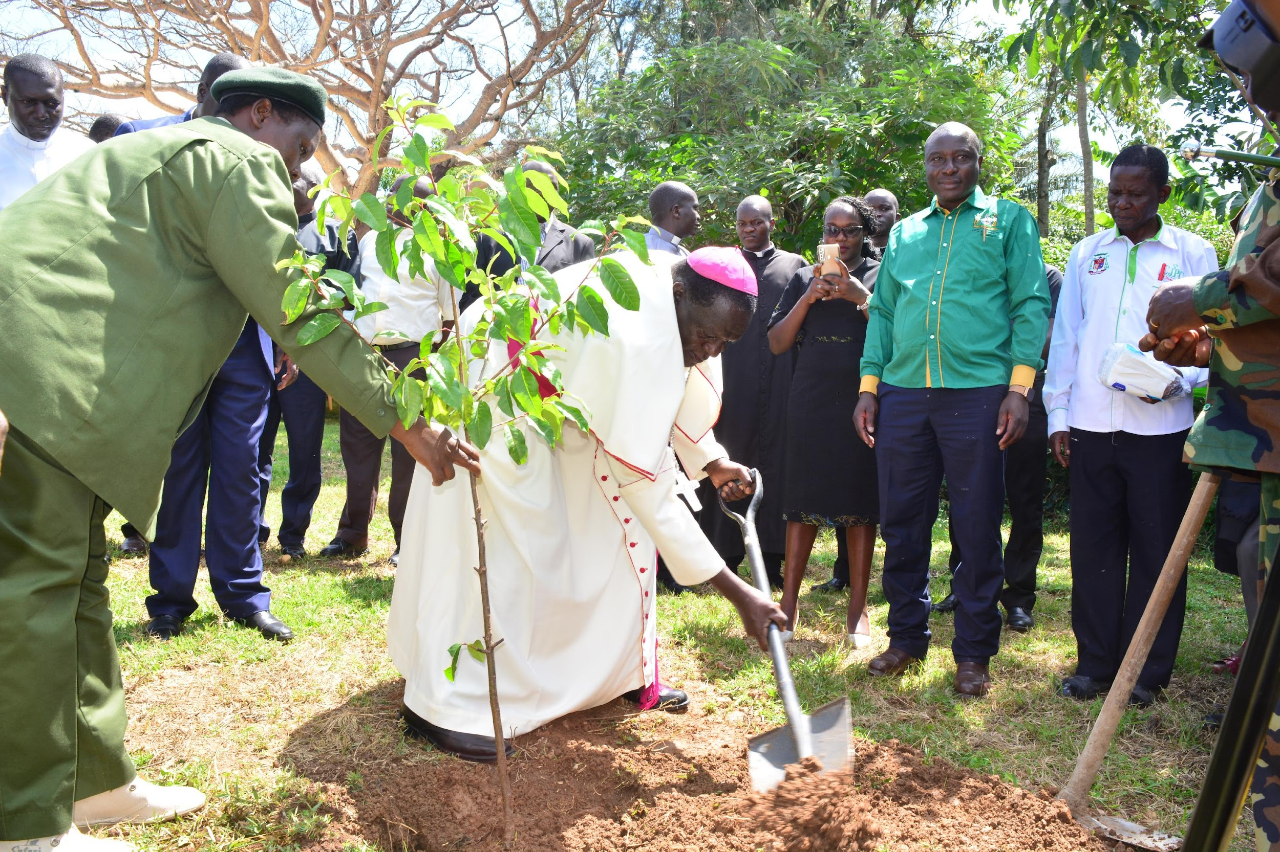
Why Strategic Partnerships?
Leveraging Resources
Building Technical Capacity
Providing access to private and state land for biodiversity conservation
Increasing Public Awareness

Slide 17
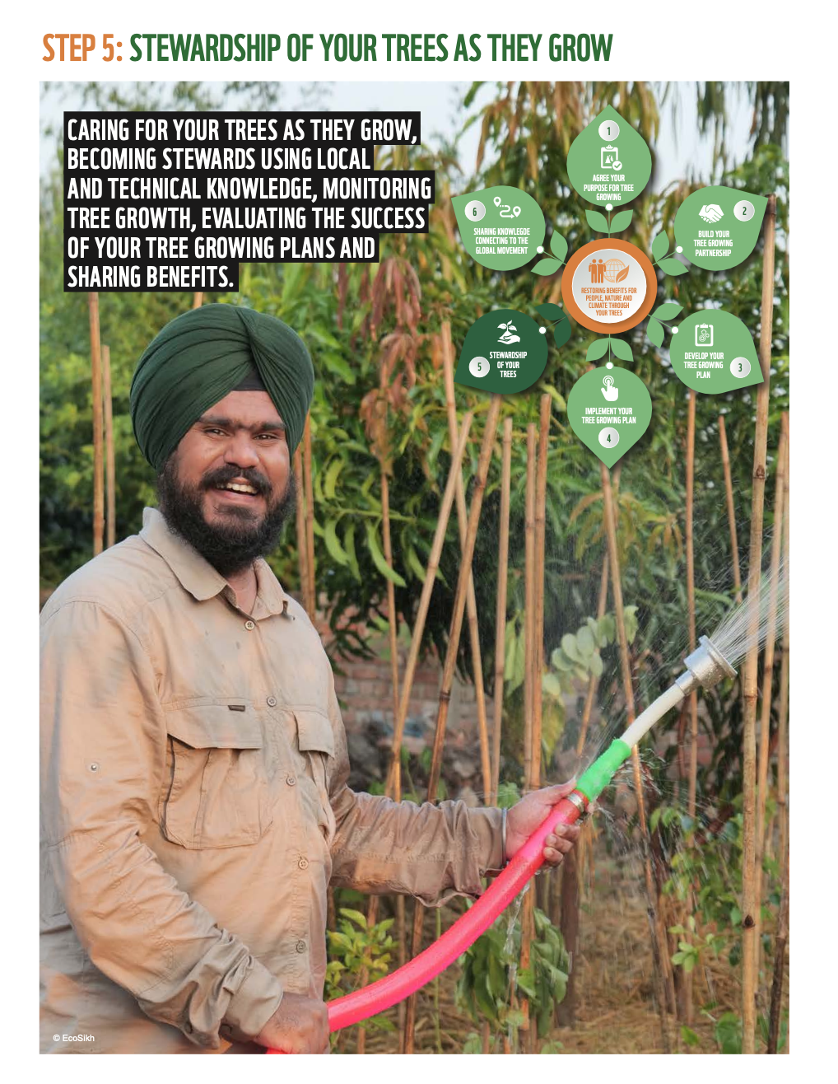
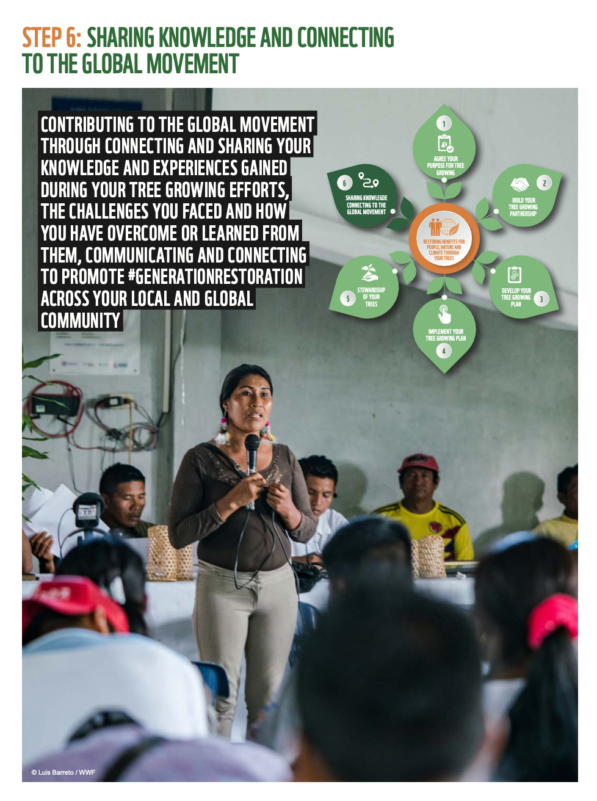

Slide 18
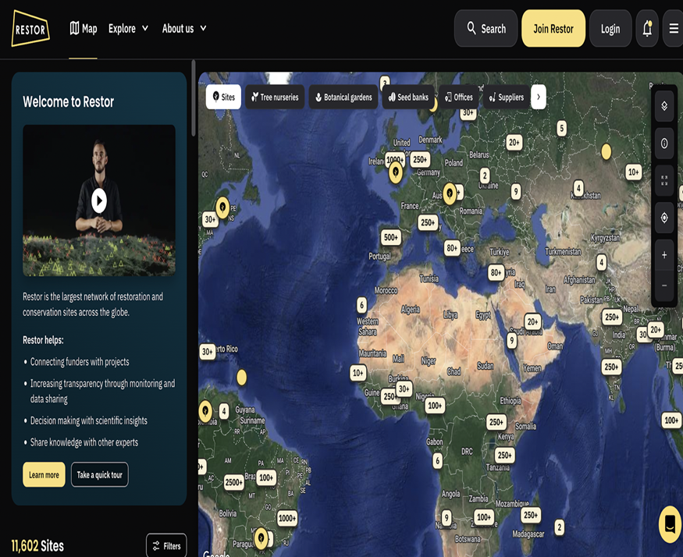
SHARE YOUR STORIES & CONTRIBUTIONS CREATE AWARENESS!
a). The RESTOR Platform
Notes:
Practical Action: Protect

Slide 19
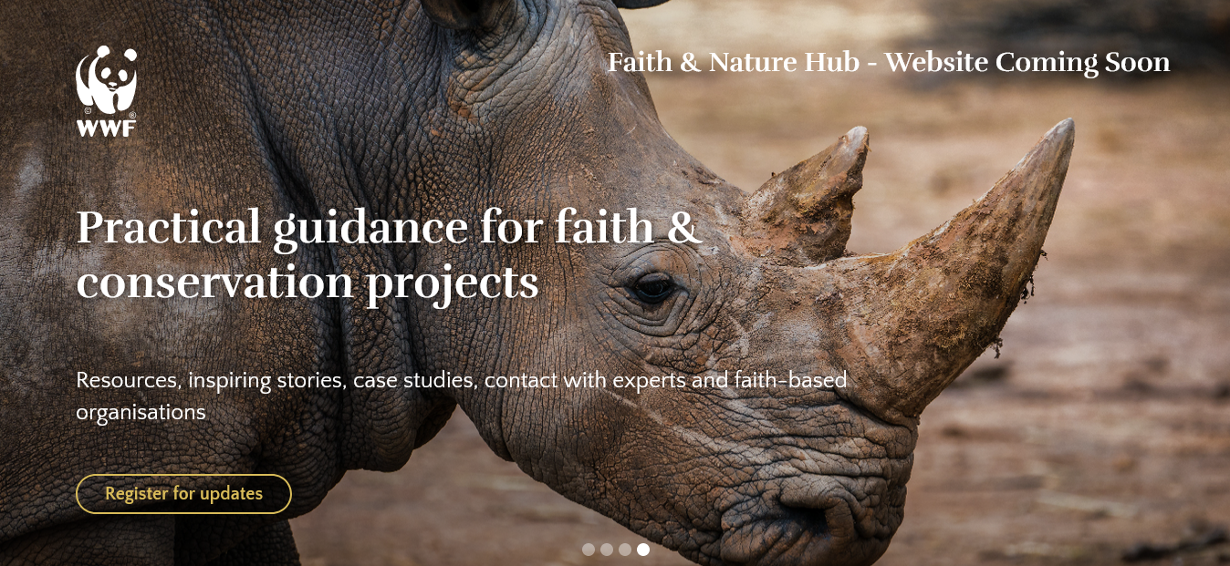
b). WWF’s Faith and Nature Hub Learning Platform

Slide 20
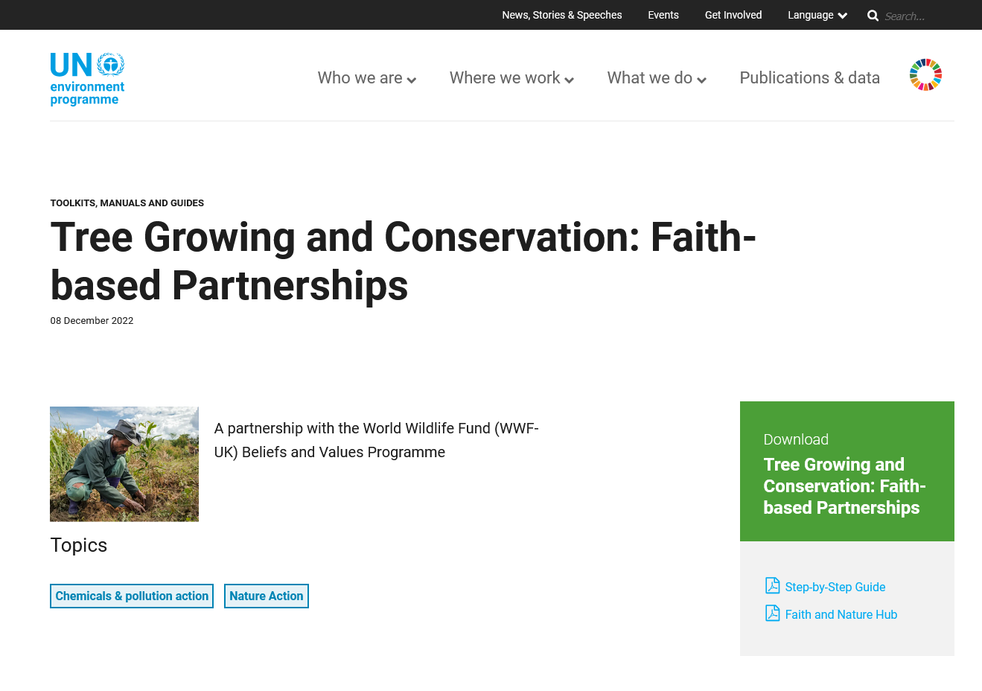
c). Upcoming Page on UN Website

Slide 21
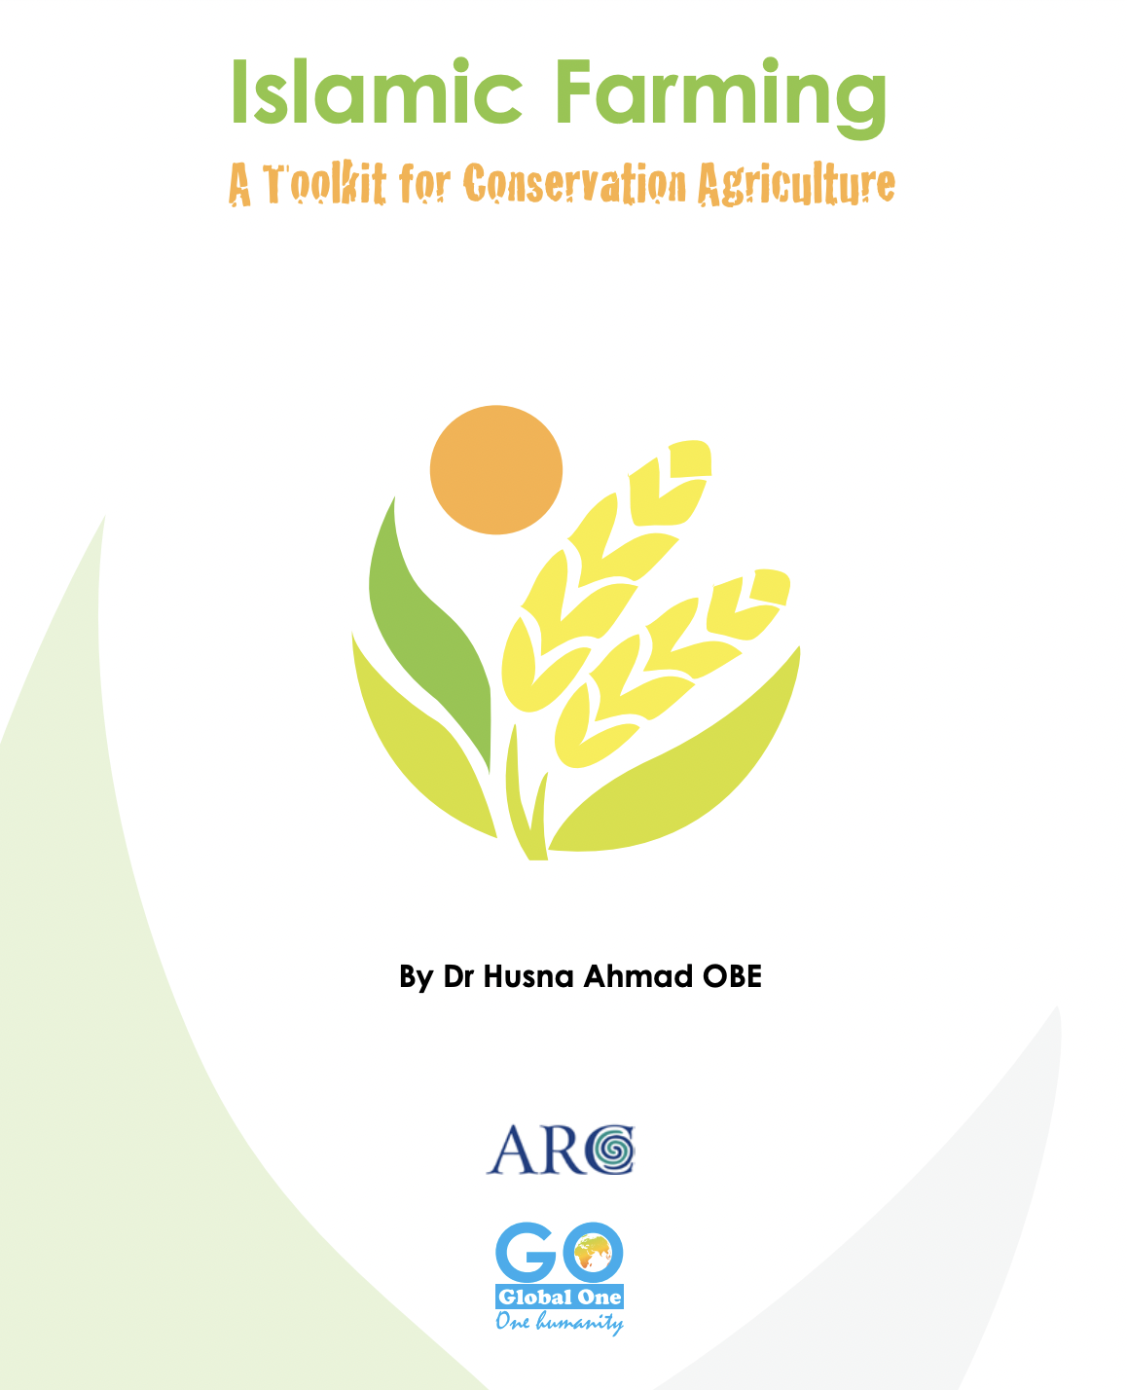
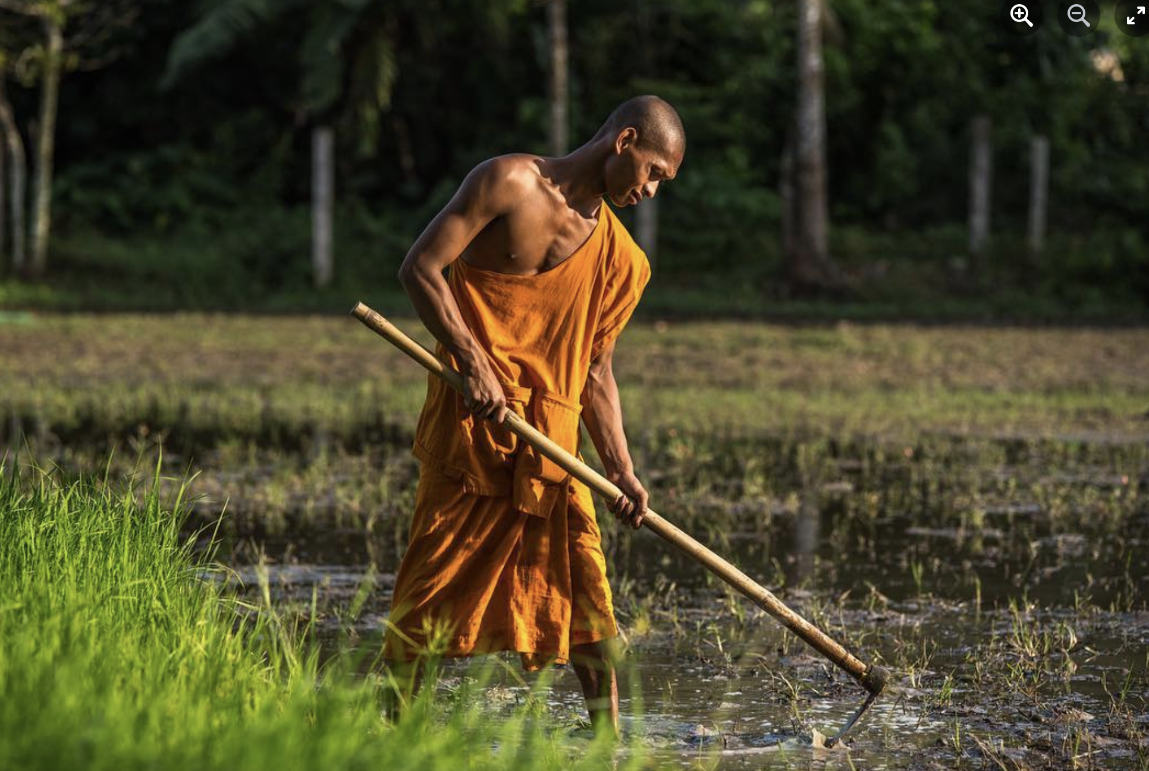
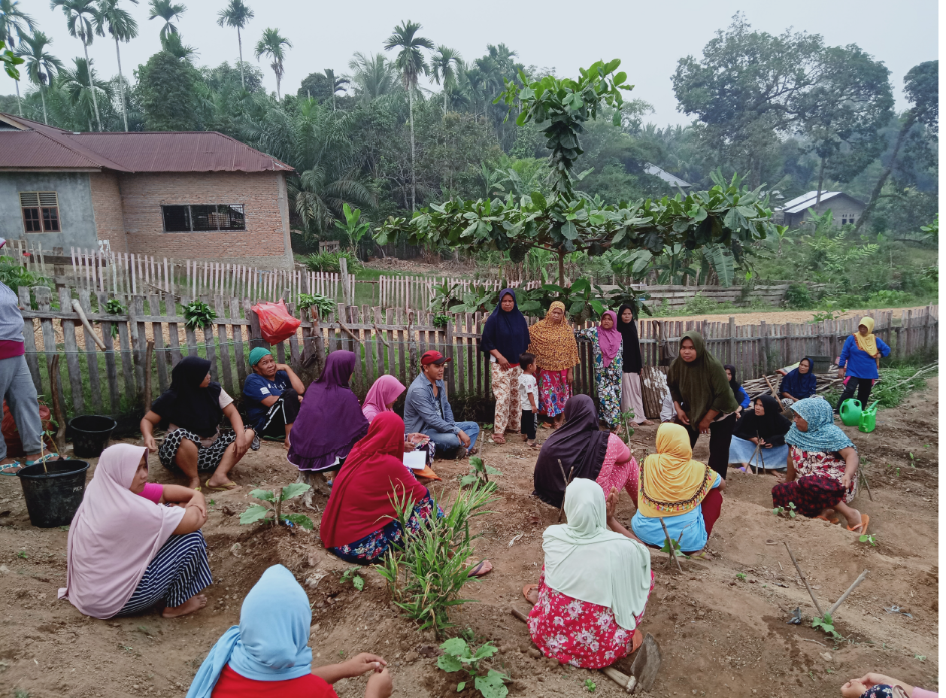
4 -RESTORE YOUR FARMLANDS: FAITH-BASED AGRICULTURE
Faith groups are carrying out agriculture based on faith teachings and values
Examples: Islamic Farming Toolkit, Buddhist-based agriculture, Christian agriculture
Notes:
Practical Action: Protect

Slide 22
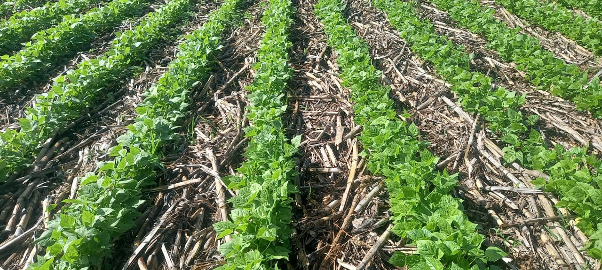
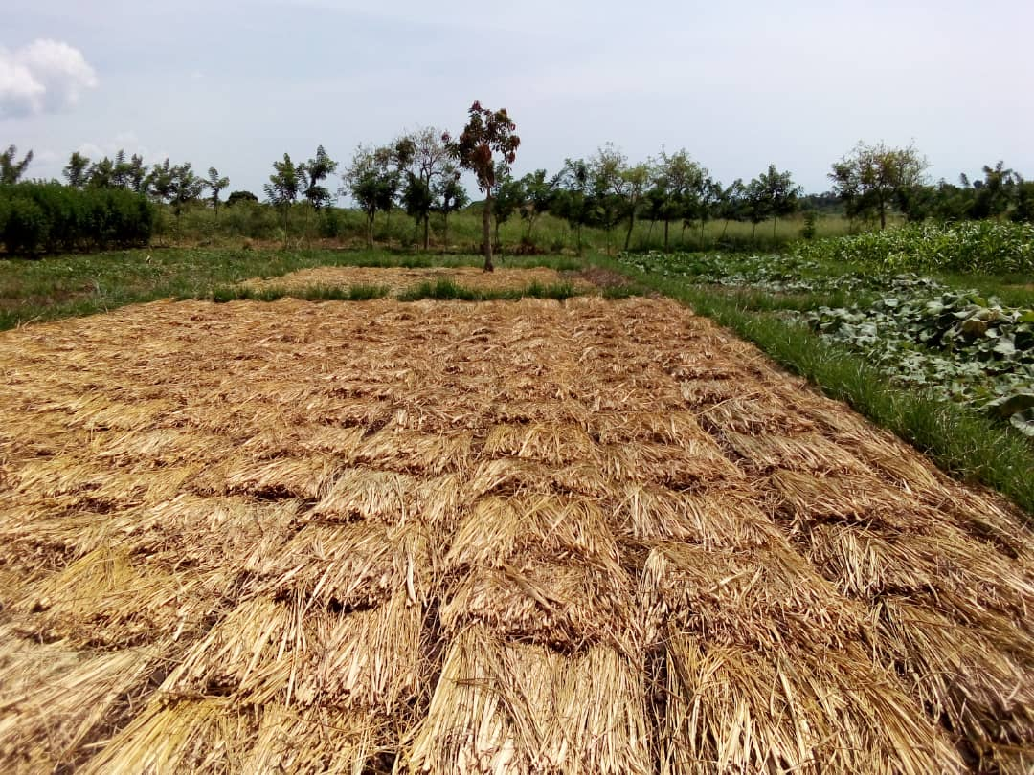
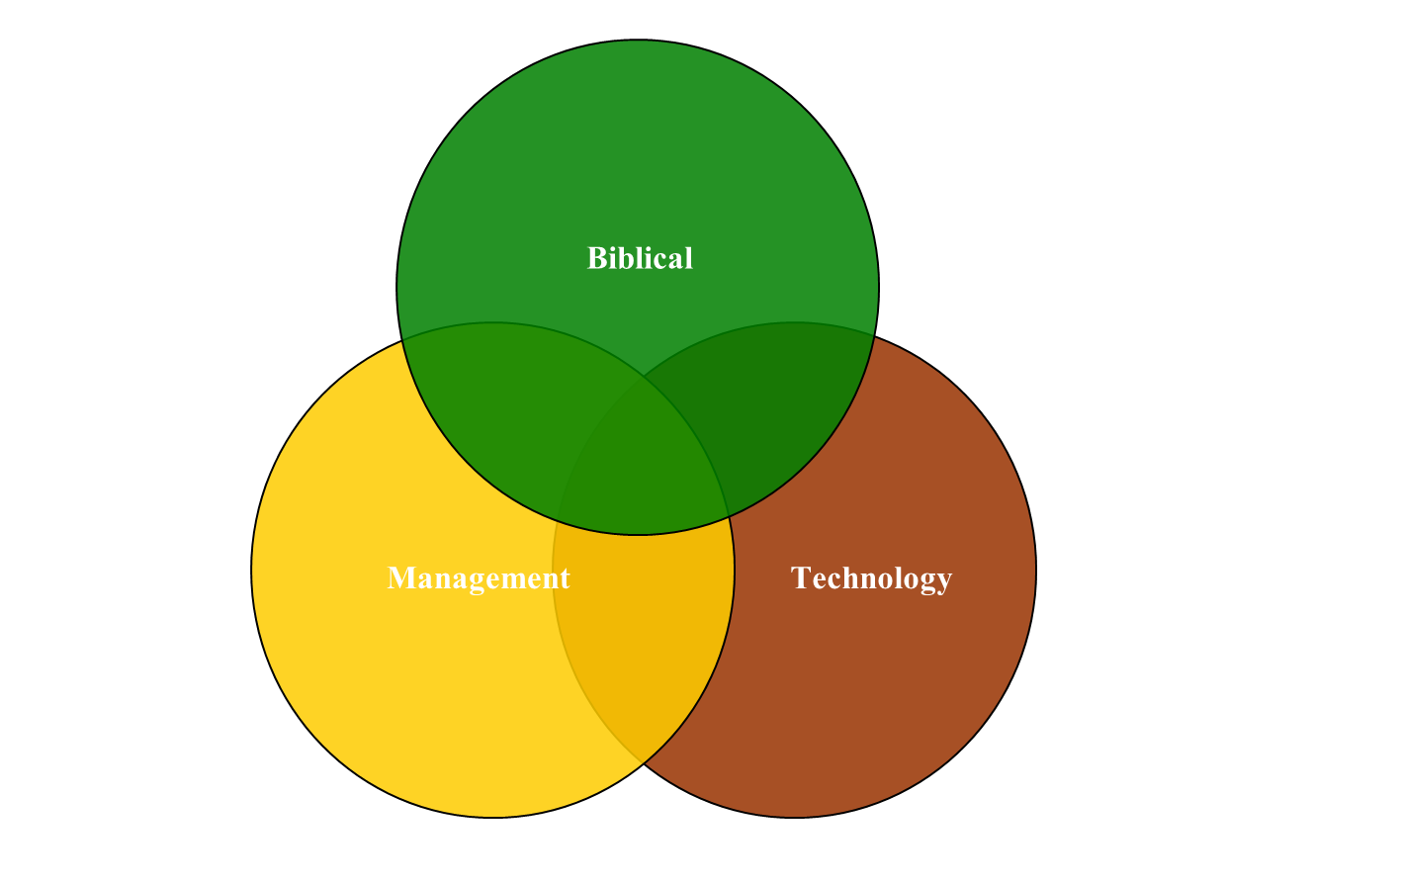
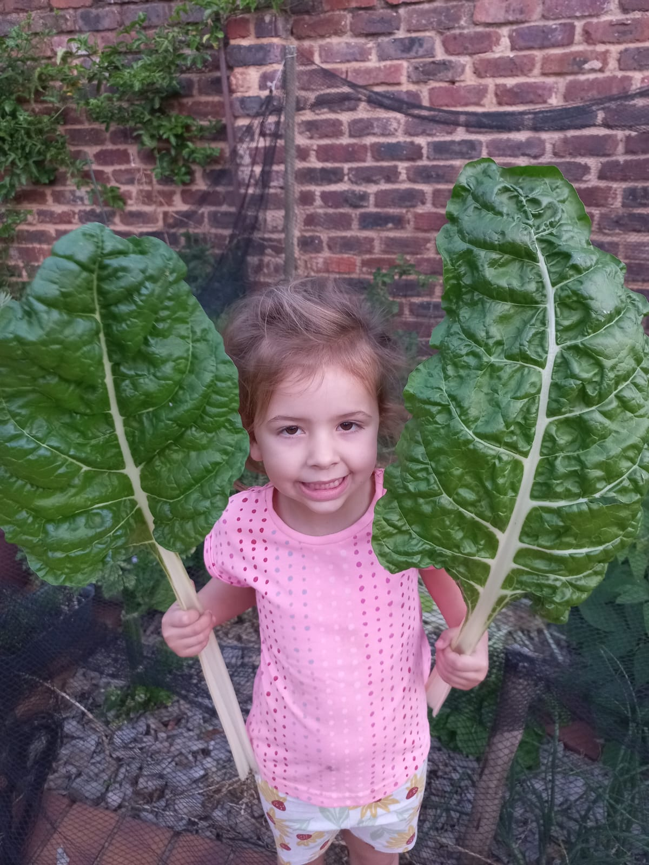
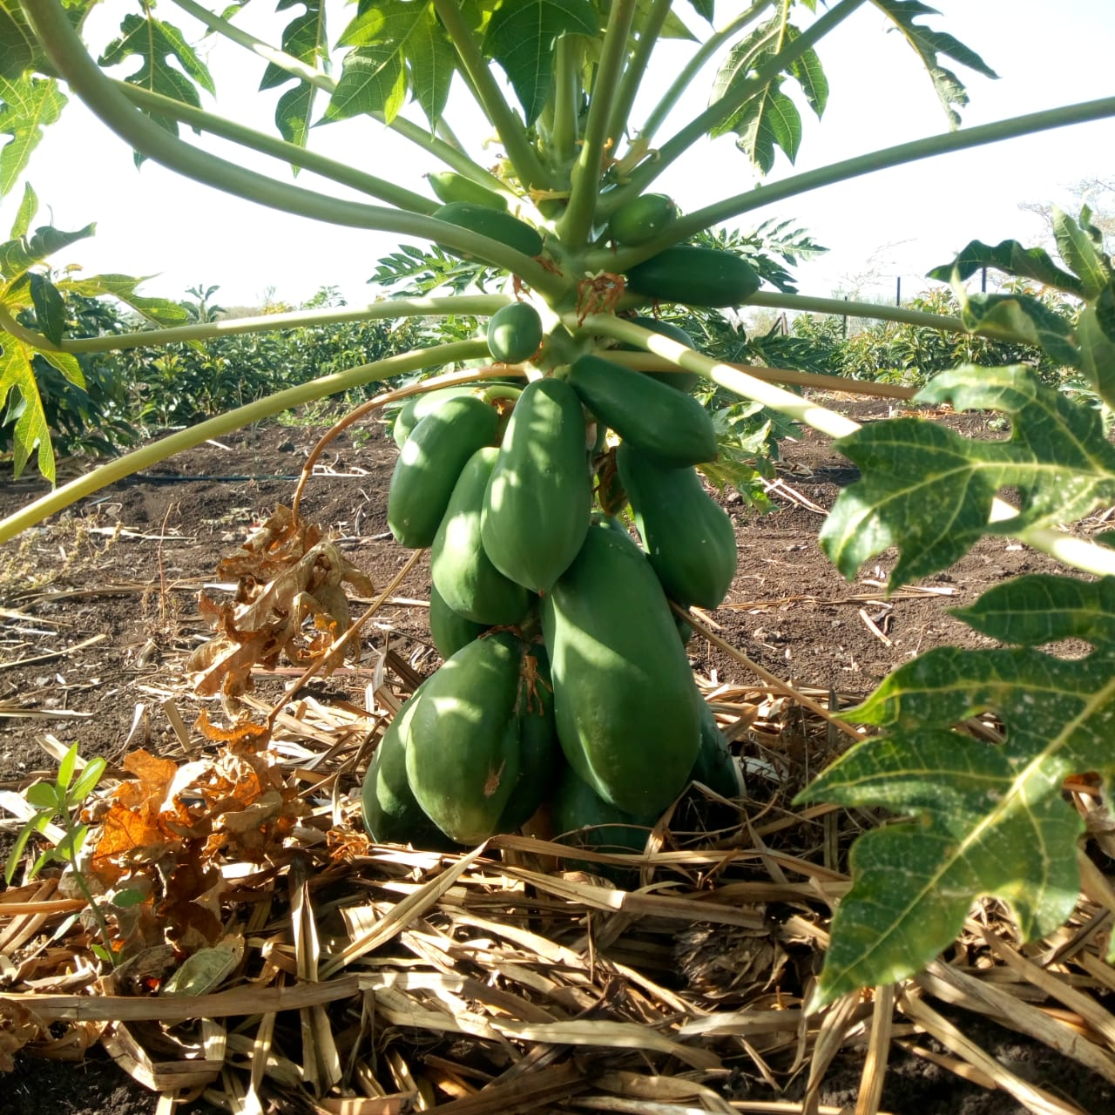
4. RESTORE YOUR FARMLANDS: FARMING GOD’S WAY
Biblical-based approach to sustainable agriculture – currently practised in more than 30 counties

Slide 23
FGW and BIODIVERSITY CONSERVATION
Improves biodiversity in the soil – the range and variety of organisms in the soil
Carbon sequestration – through ensuring organic matter on soil surface
Promotes agro-diversity – encouraging a wide range of crops and livestock on farmlands
Tree Growing - Strong emphasis on integration with indigenous tree species
Exponential increase in crop yields per unit area – hence reduces clearing of forests for agriculture

Slide 24
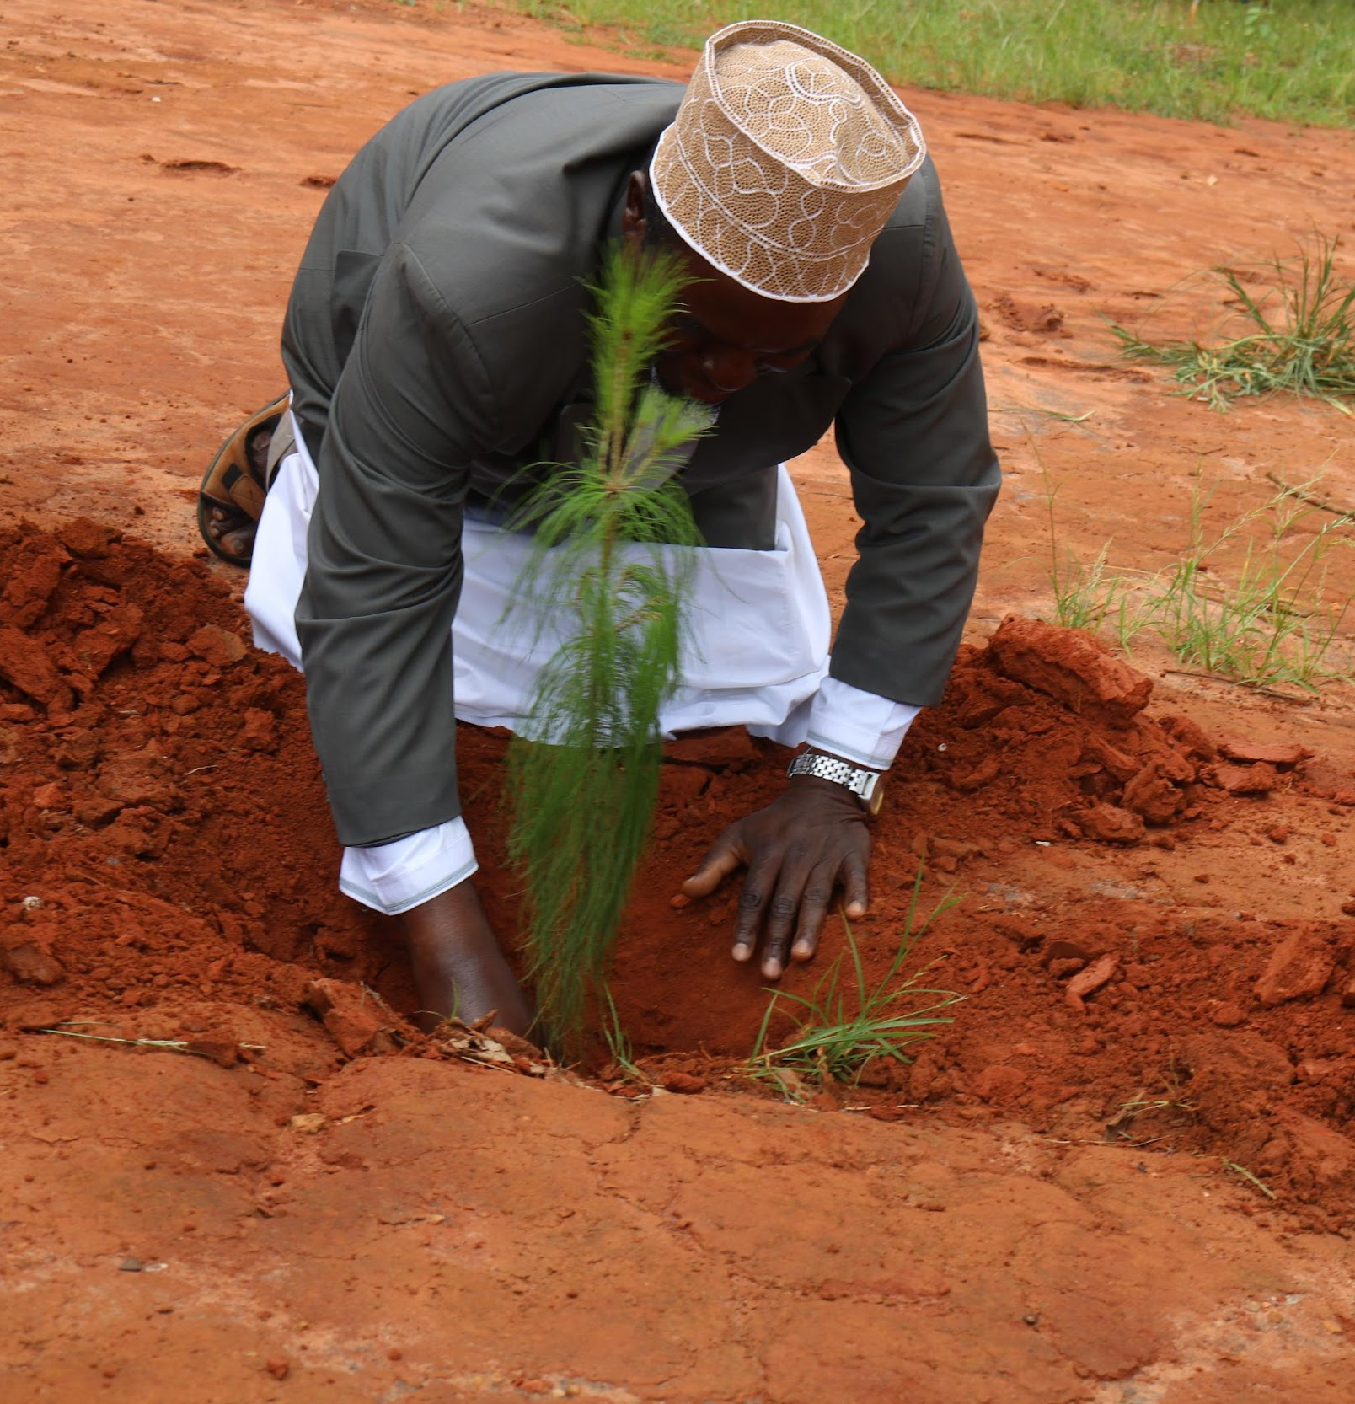
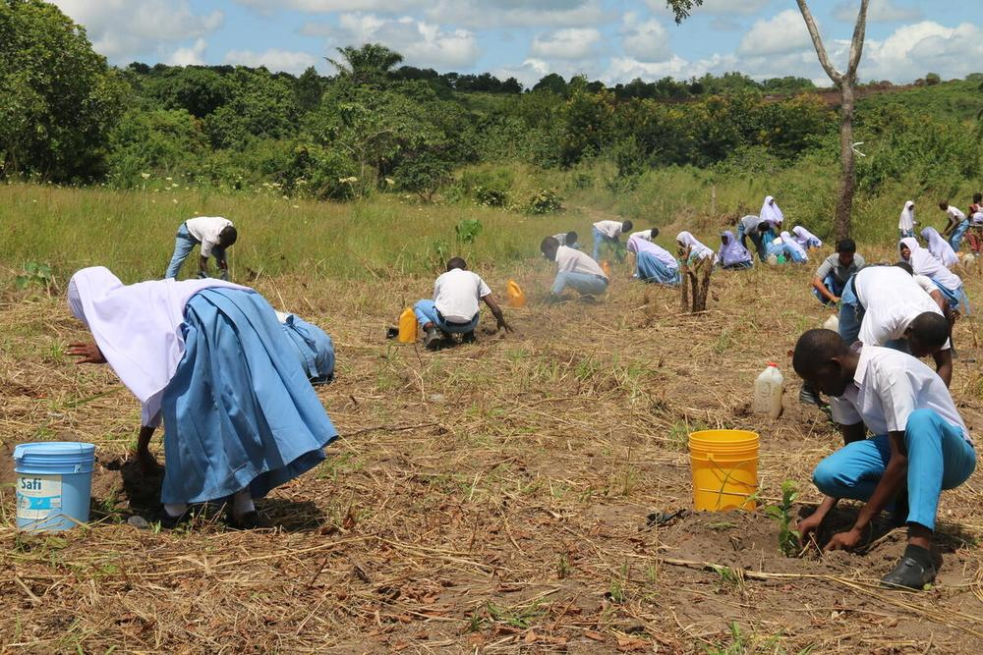
OPPORTUNITIES FOR PARTNERSHIP
EXAMPLE: AFRICA
WWF's Forest Landscape Restoration in Africa initiative aims to support the restoration of 13.5 million hectares of degraded and deforested landscapes across 9 countries by 2027 in a just way that promotes sustainable livelihoods for local people and biodiversity conservation:
Cameroon, DRC, Kenya, Madagascar, Mozambique, Tanzania, Uganda, Zambia and Zimbabwe
Here are some examples of our work with FBOs in Kenya and Tanzania:

Slide 25
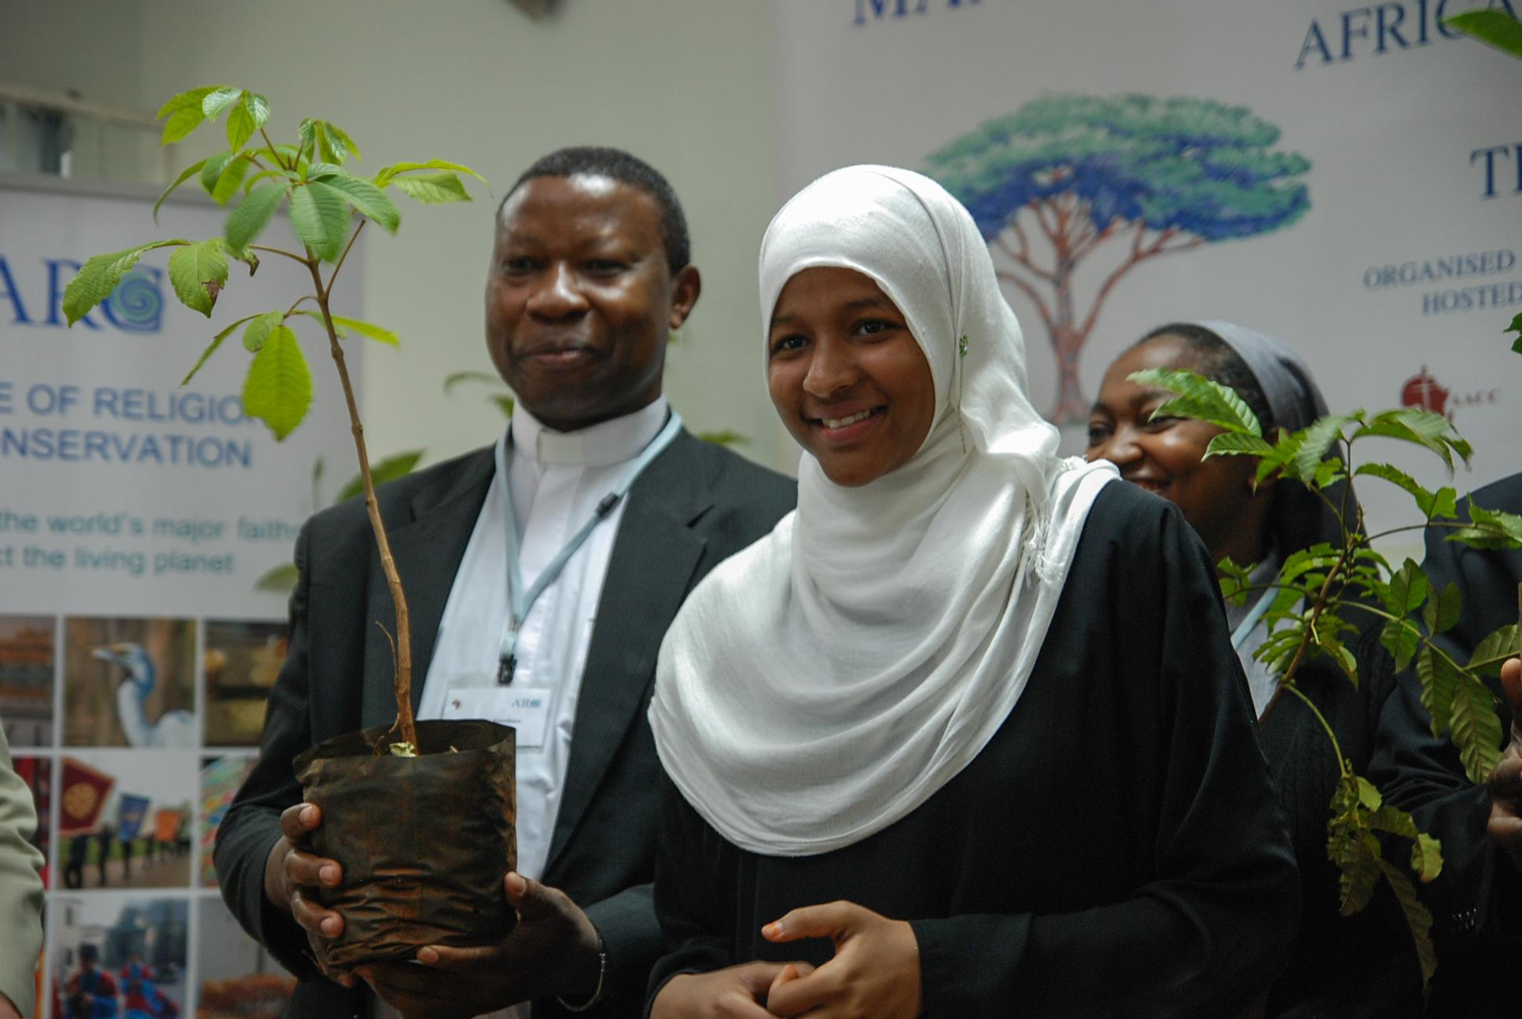
KENYA
FBOs planted 10+ million trees on 7,000+ ha of state and faith land between 2018-2021, with potential to do more
WWF BVP is supporting the first National Faith & Restoration Network of 25 multi-faith organizations, representing 250,000+ people
Also conducting Capacity building trainings on the Guide for tree growing
Establishing landscape-based faith networks and developing restoration action plans in different landscapes
Currently doing resource mobilization for pilot project and scaling to the region
We asked the country’s national clerical council:
Is there a Muslim response to Indonesia’s biodiversity crisis?
© Three Piece Media Production AB

Slide 26
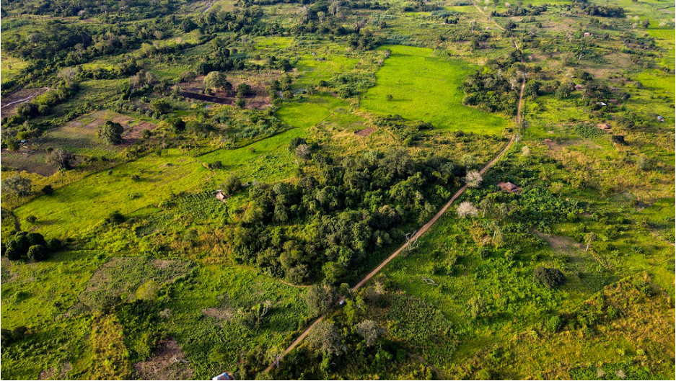
Faith-based restoration in Tanzania
Notes:
Welcome remarks - James or Almas

Slide 27
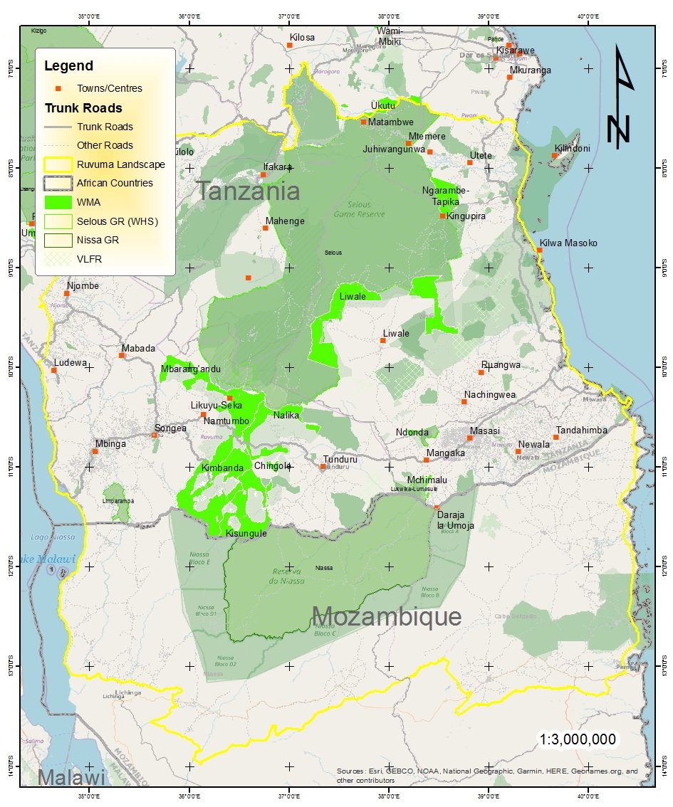
Summary - Ruvuma Landscape Overview
Notes:
It covers an area of 370,000 sq.km extending from southern Tanzania (Ruvuma, Mtwara, Lindi, Morogoro and parts of Pwani regions) to Northern Mozambique (Niassa and Cabo Delgado Provinces). The landscape is characterised by Miombo woodlands with patches of coastal forests, it comprises several protected areas including the famous Selous GR (now divided into Selous and Nyerere National Park which has been defined by UNESCO as a world heritage site) and the Niassa Special Reserve, Mozambique’s largest protected area. The Ruvuma landscape is an important habitat for wildlife as well as a key dispersal areas and corridors connecting numerous WMAs, VLFRs, CFRs and National parks harboring vital and diverse biodiversity such as the big five, the Coastal East Africa Forests, Miombo woodland, riparian vegetation, wetlands, grasslands and mangroves on the sea shores.

Slide 28
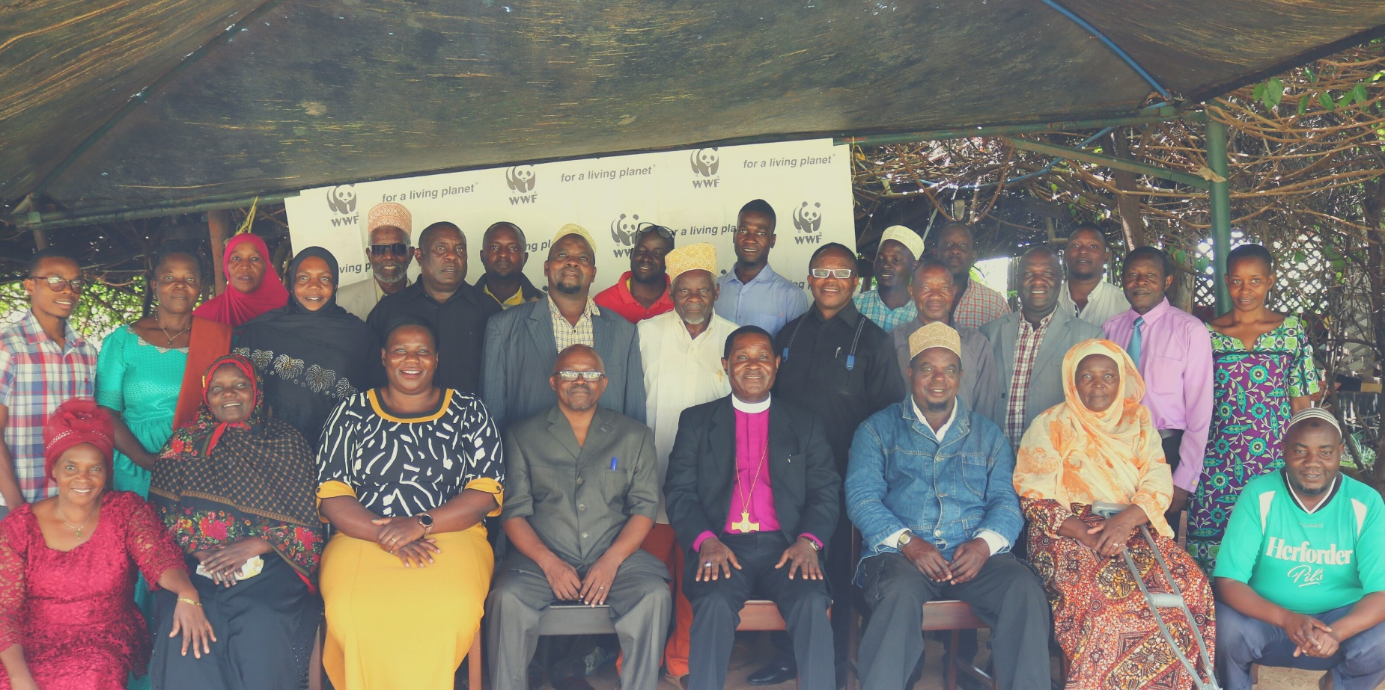
History of Working with FBOs in Tanzania
"We never preach against our sin's on nature, the damage we cause to nature.“
REV LAMECK KAZINZA AFRICA INLAND CHURCH (AIC)
"We act apart, each trying to address environmental issues alone. This meeting is a good beginning to create a common understanding."
FATUMA HAMIS ISLAMIC WOMEN ASSOCIATION
Notes:
Moreover, hundreds of Qur’an and bible verses support the protection of the environment

Slide 29
Steps of this Project
STEP #1
STEP #2
STEP #3
STEP #4
FBOs identify faith lands for tree-growing, prioritizing key watersheds
Faiths begin tree growing according to restoration best practice principles
Support the formation of FBO network for to engage in forest landscape restoration
FBOs raise awareness on restoration in their faith communities in Ruvuma landscape
Notes:
James

Slide 30
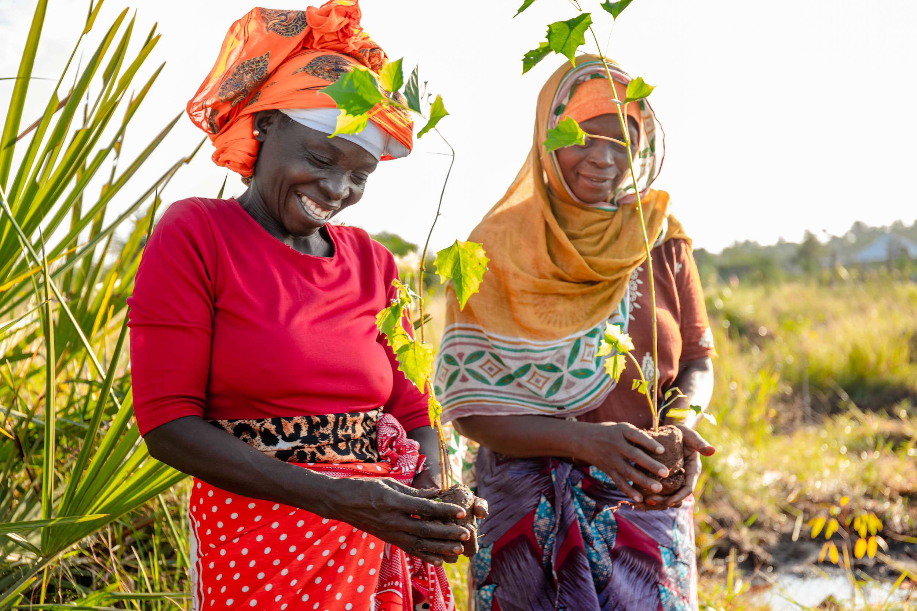
FAITH & RESTORATION: 2030 VISION
By 2030, faiths are contributing in meaningful ways to the goals of the Global Biodiversity Framework through on the ground action in important biodiversity areas by:
Restoring thousands of hectares of land that faiths own and influence
Galvanising faith networks and populations for tree growing
Practicing sustainable, faith-based agriculture
Sensitizing the faithful on the relationship between faith beliefs and values, and the protection & restoration of nature
Demonstrating impact in pilot projects for People, Nature & Climate
Sharing faith & restoration stories and experiences with the world
Connecting with policymakers to include faith voices on restoration approaches and policies

Slide 31
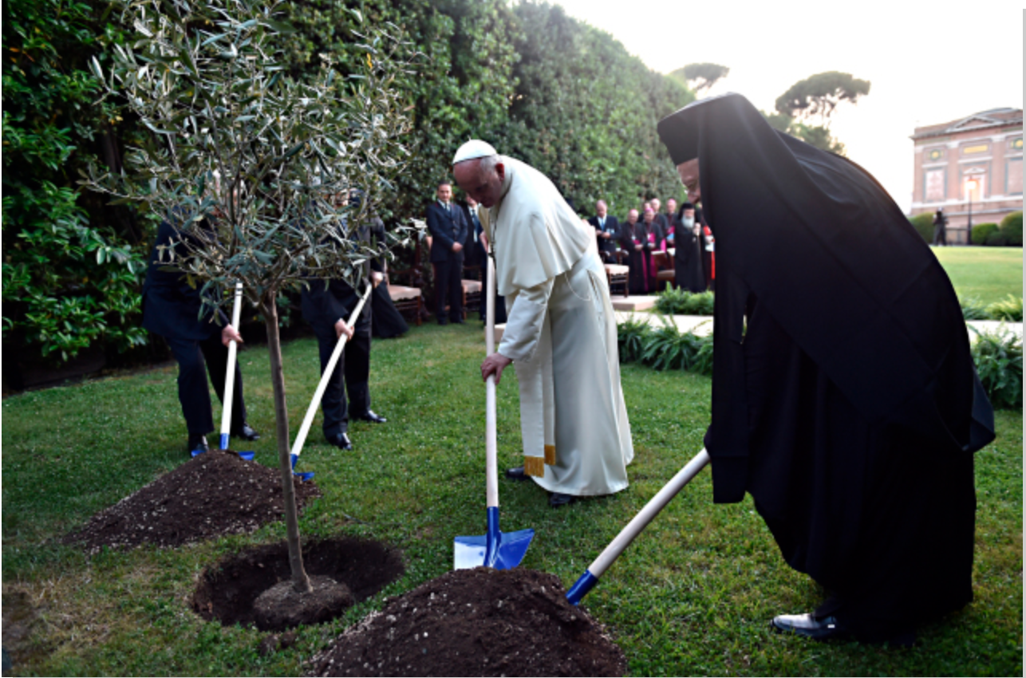
DISCUSSION:
What Resources & Networks might your group have that can be mobilized for biodiversity conservation?
Please do get in touch:
celkin@wwf.org.uk
tombarasawafula892@hotmail.com

