Slide 1
CISU Fagligt netværk: Sport, kunst og kultur for udvikling Netværksmøde 31. maj 2023
Kunst og kultur som rum for kritisk refleksion, engagement og kraft til forandring
Elsebeth Krogh

Slide 2
Dagsorden for netværksmødet
Introduktion
Formål med mødet i dag
Hvorfor har kunst og kultur en særlig forandringskraft?
Erfaringer fra Center for Kultur og Udvikling
Erfaringer fra jeres organisationer
Diskussion og anbefalinger
Sport, kunst og kultur for udvikling

Slide 3
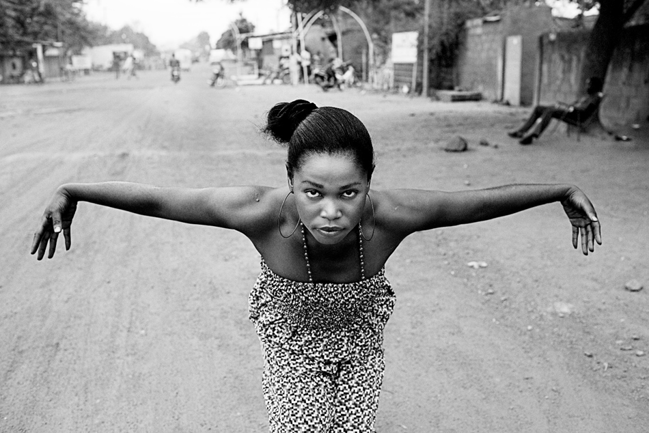
The right to art And culture: Experiences from Denmark’s Strategic approach to culture and development
Notes:
WHAT?
PROCES of DRAFTING STRATEGY
Danish support to art and culture is:
Human rights based
An element in overall Danish development cooperation
Fully supported by the Danish government
Thematically focused
Based on the UNESCO 2005 Convention
Drafting the strategy – initial considerations
Culture and development considered important by MFA/embassies as an instrument in public diplomacy
MFA’s decision to adopt a strategic approach
Centralising the funds from country-based embassy grants into a separate budget line on the national budget
Strengthening CKU capacity
Previous strategy had expired
Drafting the strategy – the process
CKU offered to assist the MFA in drafting a new strategy
ToR developed
MFA steering group established – high level managers + embassies from 3 continents + ministry of culture
CKU appointed as secretariat for the process
Funds allocated for consultancy assistance
Strategy based on previous experience and “a reading of state of the art” through consultations with experts and practitioners worldwide
Workshop Nov 2012: stakeholders/participants, methodology, outcome – EKSEMPLER, CITATER
Several drafts distributed to stakeholders for comments
Minister for Development + Approval in Parliament

Slide 4
‘the right to art and culture’ danish strategY for support to culture and development (2013)
strategic priorities:
# Empowering people through active participation in art and cultural activities
# Ensuring freedom of expression for artists and cultural actors
# Enhancing economic growth through creative industries
# Strengthening peace and reconciliation in post-conflict areas through art and cultural activities
# Promoting intercultural dialogue and intercultural collaboration.
Notes:
WHAT?
The strategy:

Slide 5
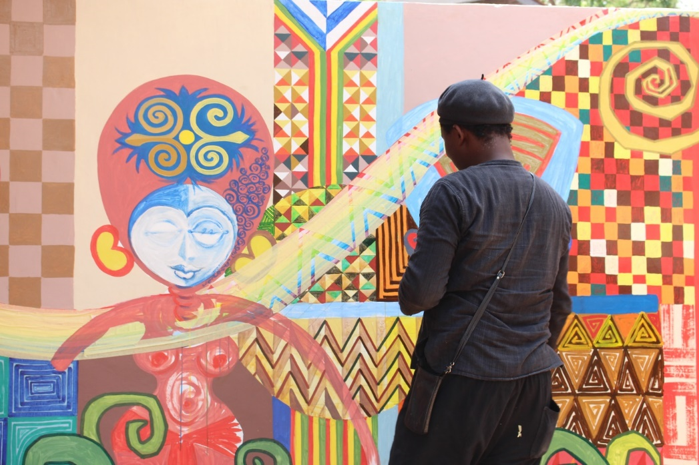
ART and culture in development cooperation 14 countries 4 regions embassies Local staff local partners
“A dynamic cultural life is a central element in an independent civil society. Art and culture give rise to critical reflections and engagement and are an important part of the development of modern, democratic societies.” Christian Friis Bach Former Danish Minister for Development Cooperation
Notes:
HOW?
Programmes and projects in 14 countries –
We are collaborating closely with embassies and representations: in order to ensure synergy with existing development intervention and
We have local programme officers in all countries that ensure the day-to-day dialogue with partners
Local partners: long-term partnerships (minimum 3-6 years of collaboration)

Slide 6
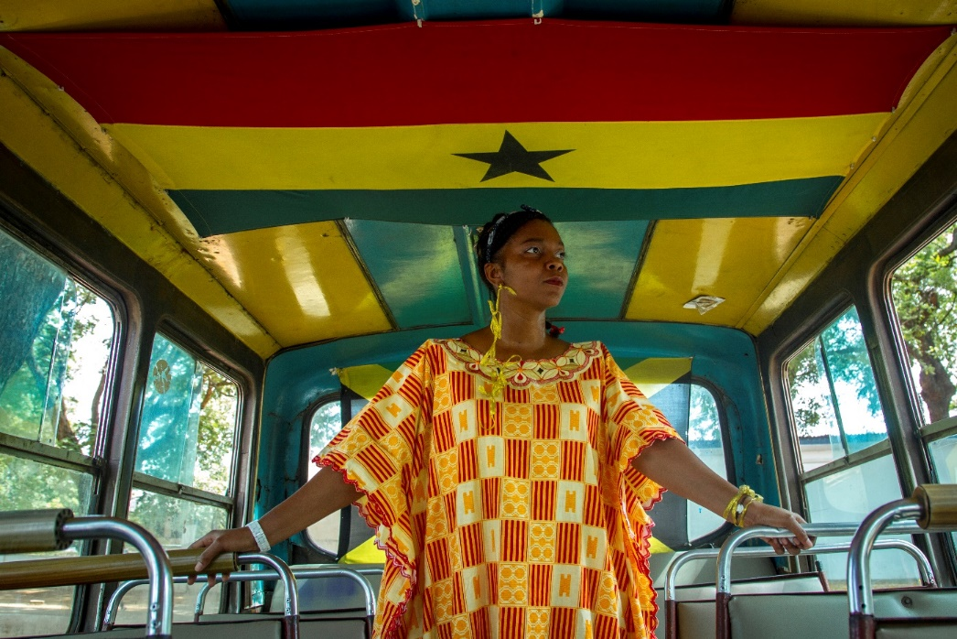
culture and development programmes human rights analysis culture sector overview partner/donor mapping consultations/dialogue partner assessment planning/implementation
“Denmark’s development engagement is based on partnerships with actors who can and wish to create change. The cooperation involves implementing concrete programmes as well as developing new and better methods..”
DANIDA, Danish Development Cooperation
Notes:
Programmes are formulated based on:
Analysis including human rights analysis and needs assessment made by in-country consultants
Previous experience
Extensive consultations with key players, beneficiaries and stakeholders
Assessment of and dialogue with local implementing partners on contextual needs and resources
Long-term activity planning
Six-year timespan
Solid theory of change
Clear strategic direction
Strong focus on results and impact

Slide 7
Hvorfor har kunst og kultur en særlig forandringskraft? Erfaringer fra CKU
OVERORDNEDE ERFARINGER:
Kunst og kultur har vist sig at være et vigtigt redskab i komplekse udviklings- og konfliktsituationer
Kunst og kultur skaber nye perspektiver, alternative og stærke lokalsamfund og ukonventionelle indkomstmuligheder
Kunst og kulturs fokus på at skabe ”safe spaces” og aktiviteter, hvor folk kan udfolde deres kreative talent, styrker deres organisering og mod på at deltage demokratisk og skabe forandring i deres samfund.
Sport, kunst og kultur for udvikling

Slide 8
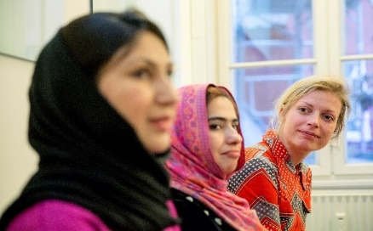
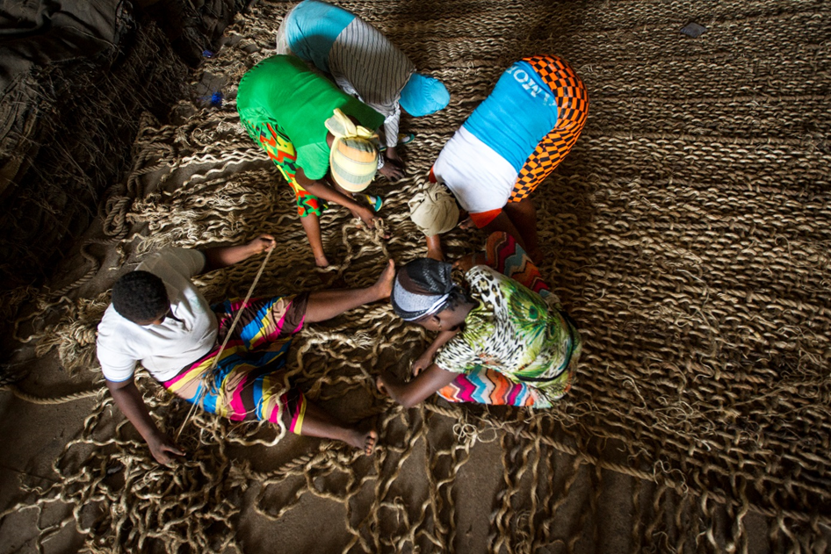
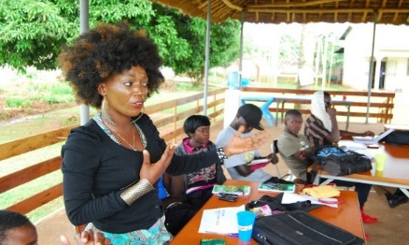
The cku approach
Intercultural collaboration as leverage for inclusive processes, mutuality, co-creation, synergies
Culture in mainstream of development, thorough in-country analysis and consultation, theory of change, change stories
Rights-based approach, strong value base, negotiated partnerships, local ownership

Slide 9
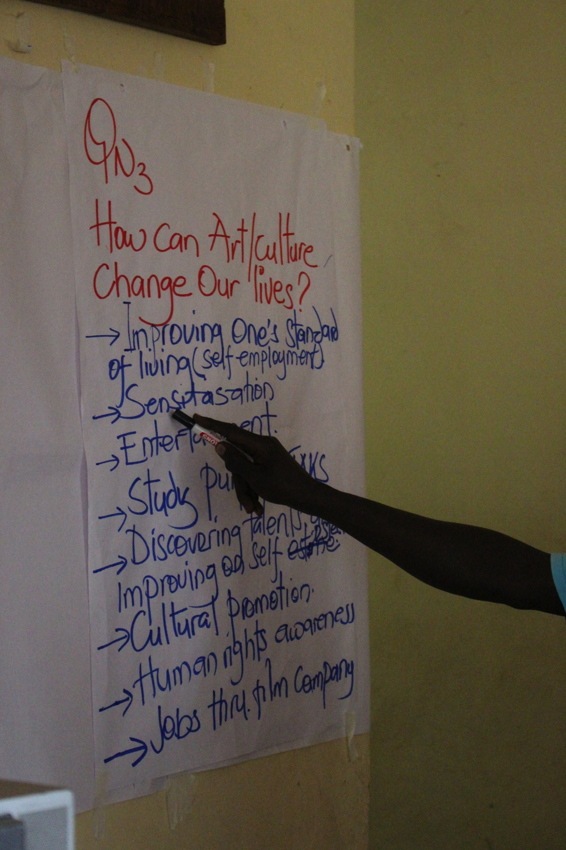
Art and culture contribute to development
Several links between strategic priorities:
Participation in cultural activities is strengthening the voice and creative expressions of disadvantaged groups
Encouraging participants to become active contributors to social and economic development
Enhancing social cohesion through processes of group based artistic production
Improving skill levels to increase job opportunities
Job creation contributes to sustain peace in post-conflict societies
Notes:
Cases: Uganda film and performing arts workshops – small scale business opportunities: entertainment for weddings

Slide 10
CKU’S ERFARINGER: EMPOWERMENT OG SAMMENHÆNGSKRAFT
Sårbare unge i konfliktområder i Uganda og Nepal deltager i poetry slam eller rapmusik– de har valgt et positivt alternativ til ekstremisme og isolation;
Intet demokrati uden litteratur: Femrite i Nord-Uganda arrangerer læse- og skriveklubber for unge og skaber interesse for samfundet;
Gadekunstnere dekorerer Nepals mure med portrætter af nationale helte;
Unge kenyanere holder spoken word events med poesi om realiteterne i samfundet og styrker den demokratiske deltagelse.
Creation Out of Crisis/Mellemøsten: Cirkus-skole giver nye uligheder for unge i flygtningelejre, og kunstnerkollektiver skaber gennem satire alternativer til magtens narrativ.
Sport, kunst og kultur for udvikling

Slide 11
CKU’S ERFARINGER: YTRINGSFRIHED
Kunstneres ytringsfrihed ofte knægtet med vold og drab i regimer styret af udemokratiske kræfter;
CKU har støttet syriske kunstneres netværk, dokumentation, publikationer, udstillinger og netværk med danske kunstnere;
Sammen med CKU har den danske ambassade i Vietnam i en årrække støttet kunstneres ytringsfrihed – hvilket har styrket deres civile rettigheder og den demokratiske proces;
Images 16 præsenterede visuel kunst fra Afrika, Asien og Mellemøsten med fokus på kunstnerens rolle i samfundet.
Sport, kunst og kultur for udvikling

Slide 12
>> Images 2016, denmark intercultural collaboration intercultural dialogue art exhibitions art labs residencies education audience/institution development
21 Danish cultural institutions 8 international art institutions 10 international Curators 5 Danish regions 20 exhibitions of Visual ART from Africa, Asia and the middle east
Images youth with schools in 15 municipalities
Celebration of images’ 25 years anniversary
Notes:
Stronger synergy between CKU’s international engagement and the activities in Denmark.
More focus on long-term partnership development.
Inviting non-Western perspectives on art and culture for increased understanding and enrichment of our work (curators)
Strengthening our knowledge base to ensure continued relevance of our work.
Focus on visual arts and culture.
Ade Darmawan – Indonesia
Artist, curator and director of the artist collective Ruangrupa
Artistic director of the Jarakta Biennale
Sarah Rifky – Egypt
Curatorial agent at dOCUMENTA (13)
Co-creator of CIRCA – Cairo International Resource Center for Art
N’Goné Fall – Senegal
Architect, art critic and curator
Former director at the Dakar biennale

Slide 13
CKU’S ERFARINGER: KREATIVE INDUSTRIER
Kreative og kulturelle industrier har potentiale til at inkludere unge i økonomisk vækst, bidrage til socio-økonomisk udvikling, forebygge konflikter og styrke dialog, realisere kulturel diversitet på verdensmarkedet, øge den kulturelle selvbevidsthed og stolthed;
Design Network Africa (DNA) med kunstnere fra Mali, Kenya, Burkina Faso, Sydafrika, Zimbabwe m.fl. opnåede stor succes på internationale platforme efter at have fået støtte fra CKU; flere hundrede jobs blev skabt og indkomst forøget;
Støtte til Ugandas dynamiske hip-hop-industri viste alternative indkomster til unge og en vej ud af arbejdsløshed – Newz Beat – nyhedskanal for unge – blev startet af en rapper Lady Slyke…
Støtte til musik- og filmindustrien i Tanzania har ført til, at den nu indregnes i det nationale budget.
Sport, kunst og kultur for udvikling

Slide 14
The potential of Creative and Cultural industries?
Creative and cultural industries are:
Emerging in growth economies
Influenced by growth in other sectors
Providing alternative income opportunities
Recognised politically as a bridge to trade and tourism
Creative and cultural industries hold the potential to:
Include young people in economic growth
Contribute to socio-economic development
Prevent conflicts and increase dialogue
Realise cultural diversity on the world market for cultural products
Enhance cultural self-esteem through identification in cultural products.
Notes:
afghanistan

Slide 15
CKU’S ERFARINGER: FRED OG FORSONING
CKU har støttet kulturelle aktiviteter i kølvandet på konflikter, krige og borgerkrige i Sydsudan, Jordan, Uganda, nepal, Palæstina, Pakistan, Indonesien, Afghanistan;
Befolkninger mærket efter konflikt har brug for at bearbejde traumer og genopbygge tillid;
CKU har udgivet publikation om The Contribution of Art and Culture in Peace and Reconciliation Processes in Asia.
Sport, kunst og kultur for udvikling

Slide 16
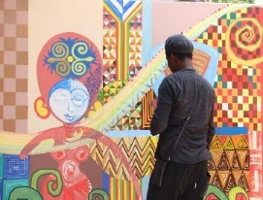
The future of culture and development ?
DISTURBING TRENDS
World more complex- stable countries becoming fragile – increased need for conflict prevention and rebuilding societies after conflict and disaster – massive migration and forced displacement - radicalisation
Changing attitudes towards human rights – internationally endorsed values and frameworks under threat
Manoeuvring space for civil society reducing due to political repression in many countries
A number of European countries have reduced the development budget including support to culture and development
HOPES FOR THE FUTURE: It seems that Denmark’s work has been of inspiration:
EU has incorporated culture in new development policy
UNESCO is promoting the Danish approach
German GIZ with Goethe Institute: Cultural and creative industries as a driver of employment – support for women in a future-oriented sector in Africa & Middle East
Sweden: The Swedish Arts Council has launched a new programme to strengthen artistic freedom globally during a three-year period through SIDA (2021-2023).
Switzerland strengthens the role of arts and culture in development cooperation (Strategy 2021-2024)
France: The European Cultural Network for Development Cooperation

Slide 17
https://www.roskilde-festival.dk/da/years/2023/news/react-sound-and-voice/

Slide 18
UGANDA YOUTH: Rap-orters
https://www.google.dk/url?sa=t&rct=j&q=&esrc=s&source=web&cd=&cad=rja&uact=8&ved=2ahUKEwjzmu3P4pz_AhXmVvEDHegODF0QtwJ6BAg0EAI&url=https%3A%2F%2Fwww.youtube.com%2Fwatch%3Fv%3DmNY-koFCtGM&usg=AOvVaw0Kc-VuHoQzCD9MkNU9c-m-
https://www.roskilde-festival.dk/da/years/2023/news/react-sound-and-voice/
Sport, kunst og kultur for udvikling

Slide 19
Hvorfor har kunst og kultur en særlig forandringskraft? Erfaringer fra jeres organisationer
Diskussion og anbefalinger
Sport, kunst og kultur for udvikling

