Slide 1
VISIT WWW.INNOVISOR.COM AND FOLLOW ON
ORGANIZATIONAL NETWORK ANALYSIS
JEPPE VILSTRUP HANSGAARD, CEO – JEPPE.HANSGAARD@INNOVISOR.COM

Slide 2
EVERY DAY IN ANY ORGANIZATION…
Could you…
But she…
Wonder what it means…
I think..
How do you…
Can we…
What if…
It is just…
Do you…?
Notes:
At the water cooler, copy machine… in the lunch break… or at a corporate event like the one you are holding today!
Where people talk about their kids, new movies, a show on national television, their favorite sports team…. Or whatever is close to their heart
They seek out likeminded people with whom they share interests and passions.
Some people would like their employees to skip that and get on with the real work… I think it is much more important than that

Slide 3
… SOME HAVE MORE IMPACT THAN OTHERS
Could you…
But she…
Wonder what it means…
I think..
How do you…
Can we…
What if…
It is just…
Do you…?
Notes:
At the water cooler, copy machine,

Slide 4
WHO ARE THE THOSE PEOPLE?
THEY ARE EMPLOYEES THAT COLLEAGUES GO TO, IF THEY HAVE QUESTIONS OR CONCERNS AND WHOSE OPINION THEY TRUST.
THEY HAVE THE INFORMAL POWER TO EITHER IGNITE OR BLOCK CHANGES.
THEY ARE OFTEN SURROUNDED BY COMMUNITIES

Slide 5
CASE – TECHNOLOGY COMPANY
THE CENTRALLY IDENTIFIED ‘experts’ were LOCATED IN THE REGIONAL HEADQUARTERS
Nottingham – an office with only 30 people - was home to the #1 expert, if ASKING THE “Wisdom of the Crowd”
12,000 EMPLOYEES IN 188 LOCATIONS

Slide 6
HOW DO WE FIND
THE KEY PEOPLE?
HOW DO YOU GAIN INFLUENCE AND DEVELOP TRUST?
Notes:
Can you find them on YAMMER?
Talk about the 1-9-90 rule…
Draw two people – what can keep them from interacting? List on flipchart
Primary barriers: Hierarchy, Geography, Function and Tenure
Accept KEY PEOPLE EXIST WITHIN MICRO COMMUNITIES!!!
So what connects?
FUN FACT: To be trustworthy a key parameter is that you can feel guilty… https://qz.com/work/1373603/how-can-you-tell-who-to-trust-psychologists-have-a-surprising-answer/

Slide 7
ORGANIZATIONAL NETWORK ANALYSIS ILLUMINATES
THE ORGANIZATIONAL CHART
THE REAL ORGANIZATION
CEO
Notes:
Explain visual
Top-down and Bottom-up… Explain the distance from the CEO to the white ‘silo’.
How does that impact the message? – Explain the Pharma Community with the person sitting in Kuala Lumpur needing help.
If you know: Draw the 2 x 2 with Formal vs Informal and Structured vs Unstructured

Slide 8
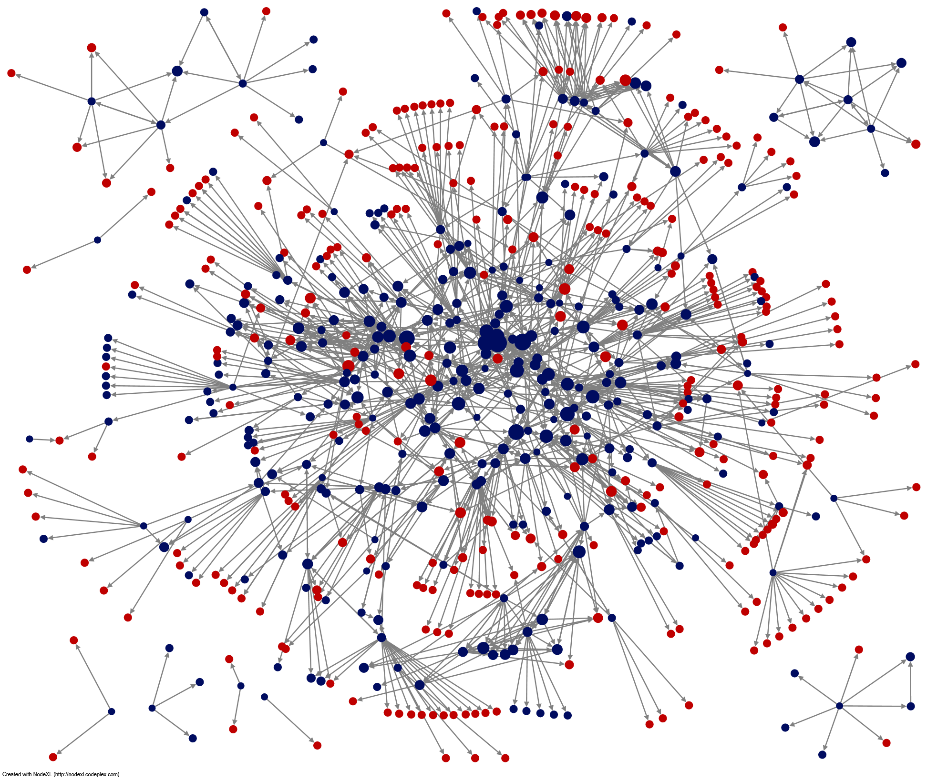
CASE – COMMUNITY IN MANUFACTURING COMPANY
50% WAS UNKNOWN
Notes:
Red were unknown…
You cannot see your community from your ivory tower, because you cannot see, who people trust…

Slide 9
CASE – TRANSFORMING A COMMUNITY INTO ONE 1/2
Notes:
Risky set-up → Bus KPI
What does ONE mean?

Slide 10
CASE – TRANSFORMING A COMMUNITY INTO ONE 2/2
Notes:
CoE transformed being the experts to being humble & supportive and asking for help.
Explain why asking for help is so important!

Slide 11
Notes:
Sum up key takeaways from flipcharts – after taking questions ☺

