Slide 1


Innovations in Learning
@AcademyHum
humanitarianleadershipacademy.org
humanitarianleadershipacademy.org/innovation

Slide 2
Technology
Learning
Social Impact
Atish Gonsalves
Global Innovation Director,
Humanitarian Leadership Academy
Founder,
Gamoteca
@atishgonsalves
a.gonsalves@Humanitarian.Academy

Slide 3
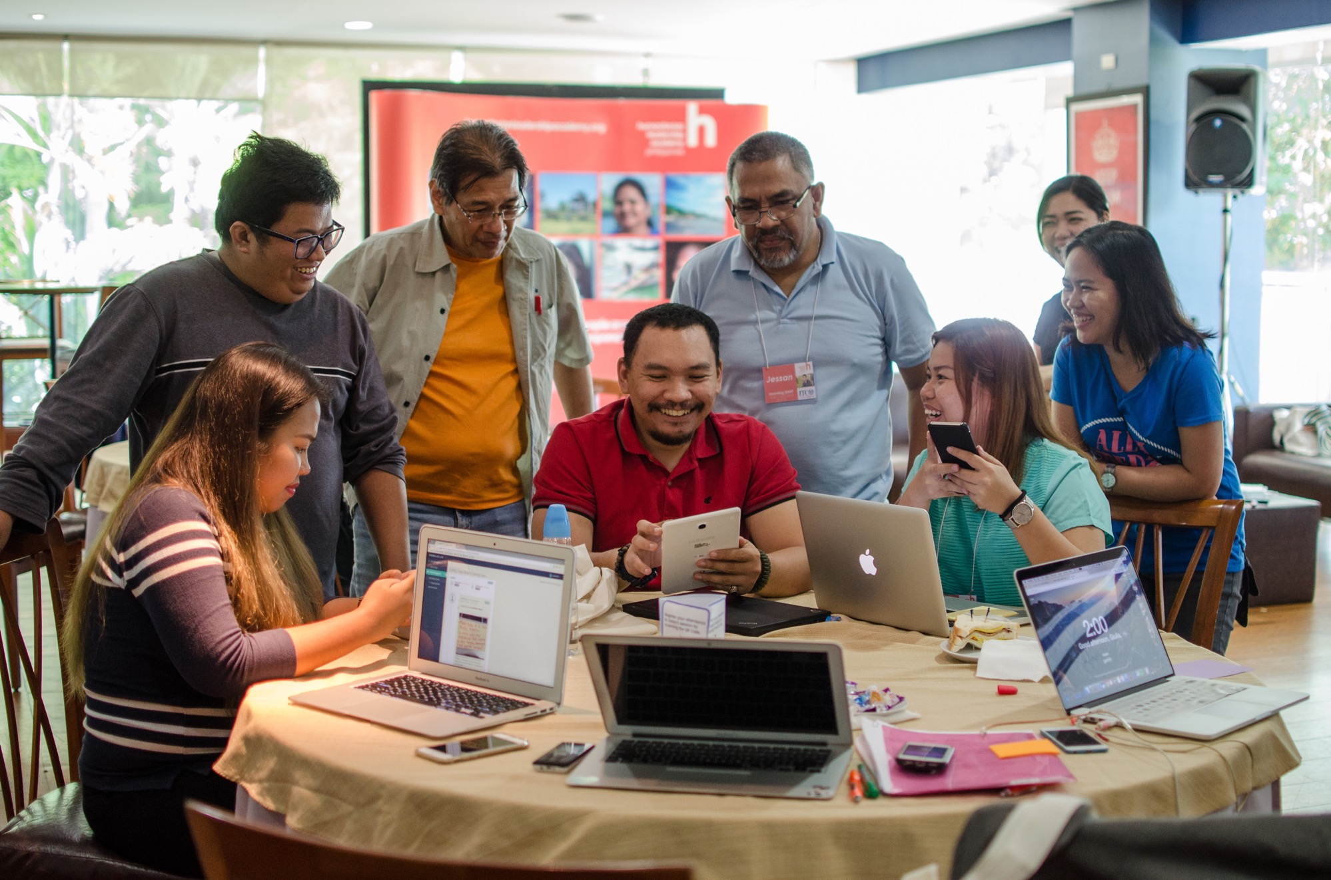
Our mission
To enable people around the world to prepare for and respond to crises in their own countries.
Our challenge
How do we co-create & share learning that is engaging, scalable and impactful?

Slide 4
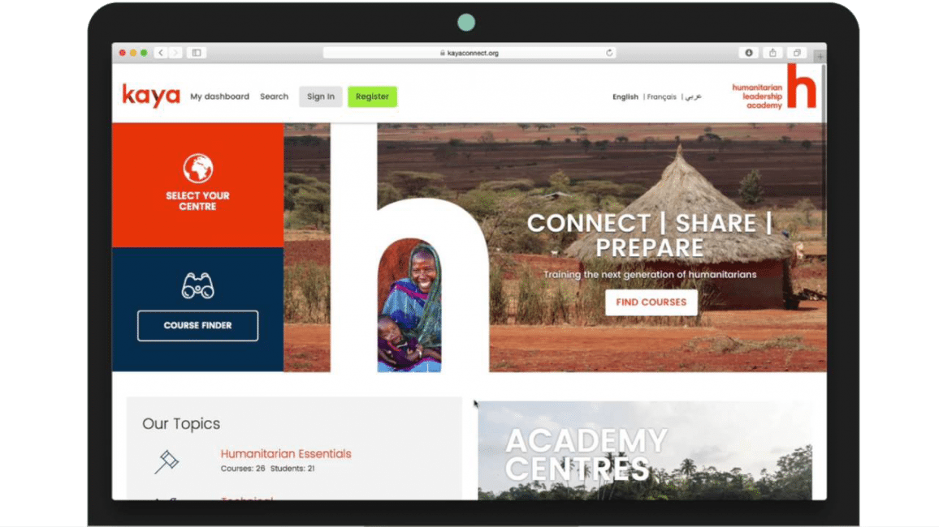
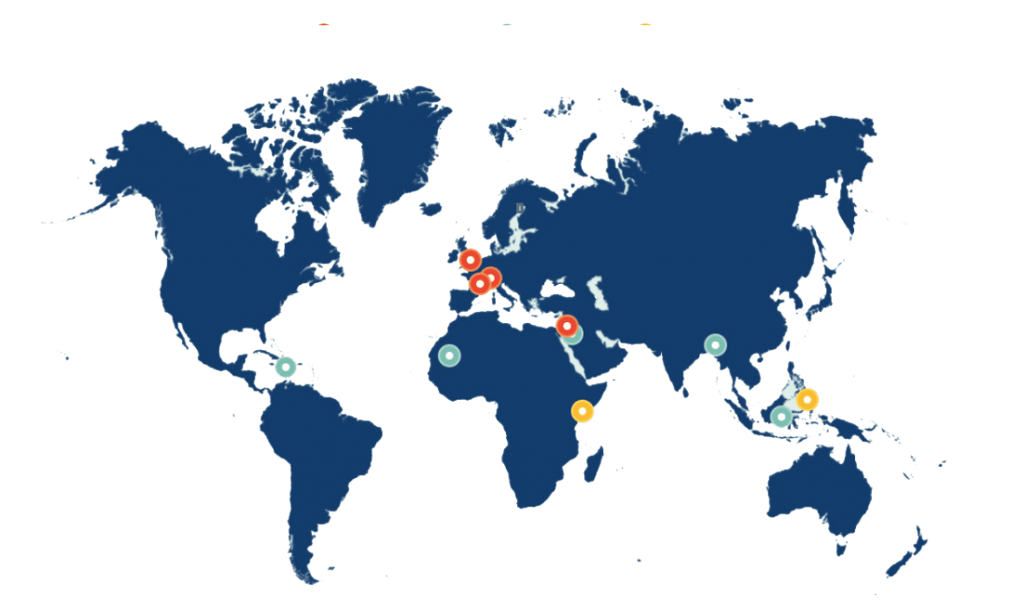
How we work
    A global marketplace of learning, Kaya, making learning accessible to everyone: KayaConnect.org
    A network of local partners creating and sharing relevant learning
Notes:
Combination of digital platform and local partners

Slide 5

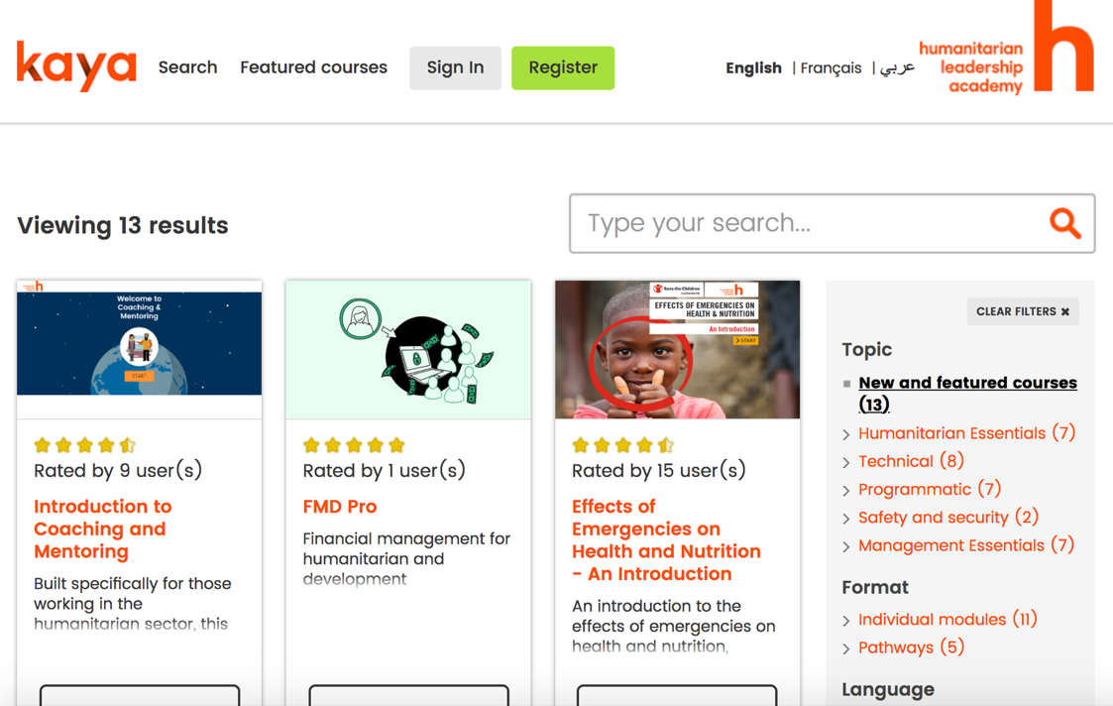
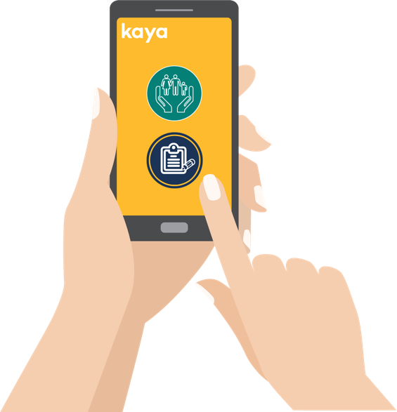
Our eLearning platform
    Launched in May 2016, we have 120,000+ learners and growing
    23% of users from very fragile states in crisis and 26% are from countries hosting large populations of refugees. Top 10 countries: Kenya, Philippines, Syria, Nigeria, UK, US, Yemen, Iraq, Uganda, Bangladesh
    400+ free online courses, in up to 10 languages
    Six learning portals with the following partner organisations: Norwegian Refugee Council (NRC), International Rescue Committee (IRC), War Child, Save the Children UK, the Cash Learning Partnership (CaLP) and Voluntary Service Overseas (VSO)

Slide 6
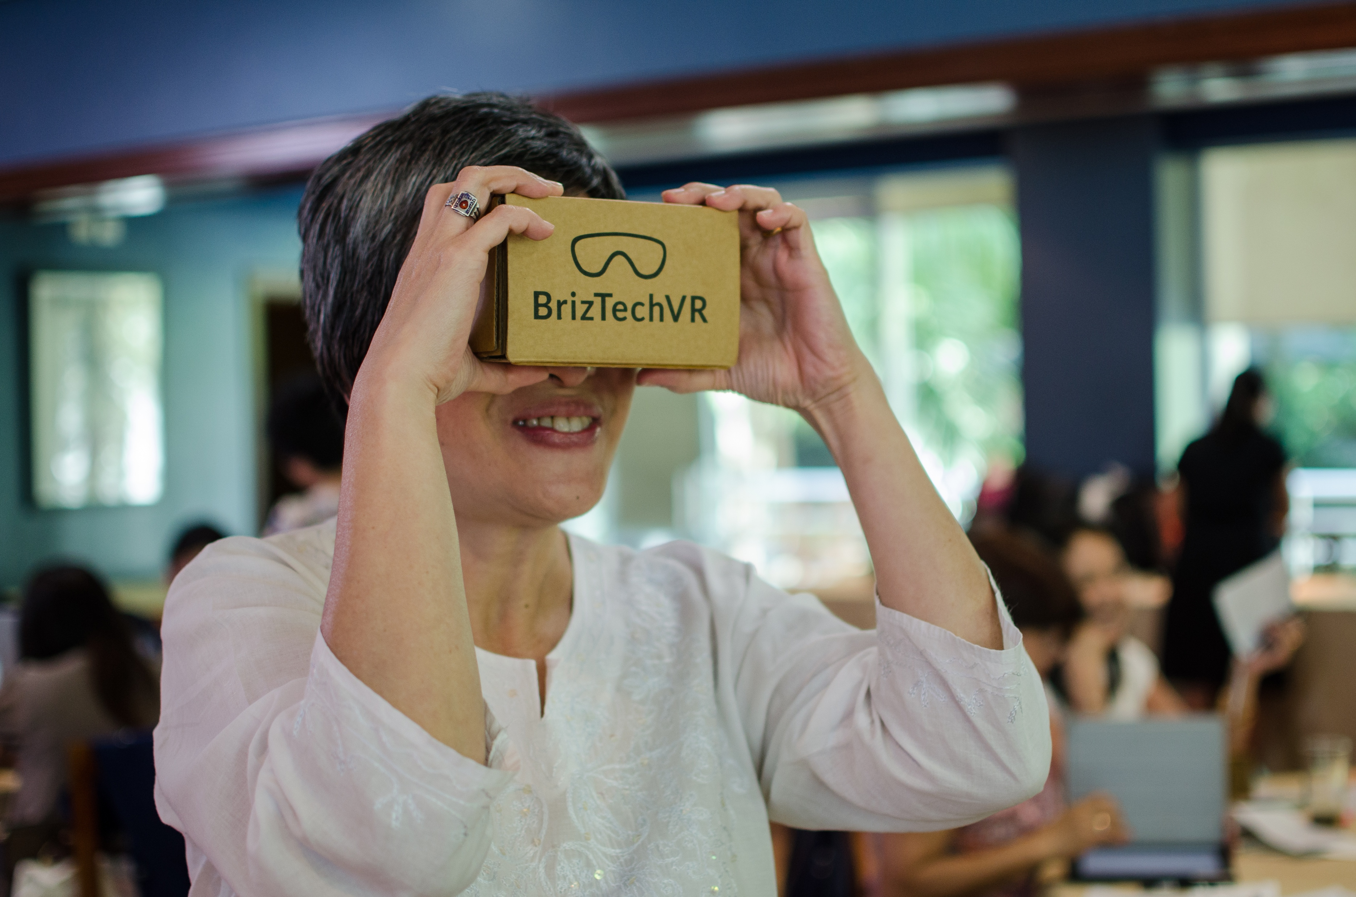
Learning Innovation Lab @ Academy
    Delinks innovation risk – Allows the Academy to test/experiment with innovative projects (emerging methodologies, technologies, content) while scaling successful ones through Kaya
    Attracts investment - Provides the Academy a mechanism to attract investment, e.g. funds aimed at edtech startups
    Local innovation – Promotes human centred design and co-creation locally, to ensure we are ”building locally and scaling globally”

Slide 7
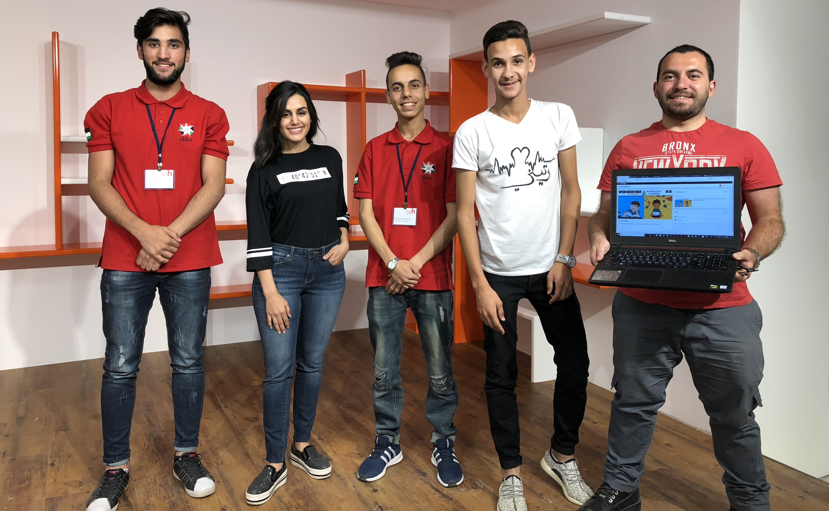
Vision - Learning that enables others to create and share more learning?

Slide 8


1. Learning about Innovation (skills)
Learning around practical innovation tools. Focus on co-creation and user-centred design (UCD) with an eye on learning outputs
2. Innovation in Learning (technology, tools, research)
Uncovering new ways of creating and delivering learning to users
3. Creating Spaces (co-creation)
Combining 1. User-centred design and 2. Innovative low-tech learning tools to co-create learning locally
    What is our unique contribution to innovation

Slide 9
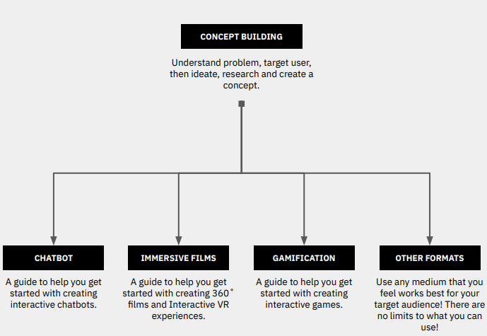
1. Learning about Innovation (Innovation Skills)
    Innovation Essentials - provides first clear steps on how to innovate from within your own organisation, with examples from the humanitarian sector.
    Humanitarian Futures & Foresight – learn about foresights methods & tools (from Institute For The Future) and humanitarian signals & trends (global signals, with focus on East Africa)
    Gamification - introduces game elements and user journeys preparing learners to use these tools to create and deploy games. Developed in collaboration with the International Training Centre of the ILO (ITCILO)
    Toolkits - to help create user-driven, innovative learning resources in new and emergent formats (games, VR, chatbots). Created with Quicksand.
    Research on Future Skills for the aid sector
Notes:
Course Links - https://www.humanitarianleadershipacademy.org/innovation/
Toolkit Links - https://www.humanitarianleadershipacademy.org/innovation/toolkits/
Future Skills Paper – https://www.humanitarianleadershipacademy.org/the-future-of-skills-in-the-humanitarian-sector-new-report/

Slide 10
1. Learning about Innovation (Innovation Skills)
    How to leverage
    Innovation Essentials, Humanitarian Futures & Foresight, Gamification – Use, share, adapt, contextualise in different formats – online, blended, workshops. E.g. ICRC has adapted Innovation Essentials for its staff
    Toolkits – Include as part of learning design services, co-creation workshops (see 3. Creating Spaces)
    Research on Future Skills – Can help to determine skill areas to develop future content to

Slide 11
2. Innovations in Learning (Technology, Tools, Research)
Chatbots
Game-based learning
Predictive learning
Immersive Learning
    Continuously scan educational technologies (edtech) externally, test/experiment and scale successful innovations
    Focus on edtech that have proven effectiveness in other sectors
    Scope for integration with Kaya
    Incrementally develop innovations, prioritise low-cost, low-tech
Notes:
We have incrementally developed new innovations in learning from chatbots, games and VR.
We are pitching predictive learning to donors, prizes, etc

Slide 12
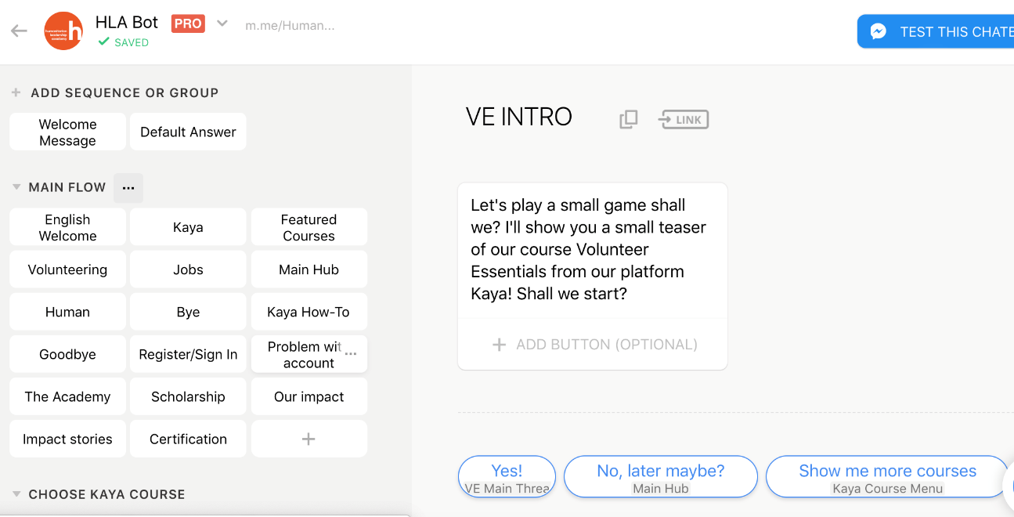
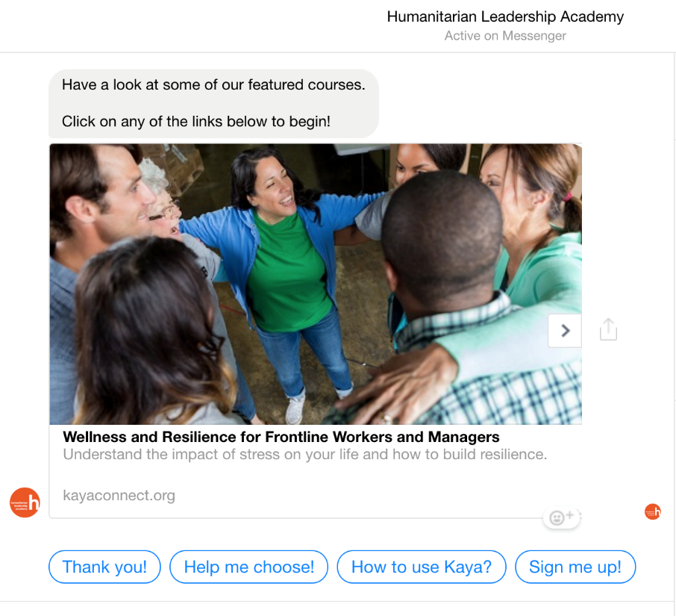
2.1. Chatbots
    Help users discover Kaya courses and build out interactive learning journeys on social media.
    Activate 600K+ Facebook followers for more user engagement and increased Kaya sign-ups
    Chatbots currently available - coaching & mentoring, wellness & resilience, innovation essentials, volunteer essentials
    Next steps – Experiment with Google Dialog Flow to build out personalised learning journeys
Notes:
Chatbot links - https://www.humanitarianleadershipacademy.org/innovation/artificial-intelligence-in-education-chatbots/
Tech used – Chatfuel. Experimenting with Google Dialog Flow (e.g. personalised learning journey)

Slide 13

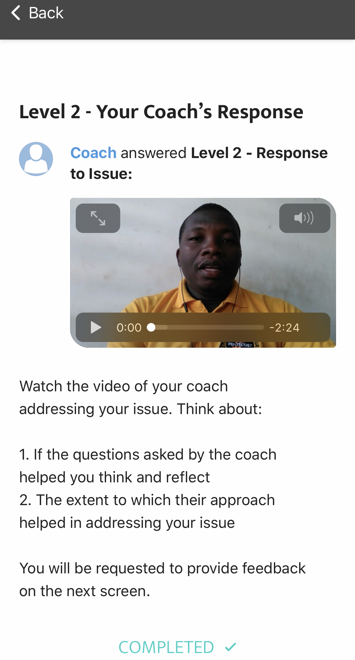
2.2. Game-based Learning
    Scale human engagement in learning via role playing, scenarios, peer-to-peer learning, simulation exercises
    Games co-created with local partners and scaled via Kaya
    Games available on Kaya - Coaching & Mentoring, The Flood - Volunteer Essentials (Philippines)
    Games being released shortly – Welcome aboard (India), Design thinking in practice (India), Challenging gender biases (Jordan).
    Next steps - Co-developing new learning games in partnership with Haiyya (India) and Red Cross
Notes:
Links to live games on Kaya - https://www.humanitarianleadershipacademy.org/innovation/gamification/
Tech - Gamoteca

Slide 14
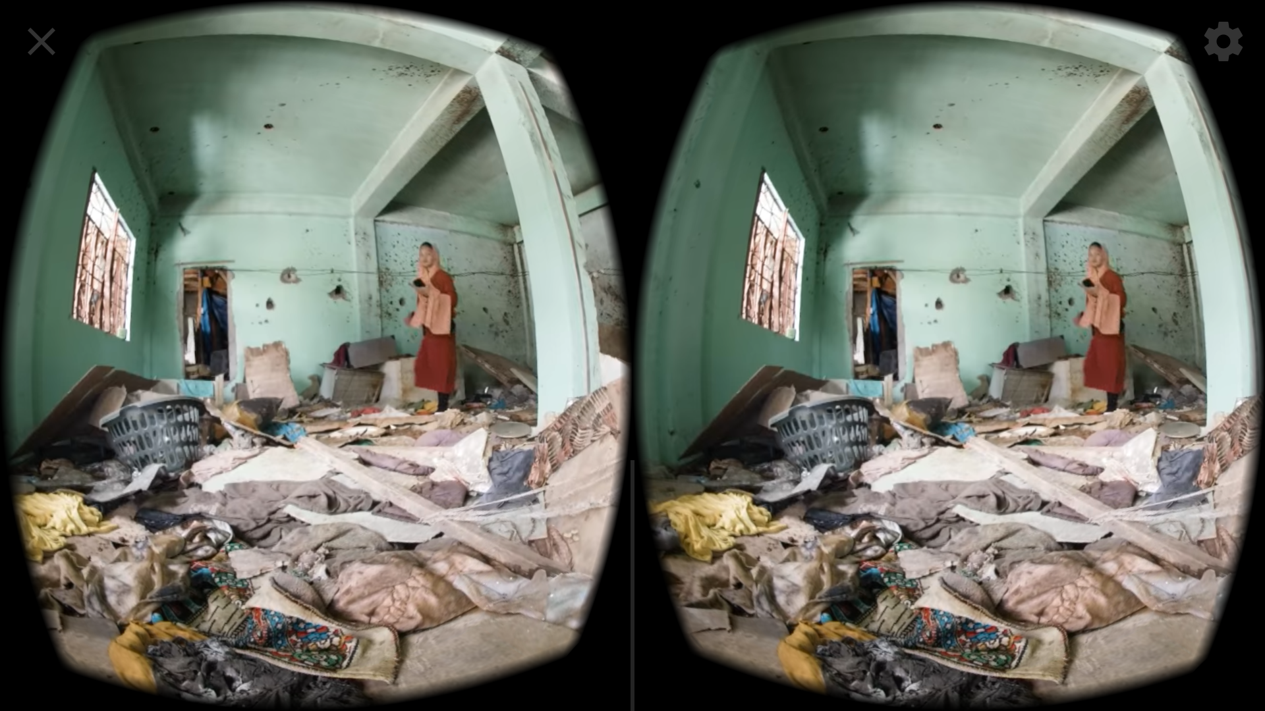
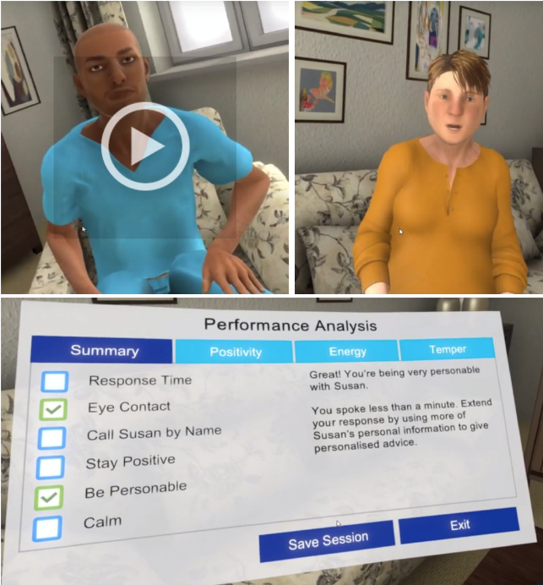
2.3. Immersive learning (VR)
    Non-interactive short VR/360 films – for immersive, empathy building that integrate with existing learning pathways easily – You Cannot Argue (Philippines) with a Flood and Gender in Conflict (Syria & Lebanon)
    Interactive “choose-your-own-journey” videos for decision making - Ebola choices (Liberia)
    Interactive low-tech VR experiences – For crisis immersion Rohingya VR, Camp 2029 (available on Oculus), Localisation (coming soon)
    Next steps
    Standalone “Kaya VR” app – That will integrate all VR experiences in one app and will be available on low-tech smart phones
    Safeguarding VR (reporting) – ”bodyswapping” leverages embodied VR scenarios as a way to elicit empathy and self-awareness in order to affect real-life behaviour.
Notes:
Links to VR, interactive videos – https://www.humanitarianleadershipacademy.org/innovation/360-films-virtual-reality/
Safeguarding VR – https://www.dropbox.com/s/g0u54damyvpqqqk/4_Final_3.mp4?dl=0
Tech – Unity, Somewhere Else, Klynt

Slide 15
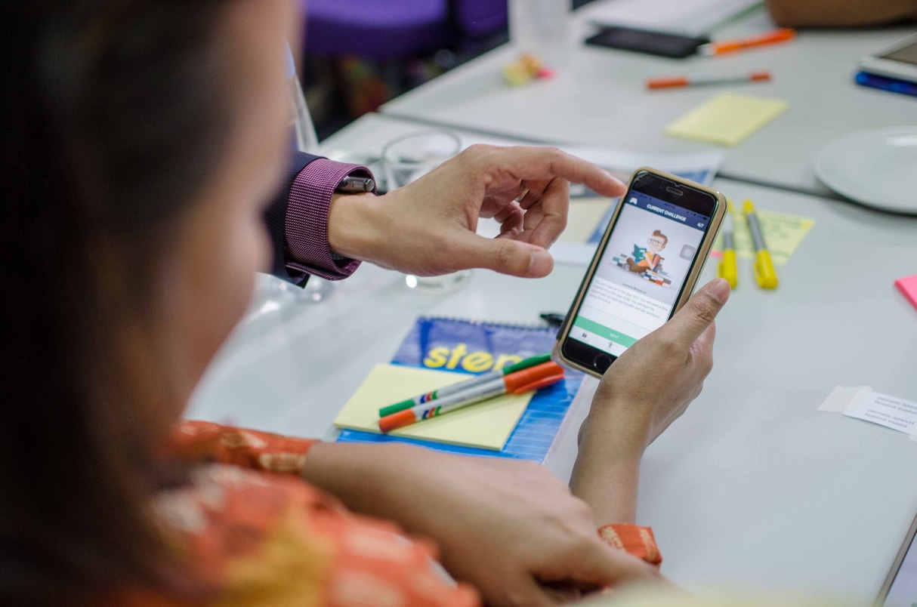
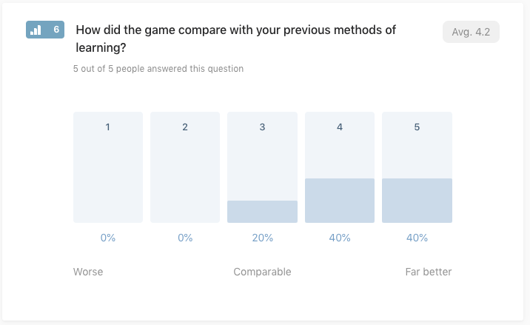
2.4 Research & Evaluation
    Research and evaluation on effectiveness, challenges using emerging edtech in learning
    Capture qualitative and quantitative feedback
    Iterative rollout strategy – test, capture feedback and improve

Slide 16
2.5 Predictive learning (next steps)
+
    Learner history on Kaya (access, registration/completion, feedback)
    Learning history of similar learners
    Related courses
    Crisis data
    Upcoming disasters (climate models)
    Predictive & personalised learning, e.g. course on disaster preparedness before typhoon season
Notes:
This is a vision of where learning on Kaya can go by combining big data and machine learning

Slide 17
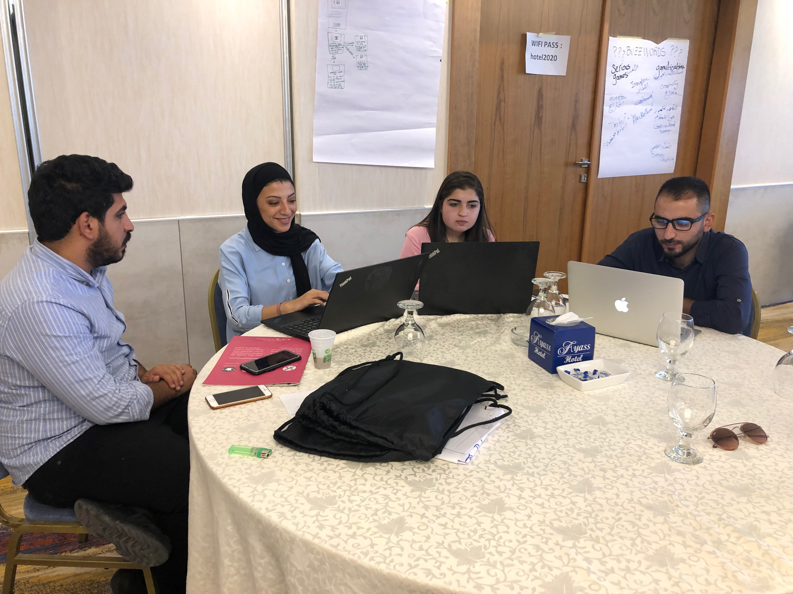
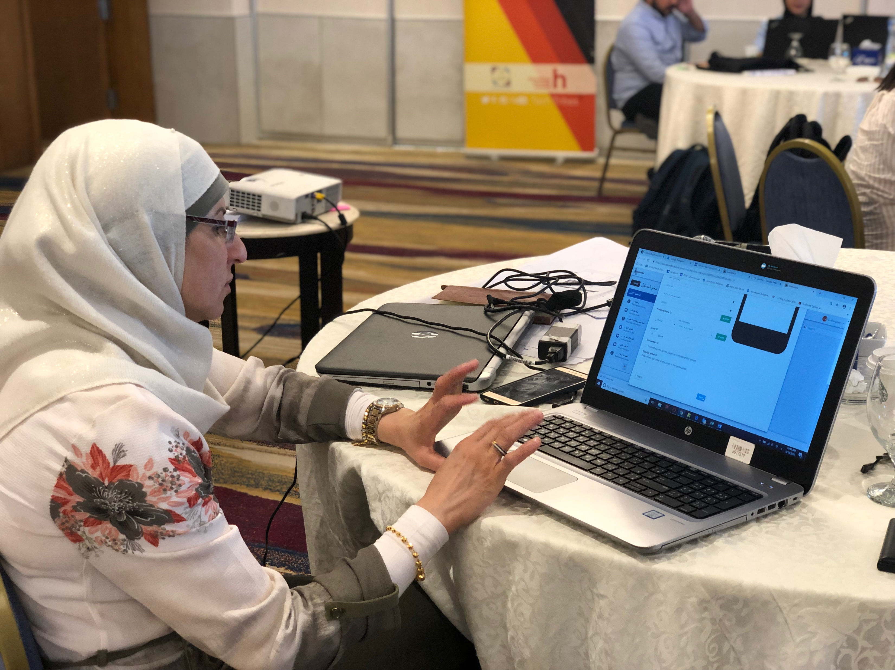
2. Innovations in Learning (Technology, Tools, Research)
    How to leverage
    Integrate innovative content into existing pathways, e.g. Philippines Volunteer Essentials Pathway, C&M Course with live game play
    Adapt, contextualise existing content (VR, games, chatbots)
    Co-develop new content with partners by leveraging toolkits and co-creation
    Collaborate on piloting, research and evaluation of emerging technologies

Slide 18
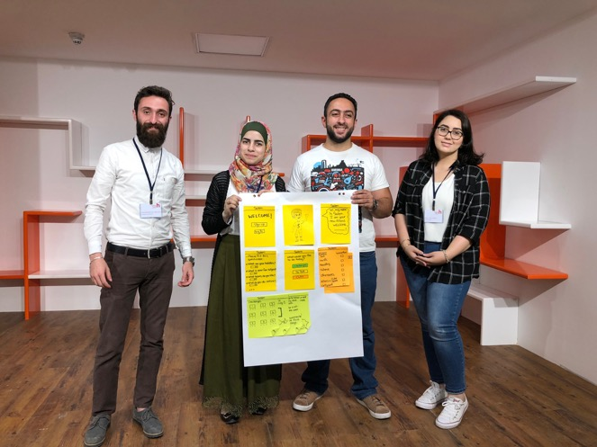
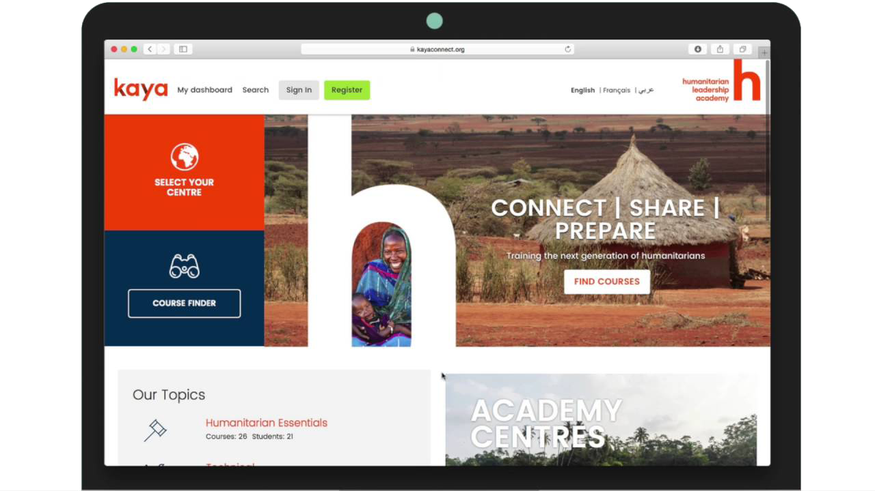
3. Creating spaces
(co-creation)
    Combine user-centred design with edtech to co-create innovative learning locally
    Scale successful innovations through Kaya
    Co-creation spaces “Learning Hackathons” can be in-person (workshops) or virtual (MOOCs, blended programmes) of varying lengths – 2 days to 1 week
Identify, test and incubate
ed-tech and learning-tech solutions
Create spaces to capture
local learning through
design thinking
Scale through
Kaya
Other learning platforms
Social media
Notes:
Build locally and scale globally

Slide 19
3. Creating spaces
(co-creation)
DAY 1 EMPATHIZE | DAY 2 DEFINE, IDEATE & PROTOTYPE | DAY 3 TEST & REITERATE
Welcome and introduction Objectives, methodology, agenda | DEFINE/ Get started in game design Who are the users? What matters to them? Drawing user personas | PROTOTYPE/ Develop web games How to implement a game on the web?
Innovation: what? How? Design thinking to promoting innovative solutions | Game elements & motivation Where do you find them? Why are they motivating? | PROTOTYPE/ Develop web games How to implement a game on the web?
Innovation and learning Connecting the dots | IDEATE/ Shape game concepts Which goal? Why gamification? What game idea? | TEST/ Launching and piloting games Group simulation through mobile devices
Gamification of learning What is it? Why? Where and how? Why games for humanitarian learning? | IDEATE/ Shape game concepts How to design a user journey? | REITERATE/ what makes it good? Critically evaluating game concepts
Gamification case study Mobile simulation on Humanitarian Learning | PROTOTYPE/ Storyboard game concepts How to develop a game for the web? | Conclusion Endorsement of follow up plan Evaluation
    How to leverage
    Host co-creation events around specific challenges, topics
    See sample agenda of 3-day co-creation event on gamification
Notes:
Previous co-creation events: https://www.humanitarianleadershipacademy.org/topics/gamification/

Slide 20


    Signup to learn: KayaConnect.org and join one of our courses
    Combine innovative tech with
    user-centred design to enable others to
    co-create learning
    Collaborate with us on gamification, chatbots, immersive & predictive learning
Key takeaways
“The future is already here, it just isn’t evenly distributed.”
William Gibson, Tech Writer

Slide 21
Download Gamoteca from Apple and Android app store
Register as a new user
Go to https://gamoteca.page.link/LT4C

