Slide 1
Conflict sensitivity and Peacebuilding: From Theory to Practice! Part 3 – Theory in Action
Part III
10 March 2020 Aarhus University Sunra Lambert Baj

Slide 2
Example of 3 day training on Conflict Sensitivity Analysis

Slide 3
Theory in Action
Learning Goal
To actively engage participants in conflict sensitive analysis.
Learning Objective
Participants are familiar with the practical basics of conflict sensitive analysis.

Slide 4
Where to start?
There are many guides, manuals, frameworks, documents available on how to be conflict sensitive and how to do analysis.
Many are technical or academic and require significant resources to implement. Factors that often discourage implementers from doing it.

Slide 5
Conflict Sensitivity needs to be:
Cross-cutting (Institution-wide application)
Flexible (context driven, people centred)
Adequately resourced (time and cost)
Practical (not academic)

Slide 6
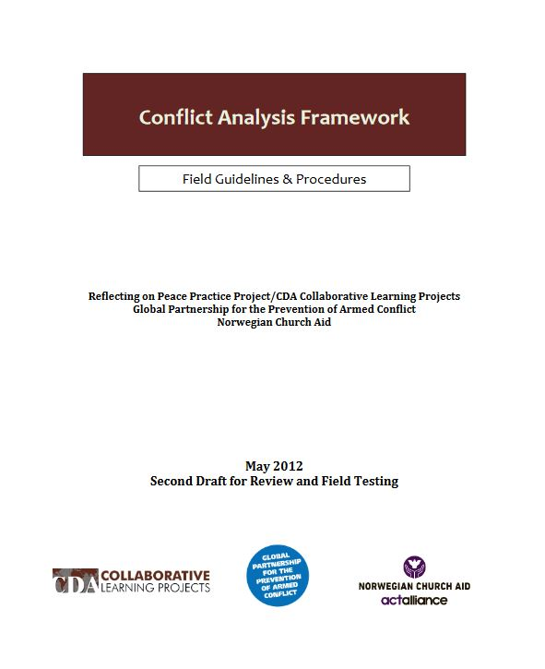
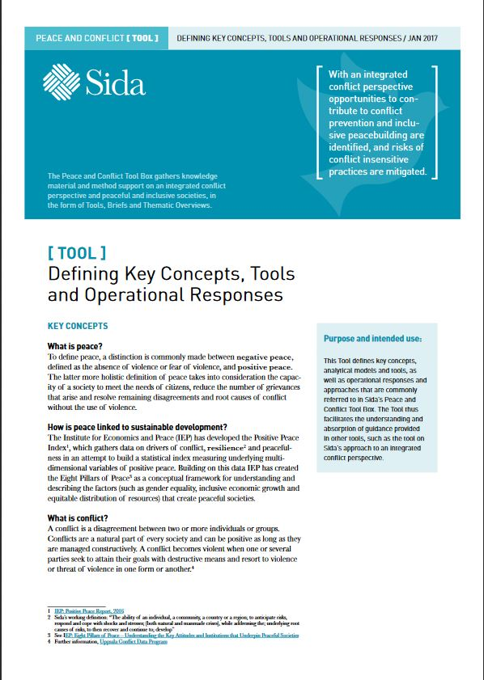
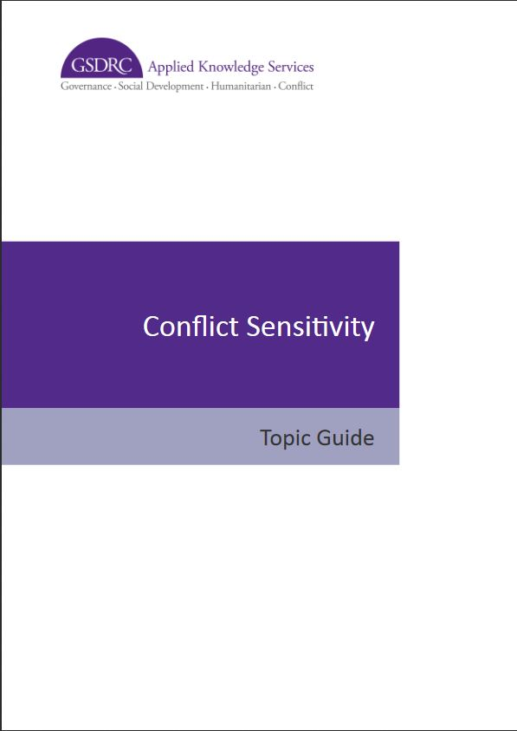
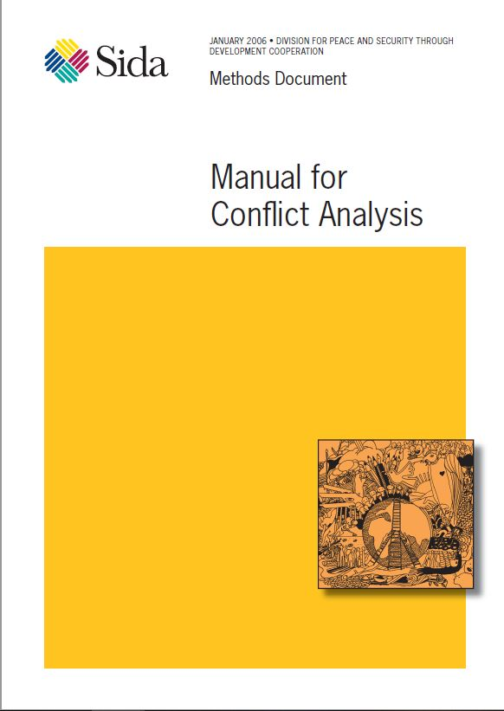
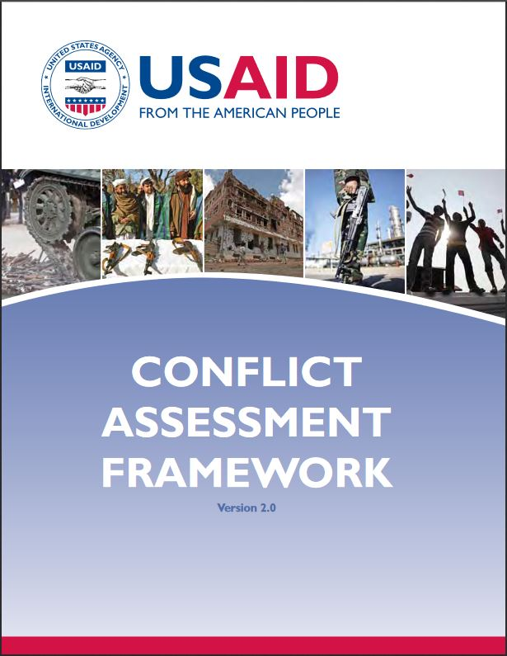
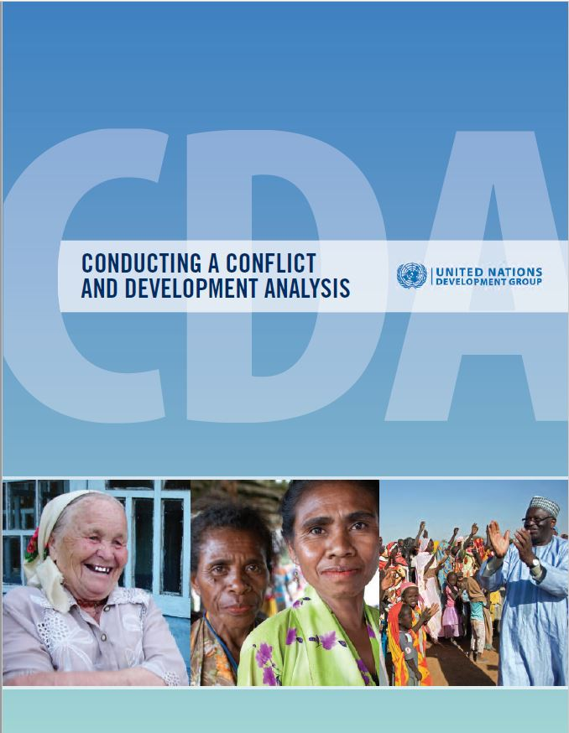
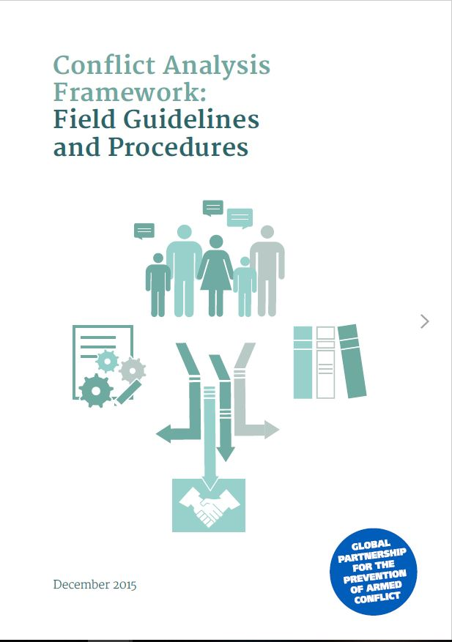
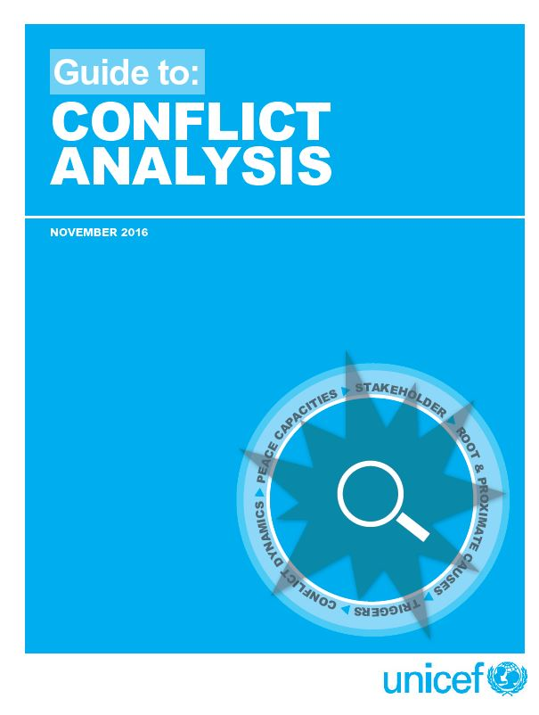
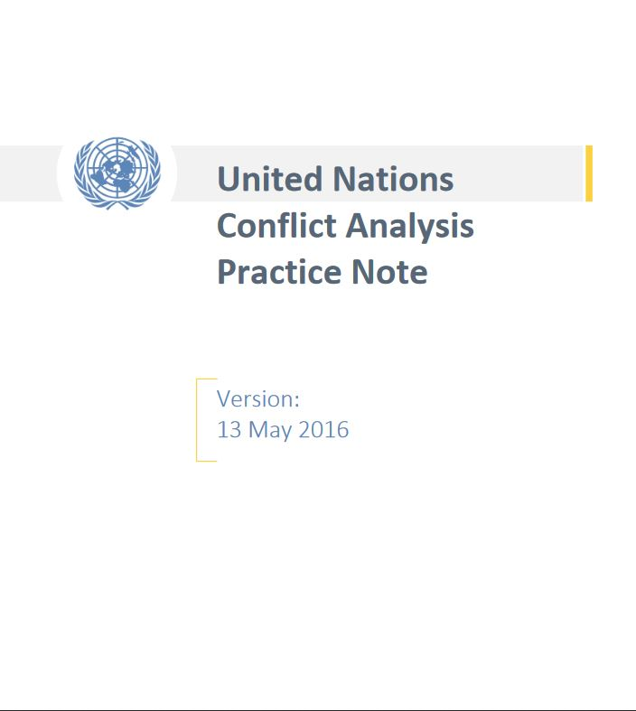
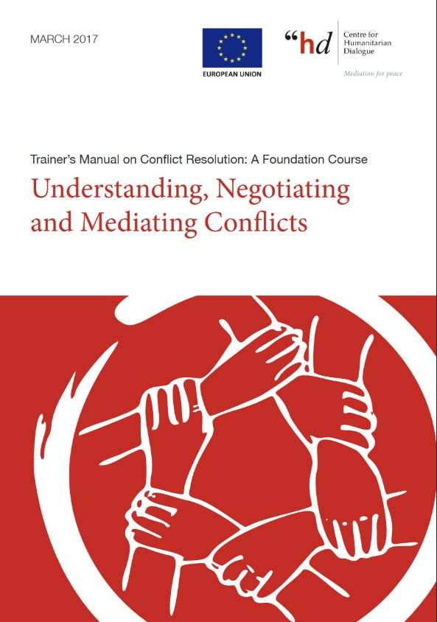
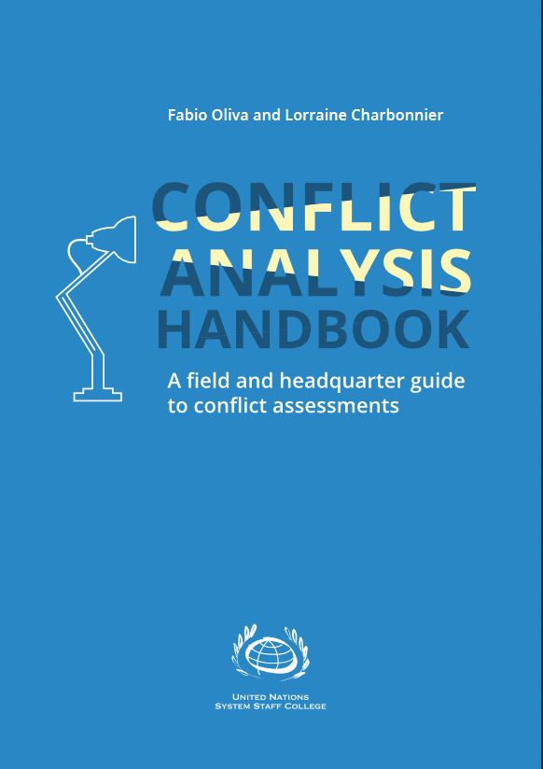
Different Approaches

Slide 7
Common Threads
Analysis tends to be loosely based on:
Factors
Actors (stakeholders)
Trends (dynamics)

Slide 8
Common Threads
Methodology tends to be participatory, collaborative, public (e.g. Participatory Rural Appraisal).
Valuable analysis gathers insights from diverse perspectives (e.g. women, youth, religious actors, community leaders, chiefs, government, CBOs).
The Common purpose of conflict sensitive analysis is to help inform activities to minimise risk and maximise positive impact.

Slide 9
Common Challenges
Managing expectations. Be clear about the purpose of your research.
Managing data. Who owns the data? GDPR. Not enough practical guides on this yet. Always obtain consent. Always anonymise personal data. Do not collect/store data that cannot be used or that could compromise the safety of individuals or communities (e.g. personal gps locations, telephone numbers, names, ethnic/cultural affiliations, religion etc). Be aware that data could be used by one side or another in a conflict to cause harm. Ensure data is secure. Ensure it is clear who is responsible for the data and who owns it (e.g. open source, commons licence).
Time and resources. There is never enough of either. Be realistic as to what you can achieve. Plan accordingly with clear timelines.

Slide 10
“Although there may be many paths up a mountain, the view from the top is the same”
Ancient Chinese proverb
This Photo by Unknown Author is licensed under CC BY-SA

Slide 11
Strategy: Rapid Context Assessment
Team: is it joint with another agency/institution?
Methodology: according to context (e.g. Participatory Rural Appraisal, Focus Group Discussions, Key Informant Interviews).
Equipment: Practical tried-and-tested analytical tools based on common best practice (e.g. nothing fancy. Basic and good-enough).
Timing: check there is no storm approaching (e.g. audits, HQ deadlines, elections, indications of major violent conflict)

Slide 12
Practical exercise
The facilitator will now put you into groups
Please appoint or elect a chair, a note taker, a timekeeper, and a presenter.

Slide 13
Rapid Conflict Sensitive Analysis- Practice
In your groups you are going to go through the three steps of conflict sensitivity based on Tiko.
You will document your findings in bullet points on the flip chart paper
After you have completed your analysis you will present your findings.

Slide 14
Structure
Understanding the Context- 15 minutes
Understanding the two way interaction between Tiko and GoodAid – 15 minutes
Act to minimise negative impact & maximise positive impact. Recommendations – 15 minutes
Presentations- 8 minutes.

Slide 15
Understanding the Context 15 minutes
In your groups consider the following:
Factors
What the 1 Political 2 Economic 3 Social 4 Safety situation in Tiko? Why?
Actors
Who are the main actors/stakeholders in Tiko with the most influence? Why are they influential?
Trends
Is the overall situation in Tiko getting worse, is it the same, or is it improving? Why?

Slide 16
Understanding the two way interaction between the Tiko and GoodAid’s activities – 8 minutes
In your groups observe the interaction between the context and the intervention:
What opportunities can you identify? Why would you say they are opportunities?
What flags would you raise and why?
Refrain from proposing solutions. Focus instead on identifying potential threats (that may cause harm to people, context, or Goodaid) and opportunities (that can maximise positive impact and contribute to peace if possible).
Bullet point your findings on the flipchart.

Slide 17
Act to minimise negative impact & maximise positive impact- Recommendations 8 minutes
In your groups consider the following:
Review the first two steps.
Use this information to provide recommendations to GoodAid on how to adjust initiatives to avert harmful outcomes and reinforce opportunities to maximise positive impact (and where possible support peace).
Prepare to present all your findings (steps 1,2,3). Your presentation will last no longer than 8 minutes.
Bullet point your findings on the flipchart.

Slide 18
Presentations
You now have 8 minutes to present your findings to another group.

Slide 19
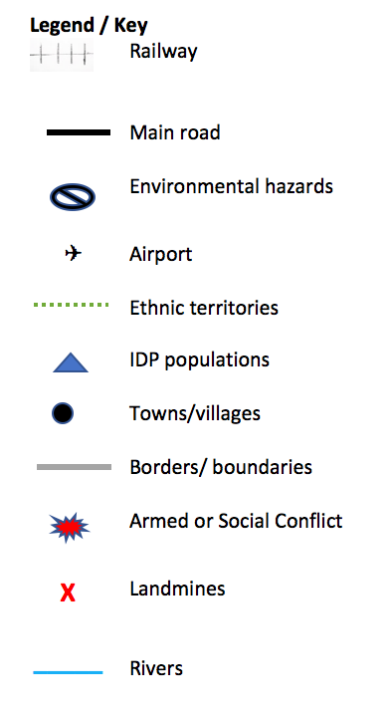
Step 1 Understanding the context - Mapping
In your groups. Please map out Tiko.
Place any important information such as landmarks, roads, borders, conflict areas.
Use the key as a guide.

Slide 20
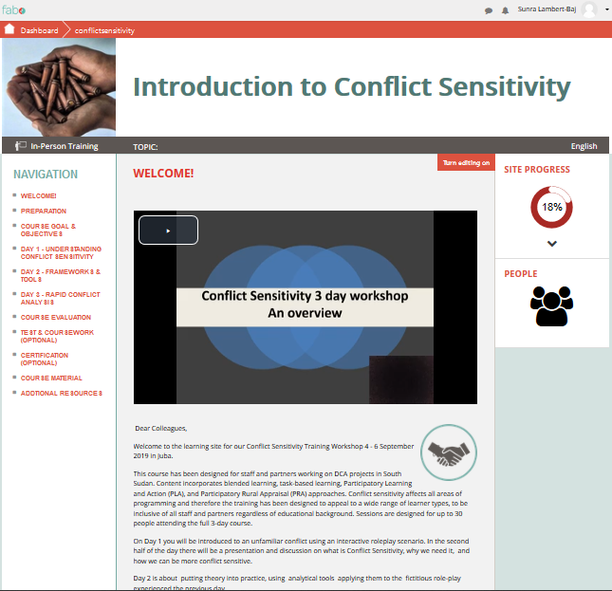
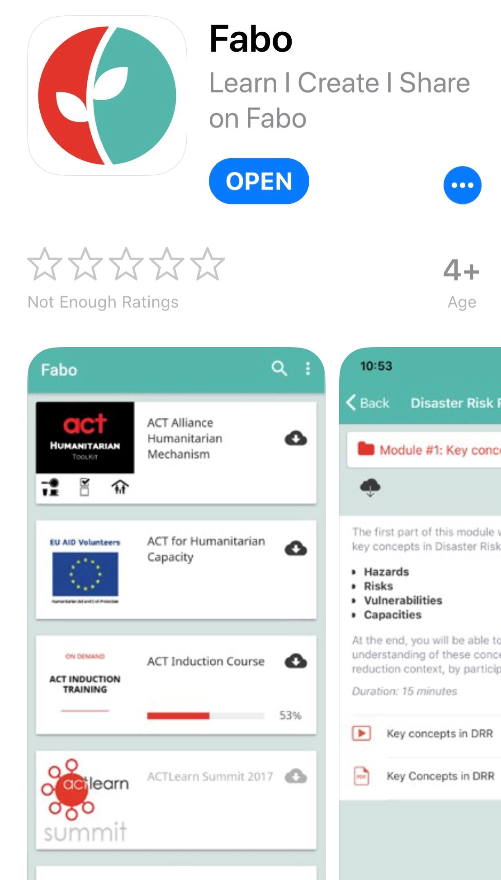
Online access
Please register on the FABO site
http://www.Fabo.org/course/conflictsensitivity_aarhus
On PC/Mac or download IOS /Android apps
Feedback Form also available
All lecture material is available online

Slide 21
Questions and Answers
?

