Slide 1
Conflict sensitivity and Peacebuilding: From Theory to Practice! Part 2 – Theoretical Overview 10 March 2020 Aarhus University Sunra Lambert Baj
Part II

Slide 2
Defining Conflict Sensitivity
Purpose
To strengthen participants understanding of conflict sensitivity and peacebuilding
Objectives
Participants can describe conflict sensitivity and the links to peacebuilding
Participants are familiar with the use of analytical tools

Slide 3
Part 2 What is Conflict Sensitivity?
Notes:
NO CLICK

Slide 4
What is the difference?
Do No Harm
Conflict Sensitivity

Slide 5
Conflict Sensitivity seeks to shape activities by understanding the context and acting to minimise negative impact (do no harm) and maximise positive impact.*
*As understood by DCA.
WHAT
is conflict
sensitivity?

Slide 6
International organisations operate in a complex, fragile and ever-changing world where armed conflicts, violent confrontations, climate related disasters, poverty and extreme inequality continue to cause human suffering.
In complex settings, good intentions can sometimes inadvertently make a situation worse. Seen through this lens, Conflict Sensitivity is based on the premise that the provision of assistance/resources is not always considered neutral especially when applied to areas affected by violent conflict.
Assistance is a form of resource that can be misused to strengthen one side of a conflict or weaken an opposing side. The possibility of substantial harm increases when interventions fail to identify and address the detrimental effects of otherwise well-intended actions.
WHY
is conflict
Sensitivity important?

Slide 7
Conflict Sensitivity came into existence as an approach to improve the provision of assistance in conflict-prone settings.
It is based on the Do No Harm concept, borrowed from the medical profession (e.g. Hippocratic oath) and was applied initially by aid actors during the 1990s (e.g. Rwanda, Bosnia & Herzegovina, Lebanon). Mary B. Anderson.
‘Do No Harm’ gave rise to Conflict Sensitivity as a term that came into use in the early 2000s. The difference between conflict sensitivity and Do No Harm is so small that both terms are frequently used interchangeably.
WHERE
does Conflict
Sensitivity come from ?

Slide 8
Conflict Sensitivity and Do No Harm are often used interchangeably.
Gender is integral, consequently Conflict Sensitivity is also referred to as Gender and Conflict Sensitivity.
Conflict Sensitivity is applicable to all conflict-prone settings irrespective of the severity or frequency of violence. This includes contexts experiencing underlying tensions (e.g. latent conflict), cultural violence (e.g. linguistic, cultural), structural violence (e.g. socio-economic, political, legal, apartheid, discrimination) and/or direct violence (e.g. extra judicial killings, use of lethal force, torture).
Conflict Sensitivity is applicable to all offices as well as regional and HQ units/departments supporting initiatives in conflict-prone settings. This includes human resources, ProLog, legal, finance, fundraising, media/communications, advocacy, projects and programmes.
Conflict Sensitivity is considered international good practice in conflict-prone settings, and is often used as an approach by international institutions, International Non-Governmental Organisations, Local Non-Governmental Organisations, Community Based Organisations, Inter-Governmental Organisations, diplomatic missions, state bodies, local authorities, and the private sector.
CONFLICT SENSITIVITY
Key Characteristics?

Slide 9
There are three main steps to Conflict Sensitivity that should be considered. These include the ability to:
Understand the context;
Understand the two-way interaction between activities/operations and the context;
Act to adjust initiatives to avert harmful outcomes and reinforce opportunities to maximise positive impact and where possible support peace.
How
To be more conflict
Sensitive

Slide 10
Conflict Sensitivity is grounded in analysis that can be used for programme management and strategic planning
Analysis is only valuable when it is context-specific and includes gender, age and diversity dimensions as well as other relevant social groupings (e.g. cultural, ethnic, religious, communal).
Since Conflict Sensitivity concerns everything related to the provision of assistance/resources, analysis can provide useful input that informs not just a specific initiative, but wider operations and activities. Conflict Sensitivity is best used as an extension, rather than constrained to a tick-box action.
How
To be more Conflict
Sensitive
Consider planning and budgeting to ensure that Conflict Sensitivity is incorporated into core aspects of operations.
Prior to implementation contemplate a dedicated study on the conflict dynamics and how they impact the provision of assistance/resources.
Prove Conflict Sensitivity training/support for all staff and partners.

Slide 11
WHAT
is peacebuilding?
There are many interpretations and definitions of peacebuilding
In DCA peacebuilding is understood as :
A broad range of approaches implemented in the context of latent, current or post‐conflict situations motivated by a commitment to identify and address the drivers/root causes of violence to transform conflict and promote lasting, just and sustainable peace.
Fragile contexts demand varied multi-disciplinary approaches to address often unique and complex challenges which require holistic, flexible, and innovative responses.
Peacebuilding speaks directly to the peace component of DCA’s Triple Humanitarian-Development-Peace Nexus approach to Saving Lives, Building Resilient Communities, and Fighting Extreme Inequality.

Slide 12
WHY
is peacebuilding important?
Globally, violent conflict currently drives 80% of all humanitarian needs. Clearly, the reasons why conflicts erupt are multiple and complex, often with far-reaching consequences.
Understanding why a conflict occurs and how to respond is therefore critical for any intervention. For instance, in some fragile contexts, climate change places significant pressure on community access to natural resources (such as land and water) with an increased likelihood that violent conflict may be used between, or within communities, to ‘resolve’ disputes.
Operating in such complex settings demands a thorough understanding of the context to inform local responses that embrace humanitarian action with practices that promote longer-term development and durable peace. If the drivers of conflict are addressed as part of a holistic response, then communities are more likely to strengthen their capacities to prevent conflict and build peace.

Slide 13
PEACEBUILDING Key Characteristics
DCA’s Key peacebuilding characteristics
Examples of initiatives that encompass elements of Conflict Prevention & Peacebuilding include:
Faith-actor engagement in peace platforms,
Dialogue
Mediation
Reconciliation
Social cohesion
Early warning
Conflict transformation / management / resolution
Transformation of violent extremism
Peace education / peace messaging
Community safety planning,
peace committees / groups
Peacebuilding processes are applicable to all SDGs in conflict-affected settings, with an added emphasis on SDG 16.

Slide 14
HOW
to work on peacebuilding?
You may wish to consider the following:
Take a Conflict Sensitive/Do No Harm approach to programming as a starting point. Good analysis can identify conflict drivers as well as provide useful input on how to address root causes.
Factor in means to identify and address multiple forms of violence such as direct physical violence (e.g. war, ecological destruction, murder, rape, and assault); structural violence (e.g. discrimination, injustice, exclusion); and cultures of violence that normalise physical and structural violence in society through cultural channels (e.g. language, ideology, art, music, law, science, social media, press, TV & radio).
Actively include women and youth in all initiatives. Consider all gender, age and diversity dimensions in programming as well as other relevant social groupings (e.g. cultural, ethnic, religious, communal).
Ensure M&E systems are sufficiently resourced to analyse progress, investigate evidence of change, and to learn more about what works and what does not.
Promote ‘silo-free’ responses, informed by the context and defined by the agency of people in crises. Contemplate Peace as part of the Nexus approach.

Slide 15
Humanitarian Development Peace
Nexus
Crisis
Development and Peace Response
Put simply:
The Humanitarian Development Peace nexus is about absorbing short-term action into a longer-term vision of fulfilling local wishes and addressing locally validated needs.

Slide 16
What’s the difference?
Conflict Sensitivity
Peacebuilding

Slide 17
Conflict sensitivity can be applied to any project. It does not have to have peace as its primary outcome.
Peacebuilding should always begin with conflict sensitivity.
Many peacebuilding programmes assume that because they are concerned with peace that it will do no harm.
But, peacebuilding is not automatically conflict sensitive. Steps need to be taken to Do No Harm.

Slide 18
Conflict Sensitivity might sound interesting, but…
how do we do it ?

Slide 19
There are three steps to Conflict Sensitivity
Do you know them?
In pairs discuss what you think they are

Slide 20
Step 1
Understanding
The Context

Slide 21
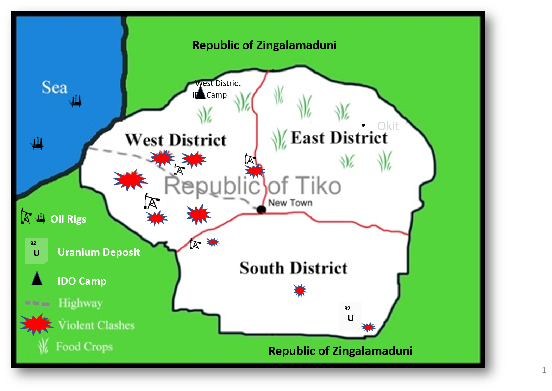
Mapping Analysis

Slide 22
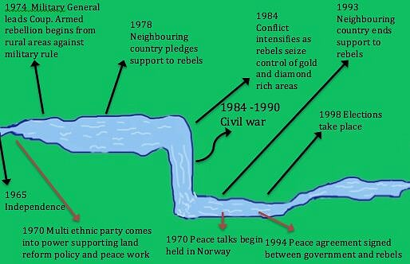
History Overview
Timeline River Tool

Slide 23
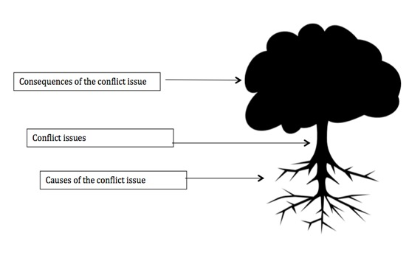
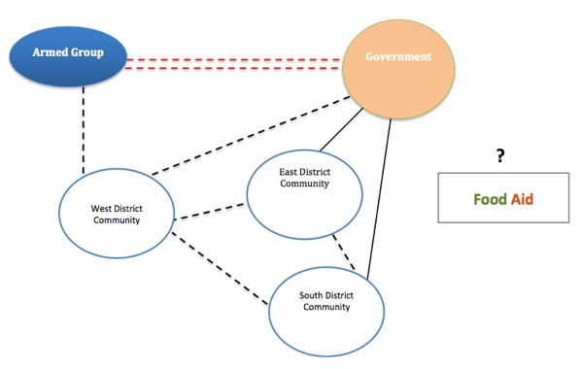
Further Analysis
Factors
Actors
Trends / Dynamics

Slide 24
Step 2?
Notes:
NO CLICKS

Slide 25
Step 2
Understanding the two-way interaction between project activities and the context

Slide 26
Step 3?

Slide 27
Step 3
(Strategic Planning & Project Management)
Planning based on context and documenting recommendations can help an organization to:
Act to minimise negative impact
Act to maximise positive impact

Slide 28
Can you remember the steps?
In pairs discuss the three steps and how you would go about conducting them
Notes:
NO CLICK

Slide 29
Conflict Sensitivity Circle
Source: Helvetas ‘3 steps for working in fragile conflict-affected situations’ (WFCS) 2013
See here for more information

Slide 30
Conflict sensitivity does not mean you are conflict-proof!
Wait a minute…

