Slide 1
Understanding Conflict Sensitivity How to be more conflict sensitive
Part III
September 2019
South Sudan

Slide 2
How to become more conflict sensitive
Purpose
To familiarise participants with rapid analysis tools
Objective
Participants can use practical tools to rapidly analyse their operational environment, and report identified programming hazards/opportunities to management so that action can be taken.

Slide 3
Where to start?
There are many guides, manuals, frameworks, documents available on how to be conflict sensitive and how to do analysis.
Many are technical or academic and require significant resources to implement. Factors that often discourage implementers from doing it.

Slide 4
Conflict Sensitivity needs to be:
Cross-cutting (Institution-wide application)
Flexible (context driven)
Adequately resourced (time and cost)
Practical (not academic)

Slide 5
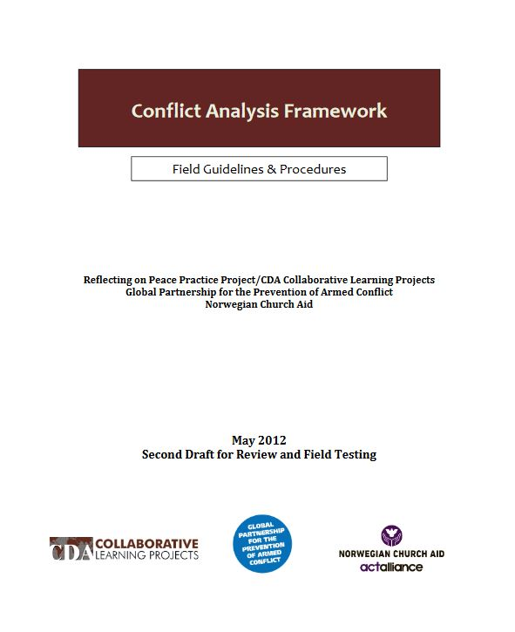
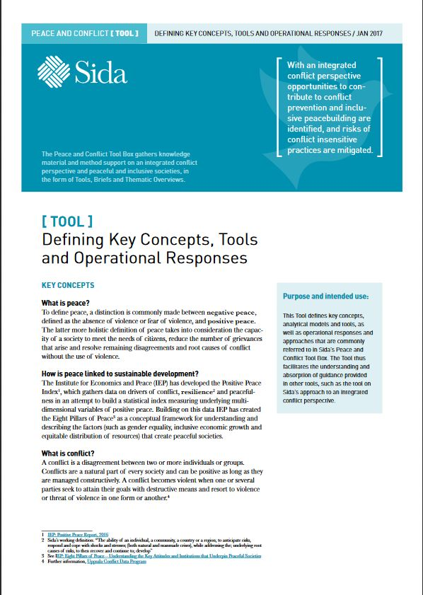
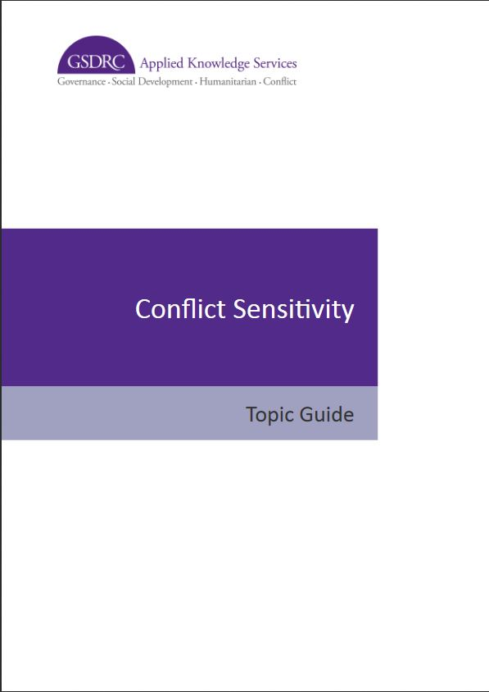
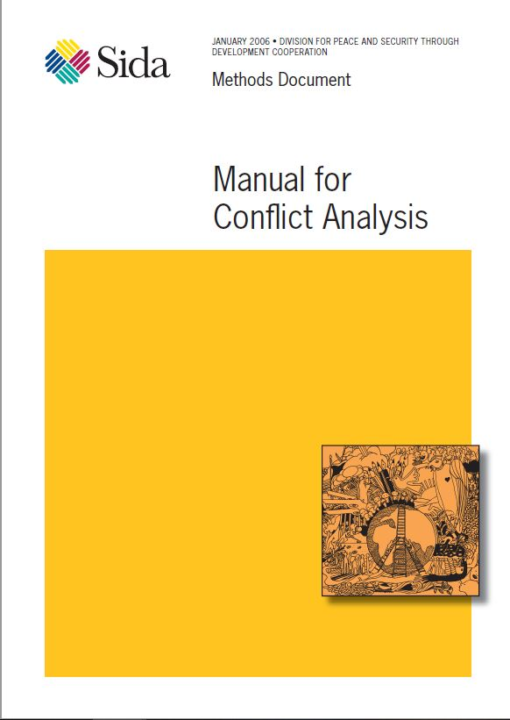
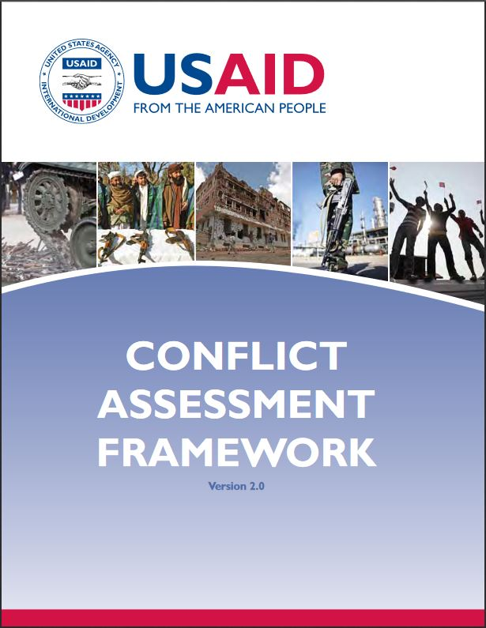
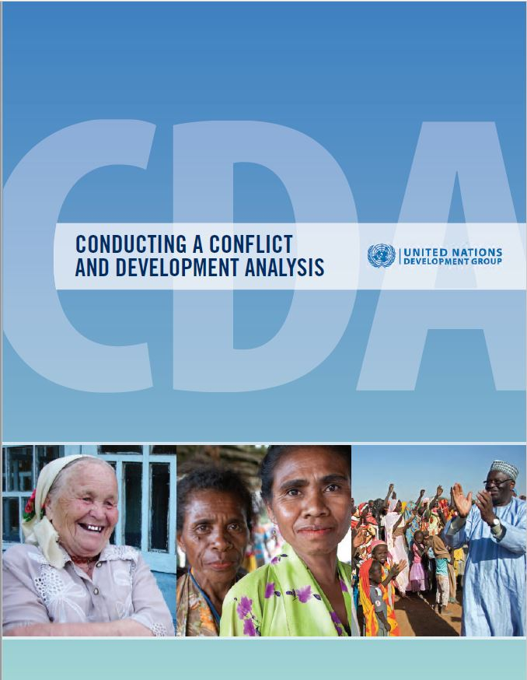
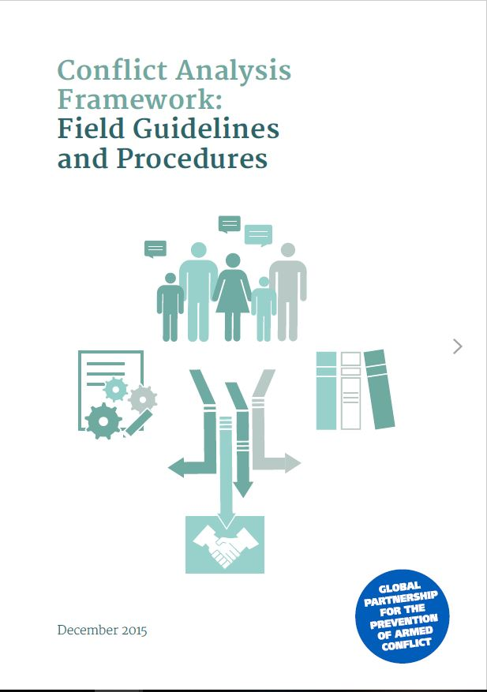
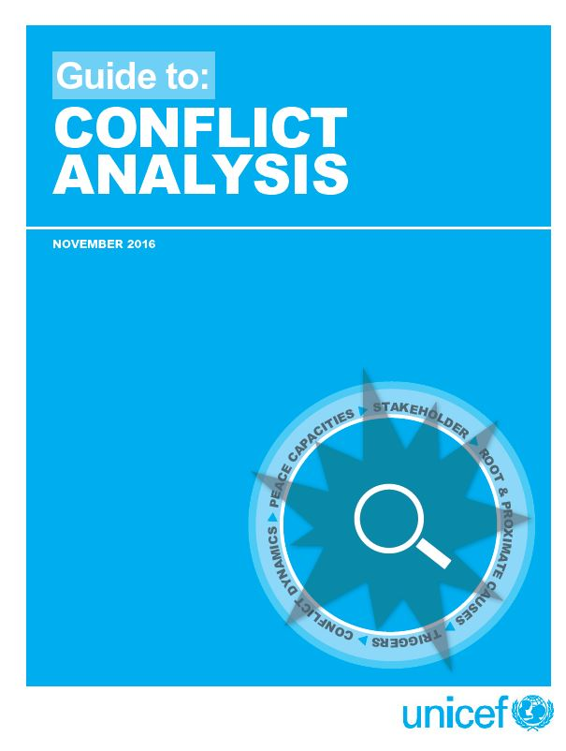
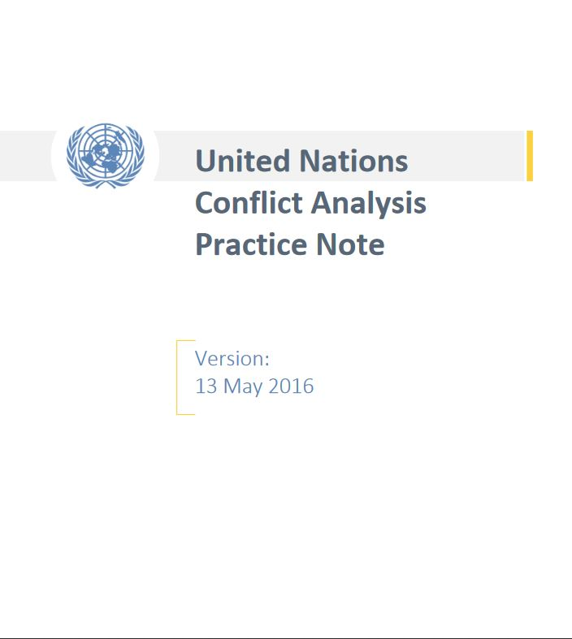
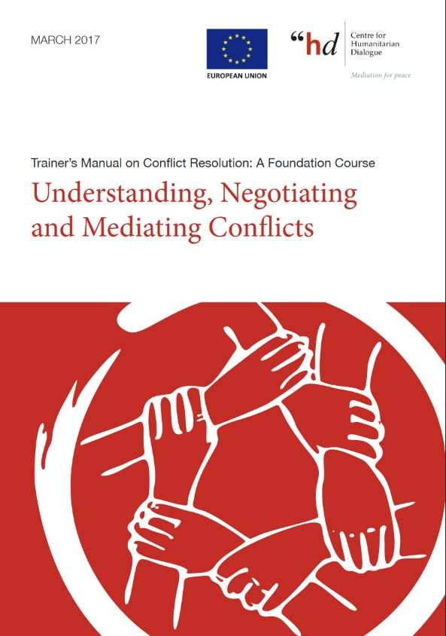
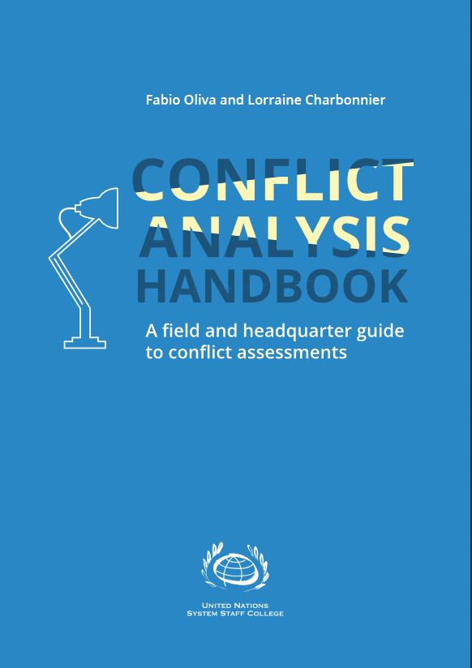
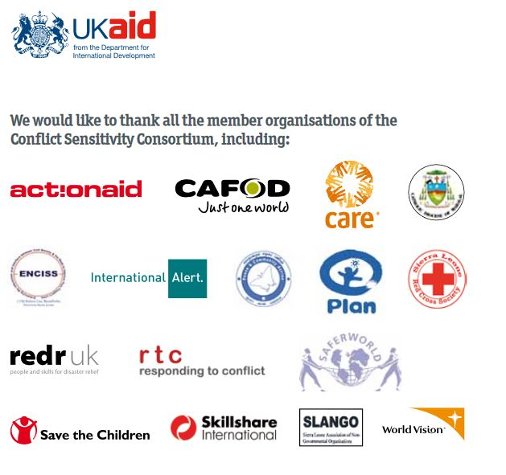
Different Approaches

Slide 6
Common Threads
Open Source analysis based on:
Timelines
Actors (stakeholders)
Causes (factors)
Trends (dynamics)

Slide 7
Common Threads
Methodology is participatory, collaborative, public (e.g. Participatory Rural Appraisal).
Gathers insights from diverse perspectives (e.g. religious leaders, women, chiefs, government, youth, CSOs)
The Common purpose of conflict sensitive analysis is to help inform activities to minimise risk and maximise positive impact

Slide 8
“Although there may be many paths up a mountain, the view from the top is the same”
Ancient Chinese proverb
This Photo by Unknown Author is licensed under CC BY-SA

Slide 9
Strategy: Rapid Context Assessment
Team: In-house (to start with)
Methodology: Participatory (based on participatory rural appraisal)
Equipment: Practical tried-and-tested analytical tools based on common best practice. Nothing fancy. Basic and good-enough.
Timing: check there is no storm approaching (e.g. audits, HQ deadlines, major violent conflict)

Slide 10
Groups
The facilitator will now put you into four groups
Please appoint or elect a chair, a note taker, a timekeeper, and a presenter.

Slide 11
Rapid Conflict Analysis
Step 1
Understanding the Context

Slide 12
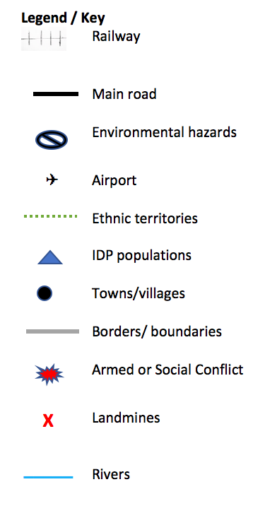
Step 1 Understanding the context - Mapping
In your groups. Please map out Tiko.
Place any important information such as landmarks, roads, borders, conflict areas.
Use the key as a guide.

Slide 13
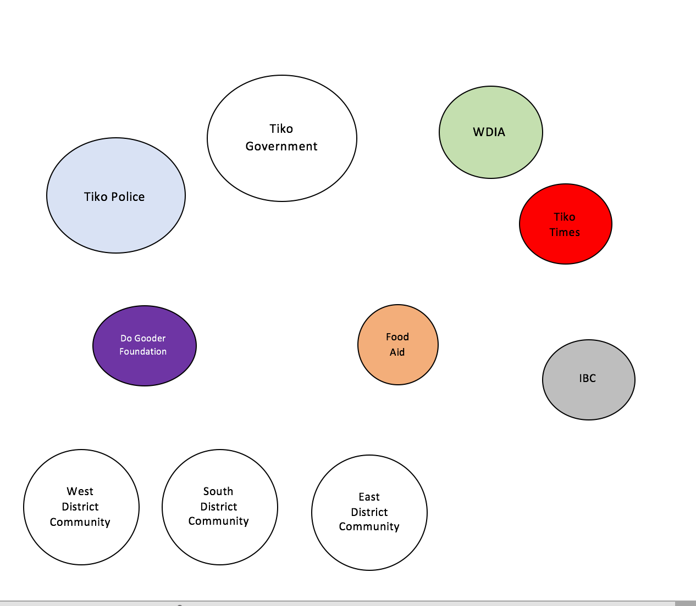
Step 1 Understanding the context Stakeholder Analysis
Identify 10 key stakeholders (e.g. organisations, government bodies, individuals, communities, businesses).
Discuss who to include and why
The size of circle denotes ability to influence the context

Slide 14
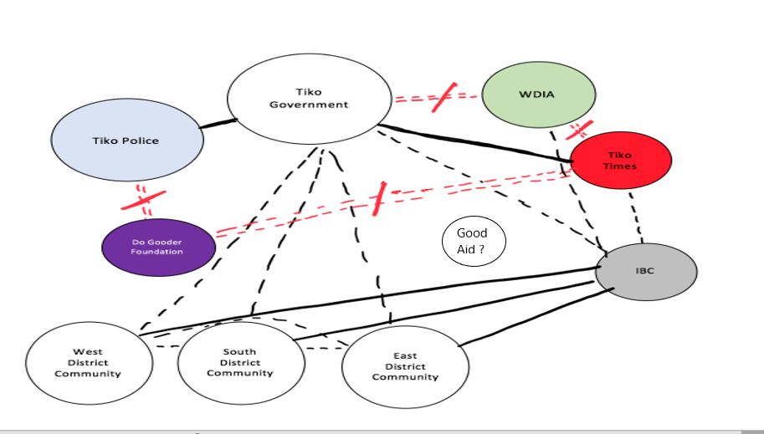
Step 1 Understanding the context Actor/ Stakeholder Analysis

Slide 15
Step 1 Understanding the context Stakeholder Analysis
Add the following lines to represent the relations between the different stakeholders

Slide 16
Step 1 Understanding the context - The Challenge Tree
Draw a picture of a tree similar to the one opposite
The Challenge Tree represents the factors / root causes that fuel challenges and problems.
The roots represent factors that are underground / unseen (e.g. social prejudice, discrimination, inequality, unemployment).
The trunk represents factors that are visible (e.g. presence of weapons, poor infrastructure, lack of government services).
The leaves represent the effects (e.g. conflict, death, injury, breakdown in trust, damage to property, high crime, lack of rule of law).
The examples above are general. Try to make examples as specific as possible according to the context.

Slide 17
Step 1 Understanding the context The Opportunity Tree
Draw another Tree
This tree identifies opportunities
Identify unseen opportunities that lie underground (e.g. Opporutnity to build trust between community X and Y through collaborative activities based on food support)
Identify visible opportunities as part of the trunk (e.g. Community X has food that could be provided to community Y).
Identify effects (e.g. Increased trust between all communties in Tiko).

Slide 18
Step 1 Understanding the context - Trends Snapshot
Discuss in your groups whether the situation in Tiko is getting better, the same or worse.

Slide 19
Political Situation / Economic Situation / Social Situation / Safety Situation
Capture the above areas.
Is it better, worse, or the same?
Why is it better, worse, or the same.
Capture aspects using bullet points on a flipchart.

Slide 20
Rapid Context Assessment
Step 2
Understanding the two-way interaction between project activities and the context

Slide 21
Step 2 Understanding the two-way interaction between project activities and the context
Discuss in your group how Tiko may have affected GoodAid’s activities? Positive? Negative? Why?
Discuss how GoodAid’s activities may have affected Tiko? Positive? Negative? Why?
Capture key aspects using bullet points on flipchart paper.

Slide 22
Rapid Conflict Analysis
Step 3
Acting to minimise negative impact and maximise positive impact
Strategic Planning & Project Management

Slide 23
Step 3 - Acting to minimise negative impact and maximise positive impact
Discuss in your groups how GoodAid could reduce negative impact and maximise positive impact
Should GoodAid change it’s activities? If so, how?
Go back to your Map. Discuss where GoodAid’s activities should take place over the next 6 months. Use a grey circle as a symbol for new locations

Slide 24
Presentation
Present your work to the other groups

Slide 25
Sources for further reference:
‘How to guide on Conflict Sensitivity’ Conflict Sensitivity Consortium.
Conflict-sensitive approaches to development, humanitarian assistance and peacebuilding - A resource pack’ Saferworld et al.
‘What is peacebuilding? Do no harm, conflict sensitivity and peacebuilding’ Interpeace, K. Van Brabant.
‘A Distinction with a Difference: Conflict Sensitivity and Peacebuilding’ CDA, Peter Woodrow.
‘The Oxford Handbook of Gender and Conflict’ Ni Aolain et al.
Notes:
CLICK WHEN INDICATED

Slide 26
All material produced by Sunra Lambert Baj for DCA, 2019
For more information regarding this presentation please contact:
sulb@dca.dk
Proprietary rights
Conflict Circle © Helvetas ‘3 steps for working in fragile conflict-affected situations (WFCS)’ 2013
All photos © Sunra Lambert Baj
Graphics produced by Sunra Lambert Baj or downloaded from www.openclipart.org (royalty free)

Slide 27
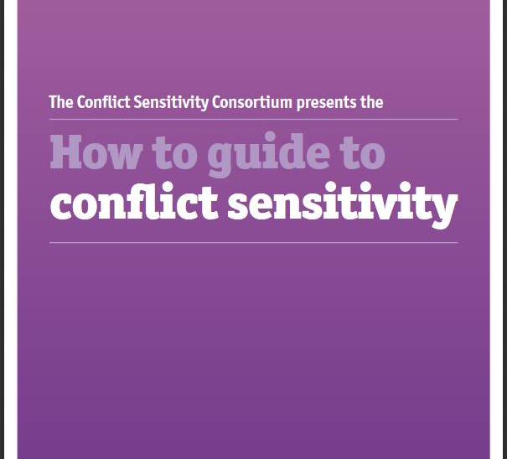
Approaches to Conflict Sensitivity
Academic
Time Consuming
Resource / time intensive
Technical
Many different types of methodology (conflict analysis, conflict assessments, conflict frameworks, PCIAs, Conflict toolkits)
Confusing

