Slide 1
Welcome
Conflict sensitivity and Peacebuilding: From Theory to Practice!
9 September 2020
Copenhagen University
Sunra Lambert Baj and Dea Andersen, DCA

Slide 2
Introduction
My name is Sunra
My experience is mainly field based
As of 2018 I’ve been based in Copenhagen with DanChurchAid advising on Conflict Prevention and Peacebuilding

Slide 3
Introduction
My name is Dea
Experience from Myanmar (ceasefire implementation) and Afghanistan/Pakistan (military academic dialogue)
Short term Conflict Analyst Associate at DanChurchAid advising on Conflict Prevention and Peacebuilding

Slide 4
Goal
To strengthen your theoretical understanding and practical application of conflict sensitivity and peacebuilding.

Slide 5
Learning Objectives
After completing this course, you will be able to:
Understand the three steps associated with conflict sensitivity.
Familiarise yourself with practical tools used to analyse operational environments.
Have an improved understanding of how conflict sensitivity and peacebuilding are applied.

Slide 6
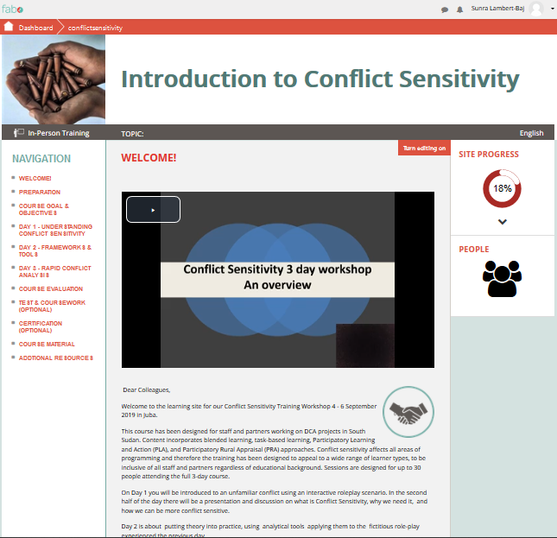
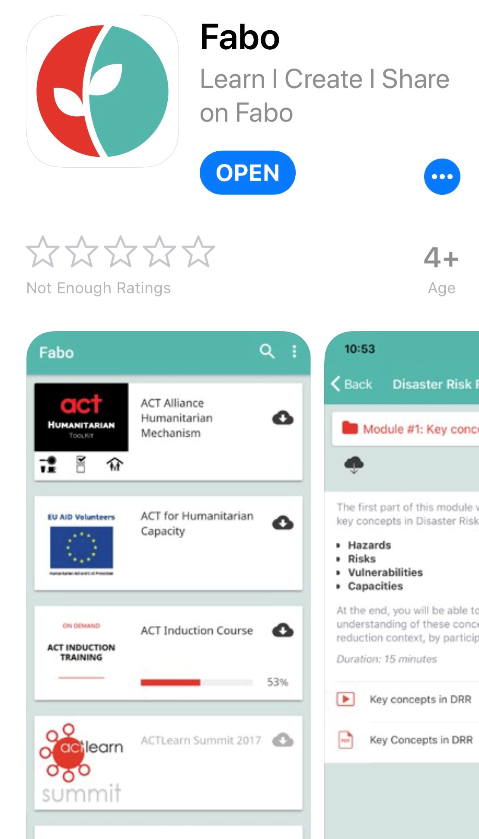
Online access
Please register on the FABO site
http://www.Fabo.org/course/conflictsensitivity_copenhagen
On PC/Mac or download IOS /Android apps
All lecture material is available online
Feedback Form also available

Slide 7
In-person Training
Methodology: Task Based learning, Blended learning.
Interactive approach.

Slide 8
Course Overview
Part 1 Role Play Scenario
Part 2 Understanding and defining Conflict Sensitivity and Peacebuilding
Part 3 Analysis: Putting theory into practice.

Slide 9
Part I
Role Play Scenario
9 September 2020
Copenhagen University

Slide 10
Conflict Sensitivity Scenario
Purpose
To create a scenario role play in which participants are introduced to the challenges of managing an intervention in a crisis
Objectives
You will have improved understanding of some of the challenges faced in crises situations
You will have an improved understanding as to why conflict sensitivity might be needed in crises situations

Slide 11
Welcome to…
You will spend the next 30-45 minutes in a role-play scenario
The scenario will be based in a fictitious (conflict-affected) country with invented characters. Some of whom may or may not appear familiar
The purpose is to provide a flavour of what it is like to operate in a completely unfamiliar context, without adequate strategic planning or project management

Slide 12
Welcome to The Republic of Tiko (RoT)
Where the Sun always shines!

Slide 13
Republic of Tiko (RoT)
Population 1 million
Government: Republic with a Supreme Leader
Official language: Tiko
Capital: New Town
Ethnic groups:
25% West District Community
50% East District Community
25% South District Community

Slide 14
Tiko Map
Republic of Zingalamaduni
Republic of Zingalamaduni

Slide 15
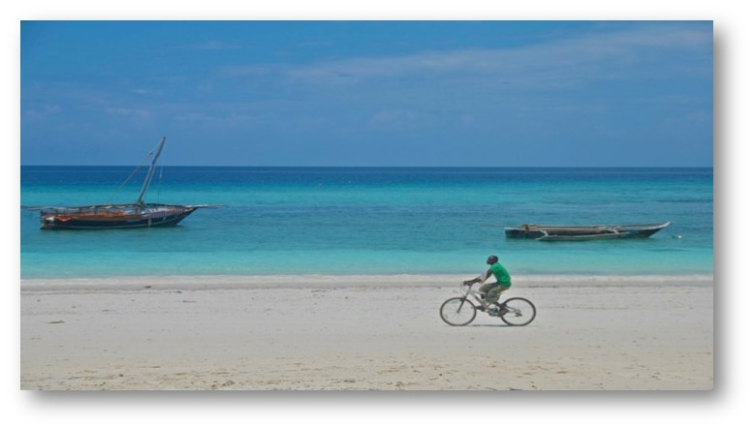
West District
West District community has lots of business and commerce because of the seaport
It is also an oil rich region with many oil fields and offshore oil rigs

Slide 16
West District has a problem
But…

Slide 17
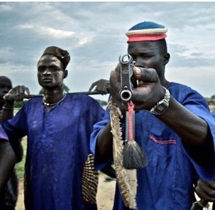
The West District Independence Army (WDIA)
WDIA has been active for decades
WDIA is well organised and controls large swathes of West District including many oil fields and large portions of the main road from the port to New Town
WDIA aspires to create an independent ‘corruption free’ state
The RoT Government brands the WDIA a terrorist organisation

Slide 18
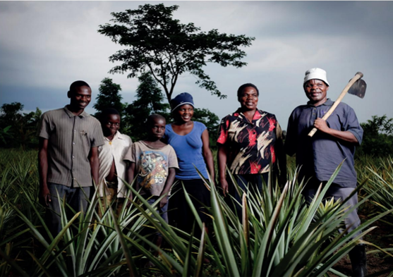
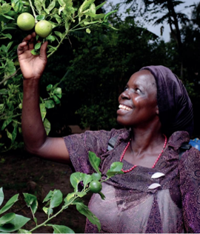
East District
East District Community are the majority ethnic group in Tiko
East District is considered the “bread basket” of Tiko
There are also many Government services available including hospitals, educational institutions, police, and courts
Thanks to public access to Government provided schools more people have high school education and speak English, more than any other District

Slide 19
South District
The South District Community is traditionally nomadic, but since Tiko's independence from Zungland many have been forced into settlements
Most have little or no education
The economy is incredibly fragile and what little exists is totally dependent on access to New Town and the port
Food security is a problem and many areas are difficult to access due to poor infrastructure. Government services are practically non-existent
Uranium deposits have been discovered recently in South District, which has resulted in the forced displacement of many people by the Tiko Armed Forces

Slide 20
HUMANITARIAN CRISIS 2020 WORLD APPEAL !
There is a drought in Tiko
200,000 people are affected in South District
The Government of Tiko has asked the international community for assistance

Slide 21
GoodAid
GoodAid has decided to respond to the Tiko crises

Slide 22
GoodAid
GoodAid is a global inter-governmental organisation with a mandate, from the League of Nations, to save souls and promote opportunities.
GoodAid believes that mankind should not discriminate on any basis.
GoodAid’s vision is a world in which no one is left in line.
GoodAid’s goal is to empower all people (including mothers and children) to attend discussions locally, nationally and regionally.
Notes:
PLEASE CLICK FOR EACH BULLET POINT

Slide 23
GoodAid
GoodAid seeks to actively engage people taking an integrated nexus linking relief rehabilitation and assistance, with aid as its core mandate, while also embracing gender-mainstreaming, climate change, poverty, protection, youth empowerment and building peace to help countries accomplish global goals according to the 2050 diary in the bargain basement.
Programmes include: Round tables, humanitarian coordination, facipulation forums, food, protection of endangered species, refugee citizenship promotion, animal rights support services, free food, infrastructure development, camp behaviour support, how-to-guide-to-slide-presentations, food, laptops-for-the-poor, food investment banks, minidisc awareness, humanitarian worker support groups, adopt-a-cow, cash 4 data, interior design, DVD awareness, get-rich-quick projects, land appropriation facility, plant-a-cashtree, cash 4 biometrics, 35mm film development, psycho support groups, violent extremists anonymous, wellbeing support, free-the-doves, peaceful co-existence initiatives, Betamax distribution, Quick Instant Projects, don’t drink and drive campaign, deforestation tree support (DTS), vaccination alternatives… and LED teams.

Slide 24
Roleplay
The scenario will last 45 minutes

Slide 25
Roles
GoodAid Country Representative
GoodAid Procurement & Logistics Officer
GoodAid Human Resources Officer
President of RoT
RoT Government Representative- MOFAHCT
Police Captain
West District Independence Army Commander
West District Civil Society Representative
East District Civil Society Representative
South District Civil Society Representative
Journalist International Broadcasting Corporation (IBC)
Tiko University Professor
Do-Good-Foundation NGO Country Director
Unemployed Workers from all the districts
Tiko Times
Head of Zungland Office for International Development Assistance (ZOFDA)

Slide 26
Before you get your role-cards please take notice of the following information. 200,000 lives depend on it!

Slide 27
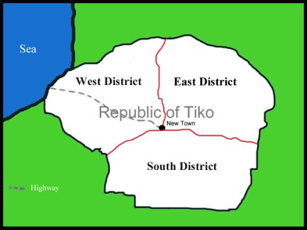
Good Aid has a team of specialists ready to go to Tiko
GoodAid
Notes:
AUTOMATED SLIDE. No clicks needed.

Slide 28
Instructions
During the role play the GoodAid team will meet representatives and unemployed workers in Tiko
During this time, the GoodAid team will create an action plan
Notes:
PLEASE CLICK FOR EACH BULLET POINT WHEN INDICATED

Slide 29
Instructions
GoodAid team’s action plan must present:
Good Aid’s Integrated Response Plan including intended operations, recruitment and procurement.
Notes:
PLEASE CLICK FOR EACH BULLET POINT WHEN INDICATED

Slide 30
Instructions
The GoodAid team must then present their action plan to the plenary and it cannot last more than 5 minutes.
After GoodAid’s presentation each representative will individually decide if GoodAid has permission to operate in their district.
Notes:
PLEASE CLICK FOR EACH BULLET POINT WHEN INDICATED

Slide 31
Representatives & Workers
Representatives and workers, you can talk to anyone.
Feel free to introduce yourselves, tell people your job title, who you are and other relevant information.
Notes:
PLEASE CLICK FOR EACH BULLET POINT WHEN INDICATED

Slide 32
Everyone
The Facilitators will now give you a role-card.
If you have any questions about your role-card please ask a facilitator.
Text marked TOP SECRET are for your eyes only, do not share with anyone outside your group!
Notes:
PLEASE CLICK FOR EACH BULLET POINT WHEN INDICATED

Slide 33
You now have 5 minutes to read your cards. Ask questions to the Facilitators
Notes:
NO CLICK

Slide 34
NOTE:
GoodAid HQ wants this mission
to be a success
200,000 lives depend on it!
Notes:
PLEASE CLICK FOR EACH BULLET POINT

Slide 35
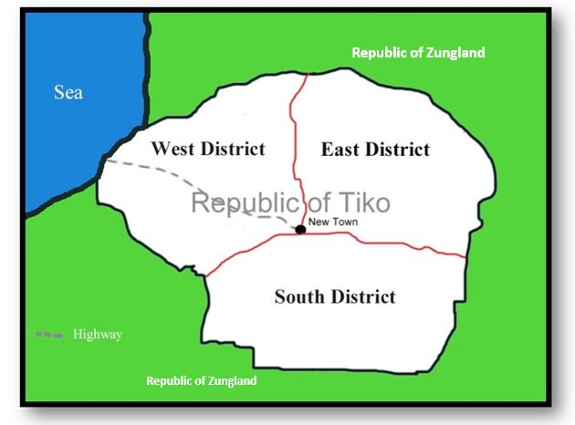
Any Questions?
GoodAid now has 25 minutes to meet everyone and develop the action plan
Your time starts now!
Notes:
ONLY CLICK AFTER QUESTIONS HAVE BEEN ANSWERED

Slide 36
Welcome Back!
The GoodAid team has 5 minutes to present its action plan to the group
Notes:
ONLY CLICK WHEN THE GROUP HAS CONVENED
PLEASE WAIT UNTIL AFTER THE PRESENTATION ENDS BEFORE MOVING TO THE NEXT SLIDE

Slide 37
Representatives
Please decide if the GoodAid project can operate in your area.
You must give a valid reason for your decision.
Notes:
Ask each representative to present whether they give permission for Good Aid to operate and why? Optional: You can get each representative to stand up and receive an applause before/after presentation.
PLEASE WAIT UNTIL THE FACILITATOR SUGGESTS MOVING TO THE NEXT SLIDE

Slide 38
Debrief
Was GoodAid’s response adequate?
Did GoodAid get permission to operate in all areas of Tiko?
What were the challenges?
What did we learn from the role play?
Do you think the GoodAid Team was Conflict Sensitive?
If not, why not? If yes, what made their work conflict sensitive?
Notes:
PLEASE CLICK FOR EACH SECTION WHEN INDICATED
Optional: Participants can do this in their respective groups (Food aid team, community representatives, Gover/Rebel representatives, unemployed workers East district, unemployed workers West District, unemployed workers South District. As particpants to look at the above questions and select a person to report back to the plenary. Provide 5-10 minutes for discussion. Emphasize the need to be conflict sensitive without going into details

Slide 39
Can you answer these questions…
Taking into consideration the role play:
What does Conflict Sensitivity mean?
Is Conflict Sensitivity important?
Notes:
PLEASE CLICK WHEN INDICATED
Optional: Either get participants to answer the questions in their previous groups or if time is constrained ask individuals in the group.
All staff need to be conflict sensitive e.g. management, Programme staff, Finance, drivers, admin, human resources, Everyone
This can be done in pairs, groups, or collectively together.

Slide 40
Who needs to be Conflict Sensitive?
Everyone!
Notes:
CLICK WHEN INDICATED

Slide 41
Any Questions?

Slide 42
Sources for further reference:
‘How to guide on Conflict Sensitivity’ Conflict Sensitivity Consortium.
Conflict-sensitive approaches to development, humanitarian assistance and peacebuilding - A resource pack’ Saferworld et al.
‘What is peacebuilding? Do no harm, conflict sensitivity and peacebuilding’ Interpeace, K. Van Brabant.
‘A Distinction with a Difference: Conflict Sensitivity and Peacebuilding’ CDA, Peter Woodrow.
‘The Oxford Handbook of Gender and Conflict’ Ni Aolain et al.
Notes:
CLICK WHEN INDICATED

Slide 43
All material originally produced by Sunra Lambert Baj for DCA, 2019
For more information regarding this presentation please contact:
sulb@dca.dk
Proprietary rights
Conflict Circle © Helvetas ‘3 steps for working in fragile conflict-affected situations (WFCS)’ 2013
All photos © Sunra Lambert Baj
Graphics produced by Sunra Lambert Baj or downloaded from www.openclipart.org (royalty free)

