Slide 1
webinar
13 march 2023
HOW TO COMPLY WITH CISU’S REQUIREMENTS FOR FINANCIAL MANAGEMENT

Slide 2
PROGRAMME
WELCOME, INTRODUCTION AND EXPECTATIONS FOR TODAY
REQUIREMENTS FOR FINANCIAL MANAGEMENT
WRITTEN PROCEDURES
BUDGETS
BOOKKEEPING AND FINANCIAL VOUCHERS
RECONCILLIATIONS
FINANCIAL REPORTS
CLOSING REMARKS

Slide 3

WE ARE HAPPY THAT YOU HAVE JOINED THE WEBINAR!
- What’s your name?
- Which Organization are you from?
- What do you hope to learn?

Slide 4

CISU's requirements for financial management
As a CISU grantee, you must ensure that the funds are managed properly in all phases of the project.
The requirements are adjusted to the nature and size of the grant.
The Danish organisation must comply with CISU’s requirements from the beginning of the intervention.
The local partner has six months from the implementation begins to live up to the financial requirements.

Slide 5
written procedures
The procedures for financial management must:
Be in writing
Describe separation of duties and control mechanisms
Include procedures for budgeting, bookkeeping, reconciliations and financial reports
NB: The bigger the grant, the more detailed procedures, do we expect!
Notes:
The procedures for your financial management must be written down. The larger grants you have from CISU, the more detailed CISU also expects the procedures to be.
At a minimum, the procedures must describe how you meet CISU’s requirements for financial management
The procedures must describe the separation of functions in the organisation. That is the personal separation (two or more) between the access to dispose, approve, bookkeep, and pay.
The procedures should also include budgeting, bookkeeping, reconciliations and financial reports

Slide 6
Separation of duties ensures that different persons have access to:
Dispose
Approve
Bookkeep
Pay
Always at least two different persons!
Notes:
Separation of duties means personal separation between two or more people in relation to access to dispose, approve, bookkeep, and pay
Put in names and titles in the procedures, so it is easy to access for you.

Slide 7
Exercise
WHICH TASKS REQUIRE SEPARATION OF DUTIES IN YOUR ORGANISATION?
One from the group adds ”sticky notes” with examples to jamboard: https://jamboard.google.com/d/1oCFNw9W_axHLiUDXg-VqMyUB_BKSRnKQmEKFW28UrSA/edit?usp=sharing
DESCRIBE THE PROCEDURE FOR A GIVEN TASK

Slide 8
Examples from cisu
The board hires the administrative management
The administrative management is responsible for the day-to-day management of the organisation’s economy and staff.
Payments up to 25,000 DKK are approved by the project manager. Payments above 25,000 DKK require the approval of the administrative management
The bookkeeper and administrative management have a ”B-authority” to the bank accounts. The controller has a ”C-authority”. No one has sole power of attorney to the organisation’s bank accounts
The secretary is responsible for the cash box
The bookkeeper makes monthly bank reconcilliations, which are approved by the controller
NB: You cannot necessarily compare your organization with others, as the degree of control depends on income, number of staff etc.
Notes:
Often we see in audit reports something along lines of ”We are aware that, due to the limited resources of the organisation, it is not possible to establish the necessary segregation of duties in the mentioned areas. We want to emphasize that the above remarks are not indicative of any specific issues or irregularities we have identified during our audit. → completely normalt, as it often requires a lot of people to have a full segregation of duties.

Slide 9
Internal control & documentation through:
Approval produres = who is authorized to approve what?
Access to funds = who has authorization to access bank accounts and who has access to cash?
Filing = who is responsible for filing and is financial vouchers and supporting documents kept physically or digitally?
NB: you cannot have a sole power of attorney for the bank account to which the grant is deposited. Therefore, there must always be at least two people approving a payment at the bank.
Notes:
Internation control and documentation plays a crucial part in working to prevent misuse of funds. The internal control can be through
- approval of procedures
- access to funds
- filing
This means that decribing the procurement procedures or having a procurement policy is a requirement and a necessary tool to prevent misuse of funds.

Slide 10
BUDGETs
Budgets and budget changes shall be approved by those responsible in the organization. Who is responsible appears from the organization's statutes or from written procedures.
If the organization has either A) fixed operating expenses, B) multiple donors/income sources, or C) salaries paid by CISU-funds, the organization has drawn up an overview of the organization's expected total expenses and from which sources the expenses are covered.
These costs have many different names:
Core Costs
Organisational Costs
CODB, Cost of Doing Business
Overhead Costs
…

Slide 11
FUNDING GRID can be used to:
Ensure no double funding
Assist with allocating unallocated funds
Identify gaps in costs not covered by projects
Assist the planning of fundraising activities

Slide 12
Example of a funding grid
Description | Budget | DONOR FUNDS |  |  |  |  | Balance
 |  | Sida | Norad | Danida | Member fees | TOTAL
 |  | Amount | Amount | Amount | Amount
Director salary | 37.000 | 10.000 | 12.000 | 13.500 | 1.500 | 37.000 | -
Administrative staff salary | 25.000 | 2.500 | 3.500 | 5.000 | 8.000 | 19.000 | 6.000
Office rent | 15.000 | 3.000 | 3.000 | 3.000 | 6.000 | 15.000 | -
Office supplies | 2.500 | 350 | 500 | 750 | 350 | 1.950 | 550
Total | 79.500 | 15.850 | 19.000 | 22.250 | 15.850 | 72.950 | -6.550

Slide 13
Fair share
For some types of costs, it is only relevant to apply for a part of the cost to be covered by the given project supported by the Civil Society Fund. Typically, this applies for organisational costs/core costs such as rent, salaries for accountants, office supplies and similar – i.e., costs that are not only related to the project.
If this is the case, it is required that you either make use of a cost allocation mechanism or describe in writing how you have calculated the amount that should be covered by the project budget. The cost allocation can be based on e.g., time registration, number of employees (pro rata) or project portfolio of the organization.
You can read more about fair share in the Budget Guide available on www.cisu.dk/skemaer

Slide 14
Bookkeeping
IF budget responsibility is above DKK 500,000:
The bookkeeping of the project's income and expenses shall be done in an electronic double entry accounting system. (NOTE: Excel is not an accounting system but a digital tool).
IF budget responsibility is under DKK 500,000:
The bookkeeping of the project's income and expenses can be done in an electronic accounting system or in a cash book. If a cash book is used, entries must not be deleted – an incorrect entry must be supplemented by a new separate entry. This also applies if Excel is used as a cash book.

Slide 15
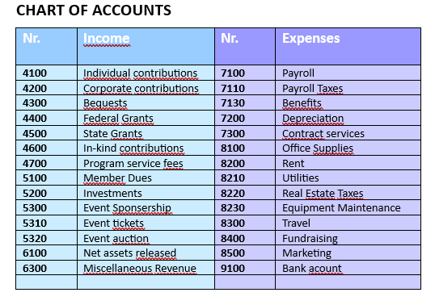
Chart Of Accounts
Should show the correlation between
bookkeeping and budget.

Slide 16
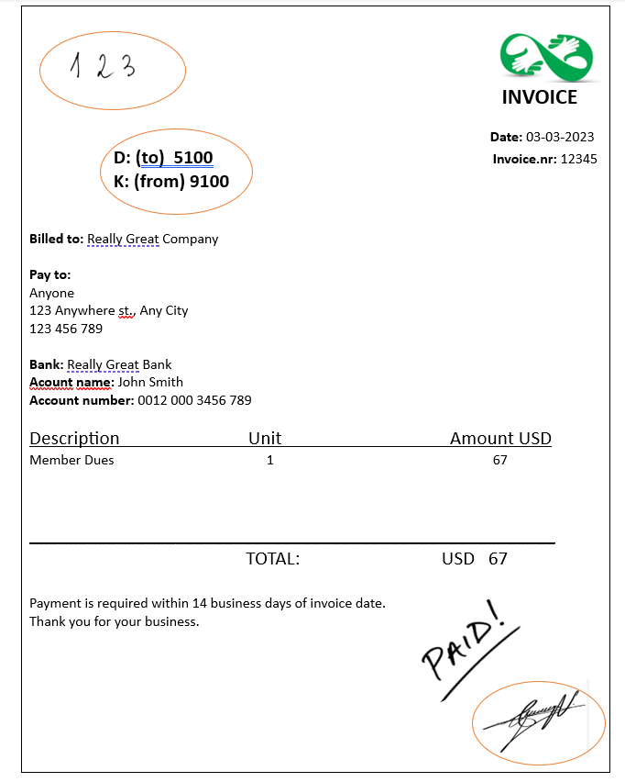

FINANCIAL VOUCHERS AND SUPPLEMENTARY DOCUMENTS
Should be
1) approved according to procedures.
2) Connected to the relevant account/budget line.
3) Physical/digital numbering

Slide 17
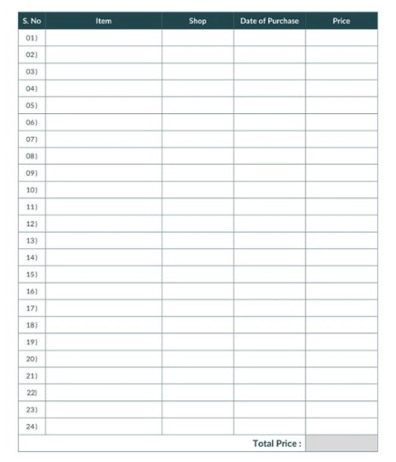
Inventory List
List of number and value of all assets – only a requirement if the CISU project covers inventory

Slide 18
reconcialiations
Bank: reconciliations are done monthly and must be checked and approved by someone else than the person who did the reconciliation.
Cashbox: reconciliations are done monthly and checked and approved by someone else than the person who did the reconciliation. The cashbox is locked and managed by another person than the bookkeeper.
Checkbook: reconciliations are done monthly, and checks must be kept in a locked place and must not be signed in advance.

Slide 19
Financial reports
Minimum three times a year
NB: There should always be two persons involved – one who prepares and one who approves.

Slide 20

WRAP-UP
QUESTIONS? TAKE AWAYS? COMMENTS?

